Slide 1
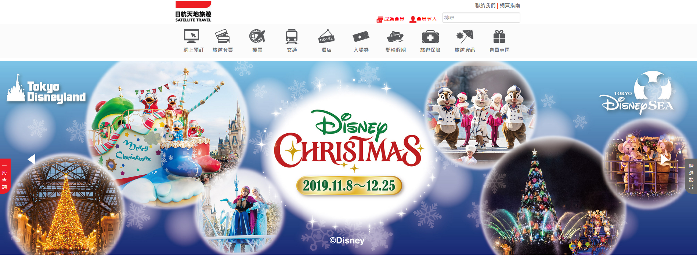
JAL Satellite Travel
TVP Program for Website Revamp

Slide 2
AGENDA
Technology Voucher Programme (TVP)
Introduction
Funding Amount
Eligibility
Funding Scope
Procurement Procedures and Project Duration
Assessment Criteria
Website Revamp Suggestion
Google Ranking, Language
Content
Design
Function
What We Can Offer

Slide 3
Introduction
TVP was launched in November 2016
The TVP aims to subsidise local entities on the use of technological services and solutions to improve productivity, or upgrade or transform their business processes, in order to enhance their long-term competitiveness
TVP website
https://www.itf.gov.hk/l-eng/TVP.asp

Slide 4
Funding Amount
Funding up to HK$400,000 for each eligible entity will be provided on a 2:1 matching basis.
E.g. Website revamp project, around HK$120,000
2:1 = HK$80,000 (Government) & HK$40,000 (Company)
Applications received by the ITC from 1 December 2019. Under the new arrangements, the ITC will disburse an initial payment of up to 25% of the approved funding amount in advance.
Subject to the cumulative funding ceiling of $400,000, up to four projects from an applicant may be approved

Slide 5
Eligibility
(a)(i). Registered in Hong Kong under the Business Registration Ordinance(Cap.310)(“BRO”);or
(a)(ii). Incorporated and registered in Hong Kong under the Companies Ordinance(Cap. 622); or

Slide 6
Eligibility
(a)(iii). Established in Hong Kong by relevant ordinances as statutory bodies; AND
(b). Not a listed company in Hong Kong, and not a government subvented organization or subsidiary of any government subvented organization; AND
(c). With substantive business operation in Hong Kong which is related to the project under application at the time of application. An entity holding a “shell” business registration will not be regarded as having substantive business operation in Hong Kong.

Slide 7
Funding Scope
Technology Consultancy
Purchase, rental or subscription of customized equipment/hardware, software and technological services or solutions that form an essential part of the project.
Purchase, rental or subscription of off-the-shelf/readily available equipment/hardware, software and technological services or solutions that form an essential part of the project.
Project auditing

Slide 8
Procurement Procedures
Not exceed HK$50,000 - at least 2 suppliers or service providers
Exceeds HK$50,000 but does not exceed HK$300,000 - at least 3 suppliers or service providers
Exceeds HK$300,000 but does not exceed HK$1,400,000 - at least 5 suppliers or service providers
More than HK$1,400,000 - publicise the tender notices

Slide 9
Project Duration
Each project should normally be completed within 12 months.
An entity is not allowed to undertake more than one TVP project at the same time.
It takes around 3 – 6 months for project approval

Slide 10
Assessment Criteria
Relevance of the proposed project to the applicant’s business
Reasonableness of the budget
Reasonableness of the implementation details
List of Typical Technological Services and/or Solutions covered by TVP
Productivity / Business Process:
Appointment scheduling and queue management system, Augmented reality (AR) technologies system, Big data and cloud-based analytics solution, Clinic management system, Cyber security solution, CRM system, POS system
Testing and Certification
Environmental Protection

Slide 11
Google Ranking, Language
Keywords | Rank
香港旅行社 | Page 8, No. 8
Hong Kong travel agency | Not On List
日本旅行 香港 | Page 4, No. 4
Hong Kong japan travel | Page 7, No. 10
香港旅行社 日本 | Page 2, No. 8
Hong Kong travel agency Japan | Page 2, No. 5
日本 旅遊套票 | Page 1, No. 6
Japan travel package | Page 6, No. 8
日本 機票 | Page 6, No. 10
Japan flight ticket | Not On List
Japan flights | Not On List
JR 火車證 | Page 1, No. 4
JR 鐵路周遊券 | Page 5, No. 7
JR pass Hong Kong | Page 2, No. 3
東京迪士尼門票 | Page 6, No. 6
Tokyo Disneyland ticket | Not On List
Tokyo ONE PIECE Tower 入場券 | Page 2, No. 5 (pdf file)
Royal Caribbean International 皇家加勒比國際遊輪 | Not On List
日本旅遊保險 | Page 5, No. 2
Japan travel insurance | Page 10, No. 9
代辦日本簽證 | Page 1, No. 1
Implementation of Japan Temporary Visa | Not On List
Japan visa application | Not On List
東京機場巴士 | Not On List
Only Traditional Chinese
Not enough content for SEO (search engine optimization)
Google Analytics
Solution: Big data and cloud-based analytics solution

Slide 12
Content
Titles and snippets in Search Results
Create good titles and snippets in Search Results
https://support.google.com/webmasters/answer/35624?hl=en

Slide 13
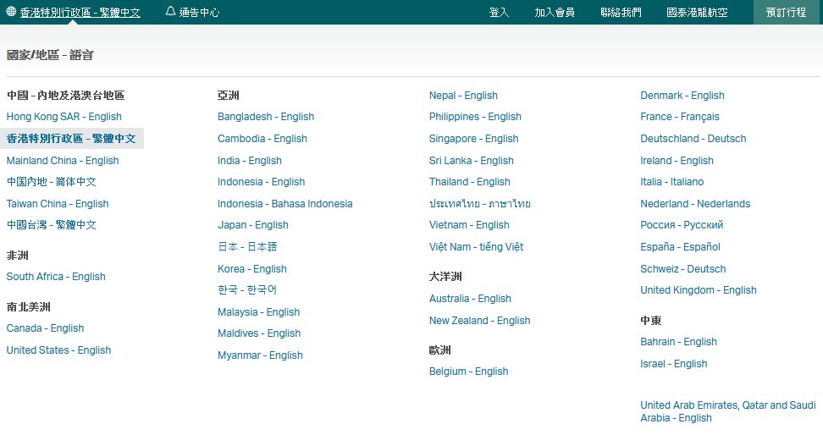
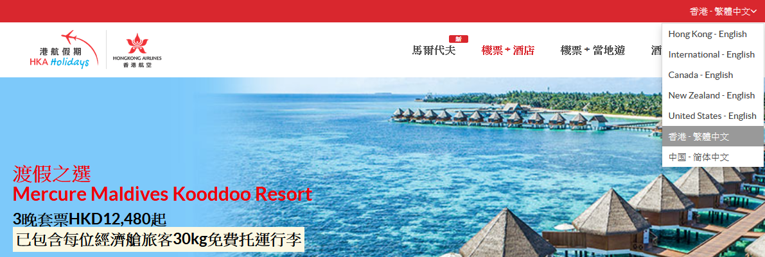
Content
Language

Slide 14
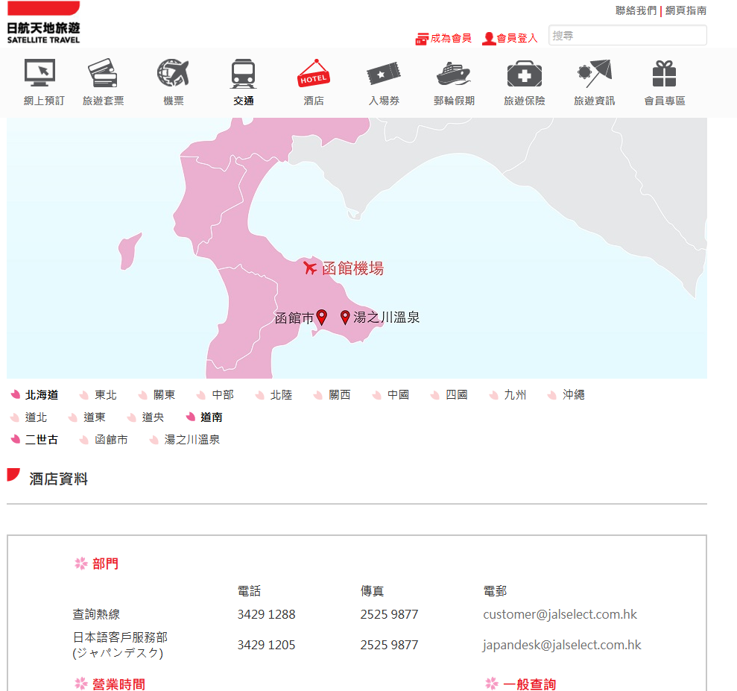
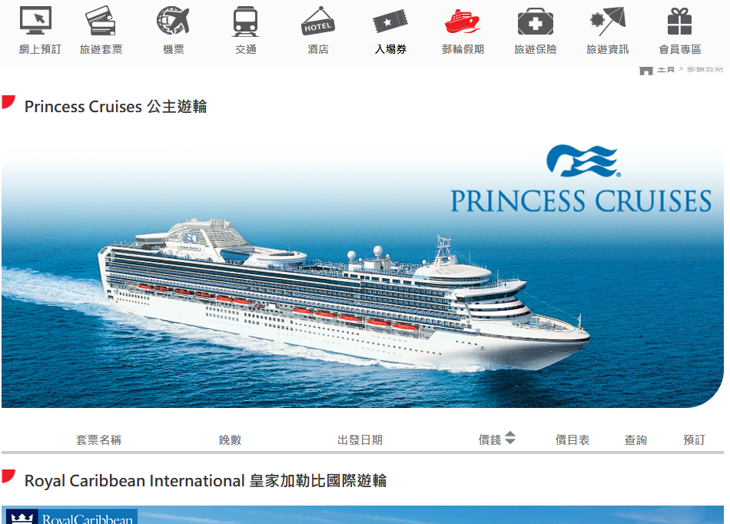
Content
Empty categories or information

Slide 15
Content
Video

Slide 16
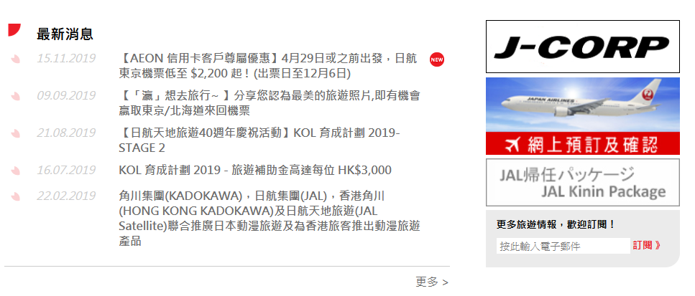
Design
Button arrangement

Slide 17
Design
Slidebox display

Slide 18
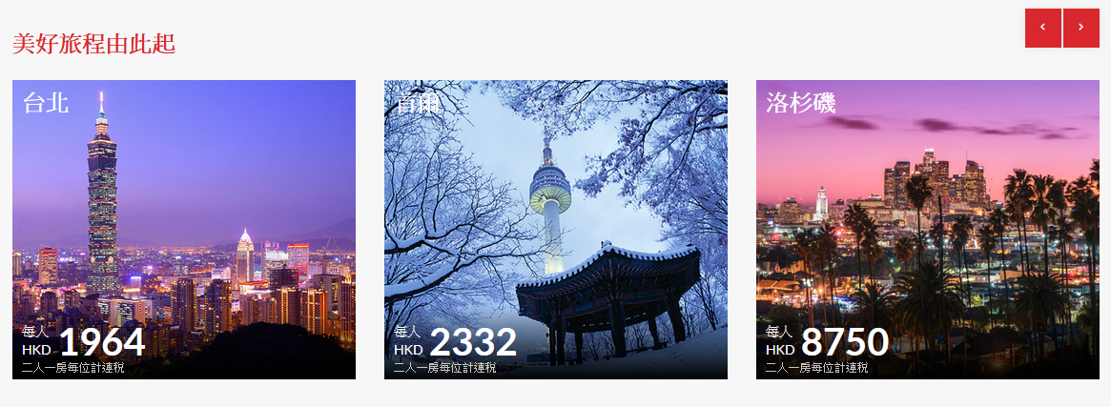
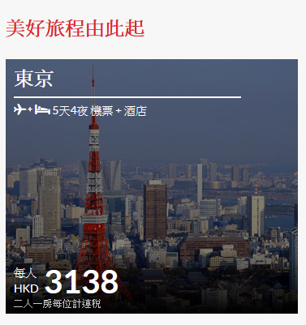
Design
Box display
Redirect to PDF file

Slide 19
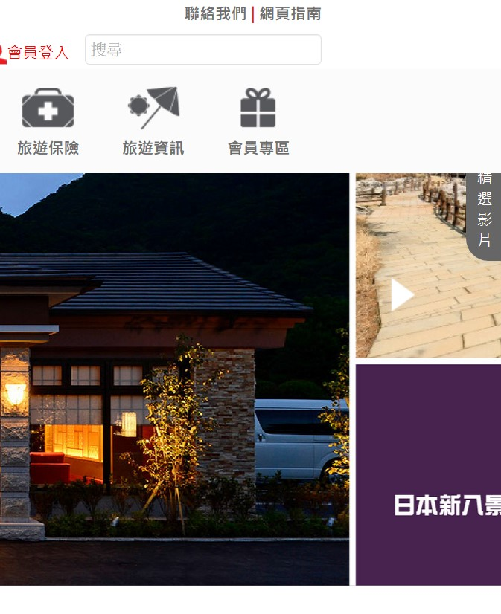
Design
Responsive website

Slide 20
Function
Social Media
Solution: Customer relationship management

Slide 21
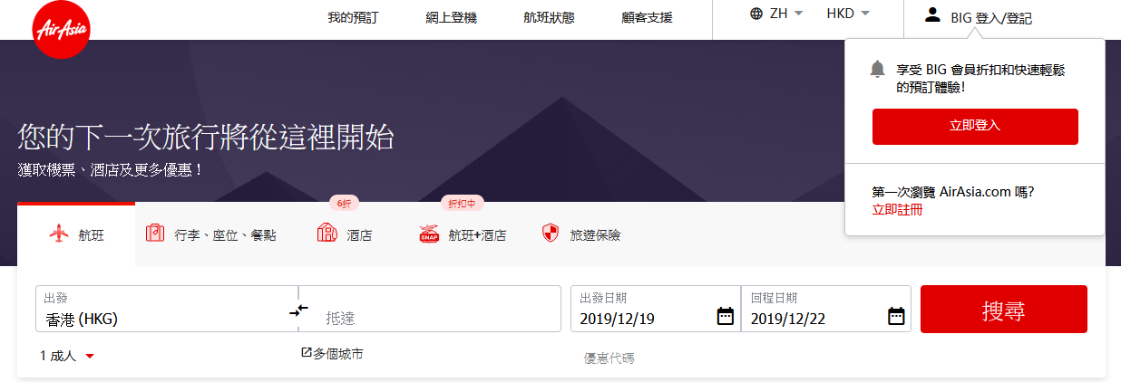
Function
Currency

Slide 22
What We Can Offer
Project Management
TVP Application
Video Production
Shooting
Post Production: editing, subtitling, motion graphic, sound recording and mixing, color grading
Digital Marketing
Graphic Design

