Slide 1
IT Solutions
29 April 2020
Zoom Meeting

Slide 2
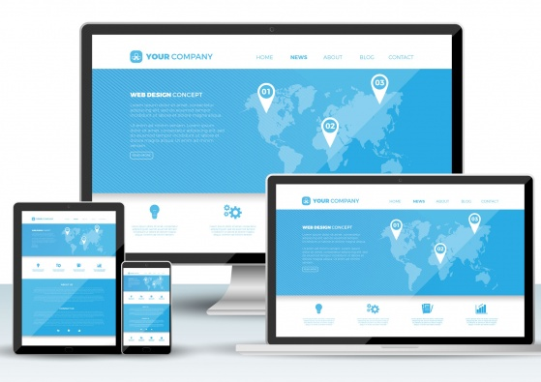
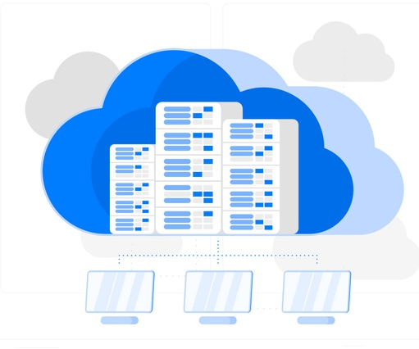
Website / Mobile Apps
Social Media
SEO / SEM
ERP (Enterprise resource planning)
Server / Cloud Storage
Cybersecurity

Slide 3
IT Consulting Services

Slide 4
IT Project Management
Identification
Identify and documentation client requirement
Evaluate client existing system
Planning
Define project scope
Develop schedule
Execution
Coordinate work with vendor
Generate report for client
Request for quotation
Closing
Training section
Final report

Slide 5
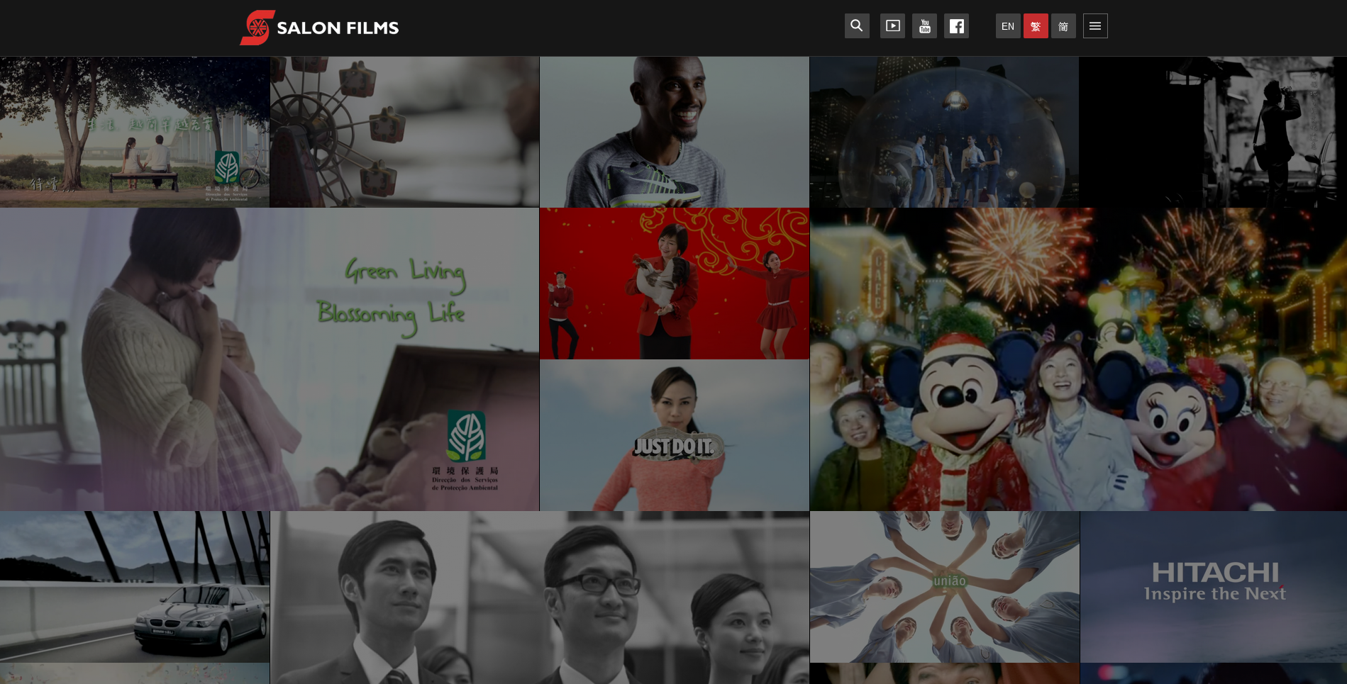
Website Revamp Project
Identify client requirement
Salon Films website – Our work
https://www.salonmedia.com/tc/project/commercials
Random display for video showcase
Identification

Slide 6
Website Revamp Project
Project Planning – Budget, Scope
Request for quotation
TVP application
Vendor / Item
Total Amount | $84,500 | $96,000 | $120,900
Language (Eng, TC, SC, Jp) | $15,000 | / | $12,000
Backend (CMS) | $10,000 | / | $40,000
Web content pages | $25,000 (8 basic pages) | / | $15,000 (11 basic pages)
Responsive Website | $15,000 | / | $7,500
Hosting | $3,500 / yearly | / | $26,400 / yearly
Planning

Slide 7
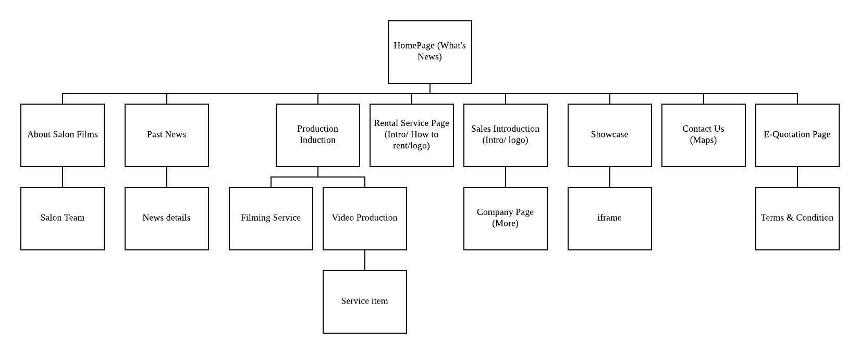
Website Revamp Project
Coordinate work with vendor
Sitemap, Data, Design(Color theme)
Execution

Slide 8
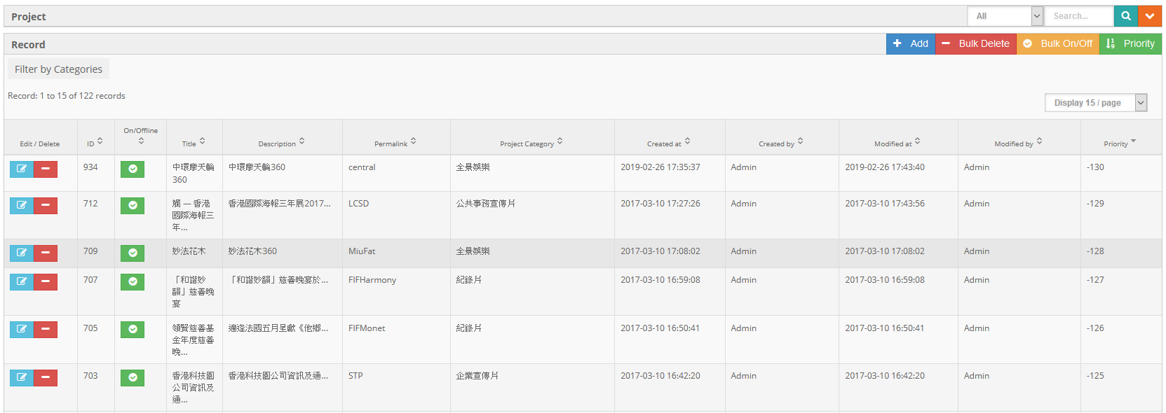
Website Revamp Project
Training – CMS, Google Analytics
Closing

Slide 9
Social Media Planning for JAL Satellite Travel

Slide 10
Target
Target new customers that haven’t been to JAL Satellite Travel before.
Capture attention quickly and drive to company website.
Lead to sales

Slide 11
Review on social media platform of JAL Satellite Travel

Slide 12
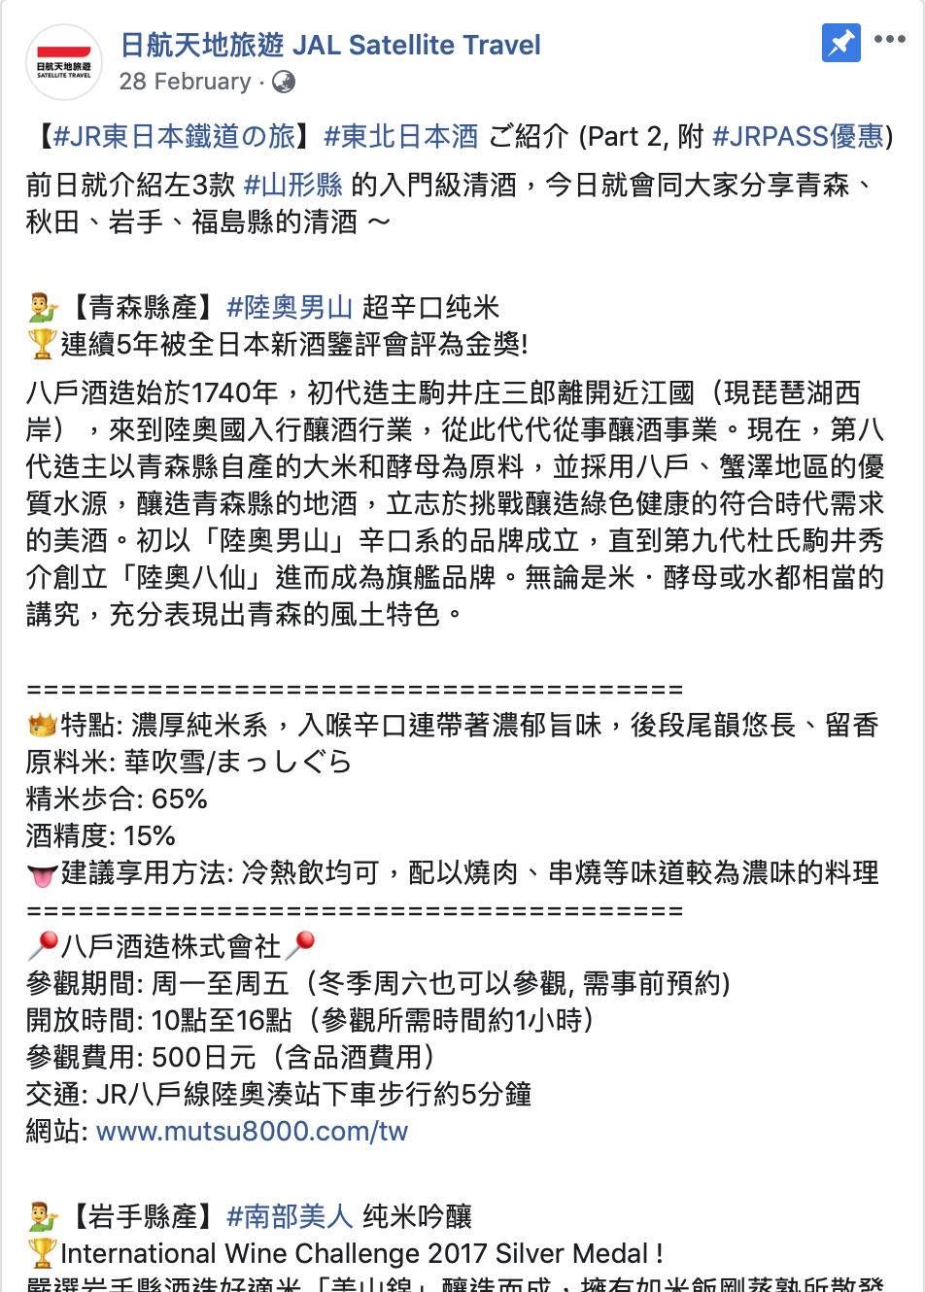
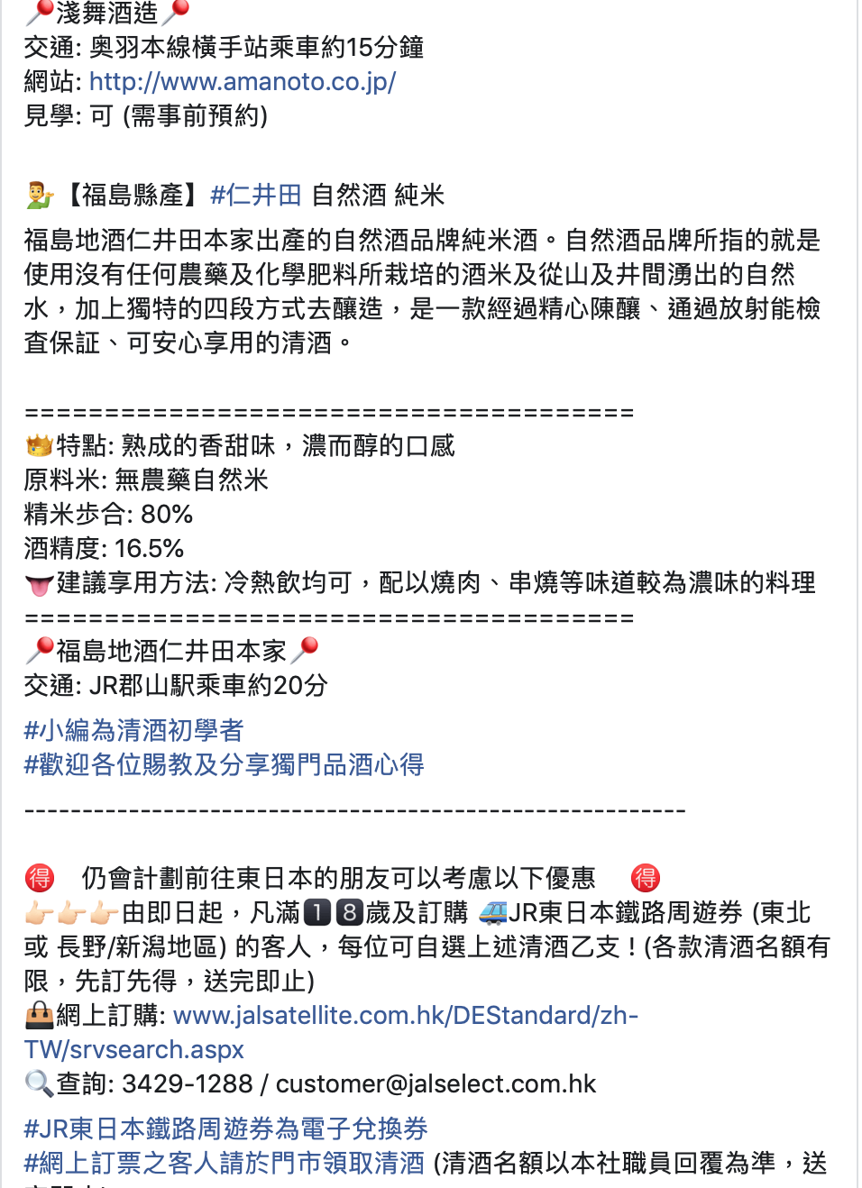
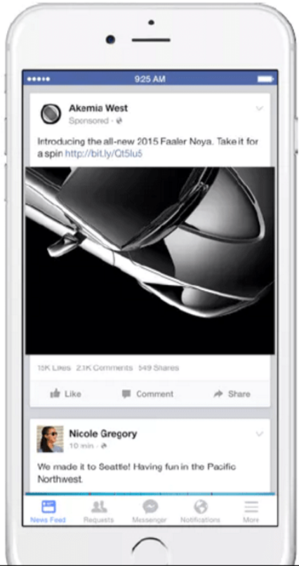
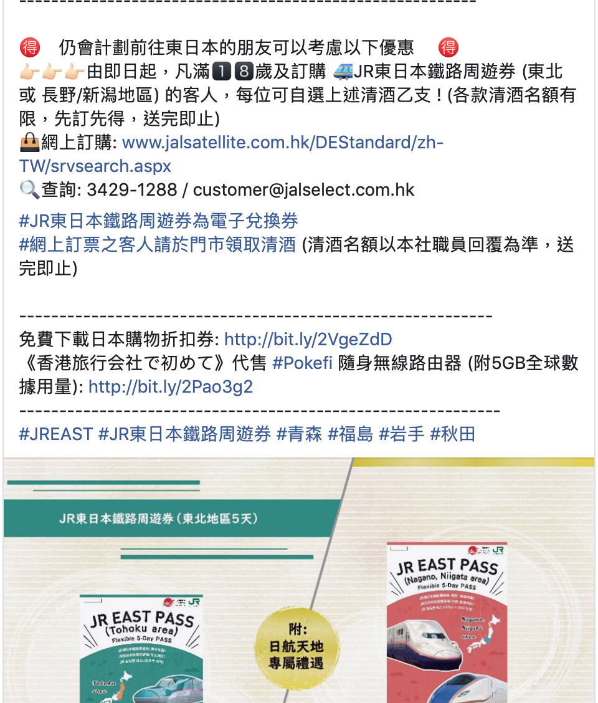
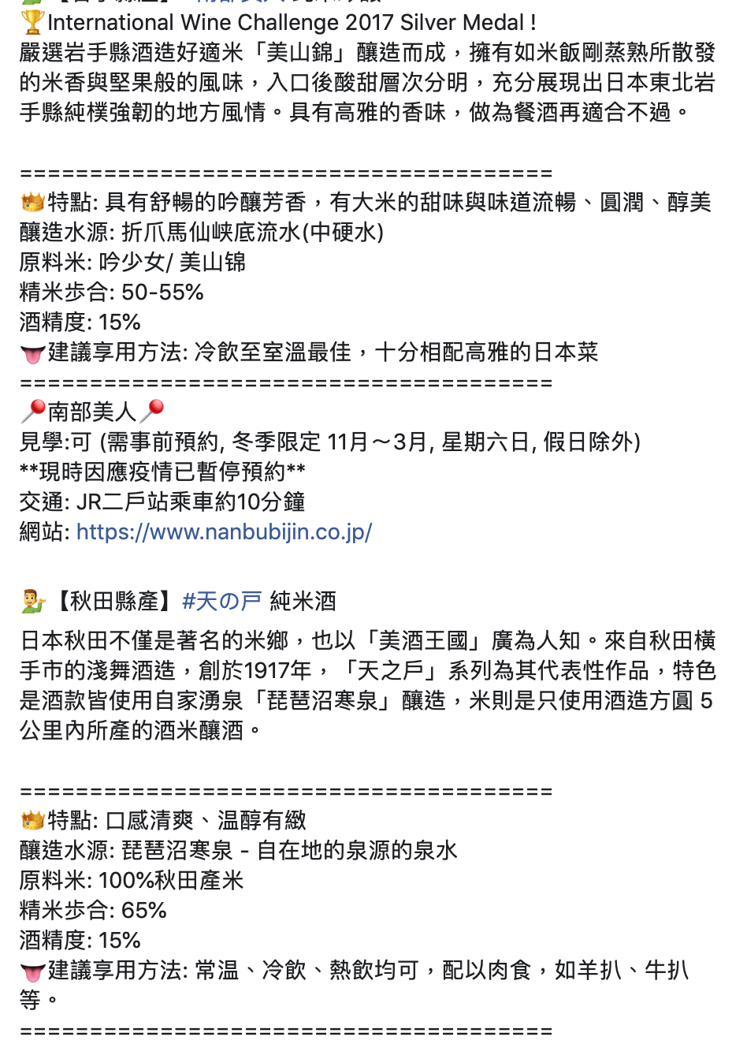
Content consists too much wordings. People unwilling to see too much words in social media.

Slide 13
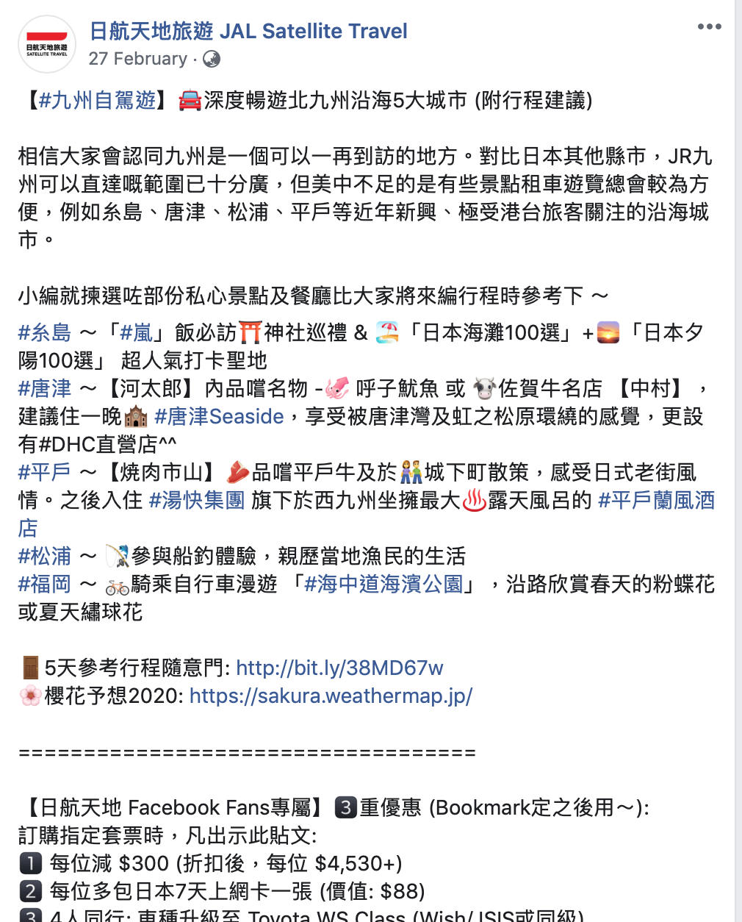
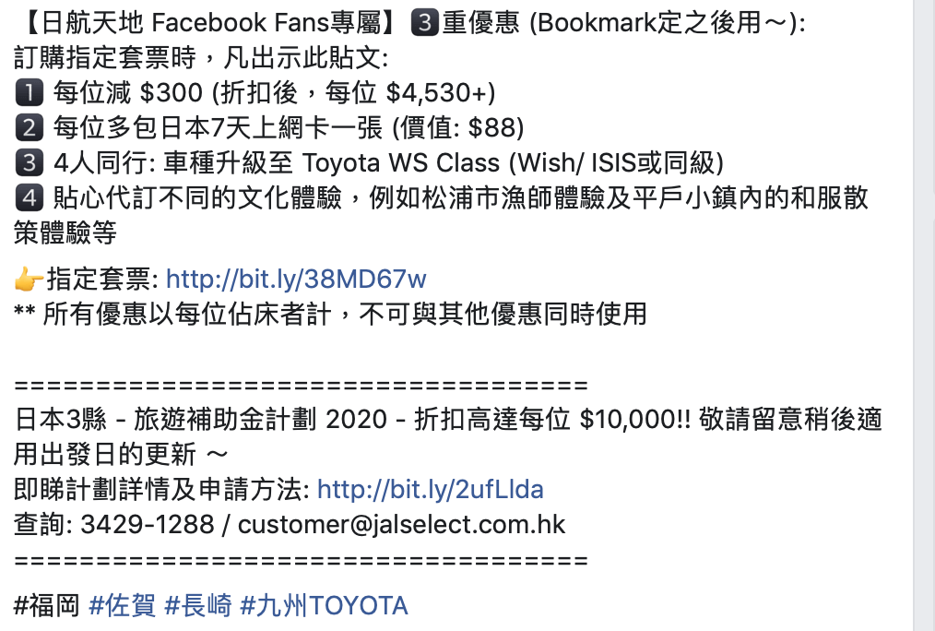
Linkage to PDF file, not call for action.

Slide 14
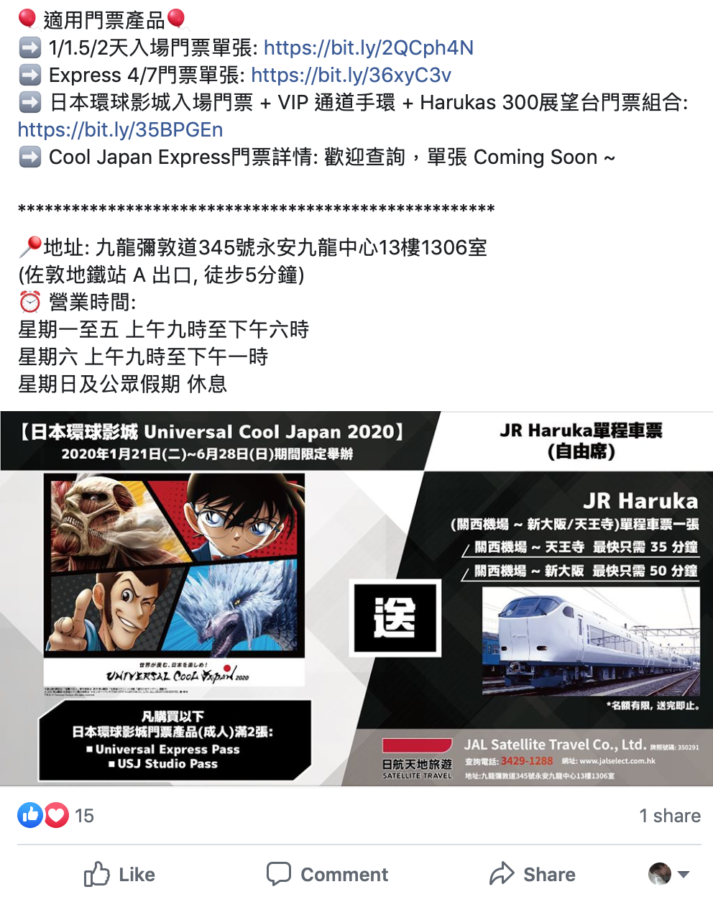
Photo is not attractive. Or too much text in the photos.

Slide 15
Too much text in the photos. Not easy to see the details from photos.

Slide 16
Limited Hashtag usage.

Slide 17
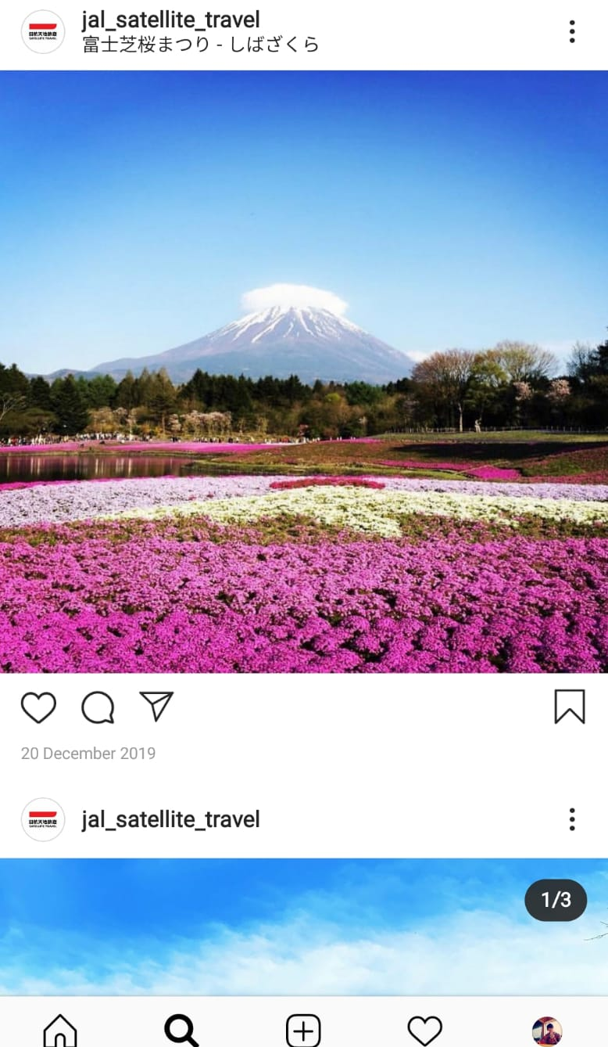
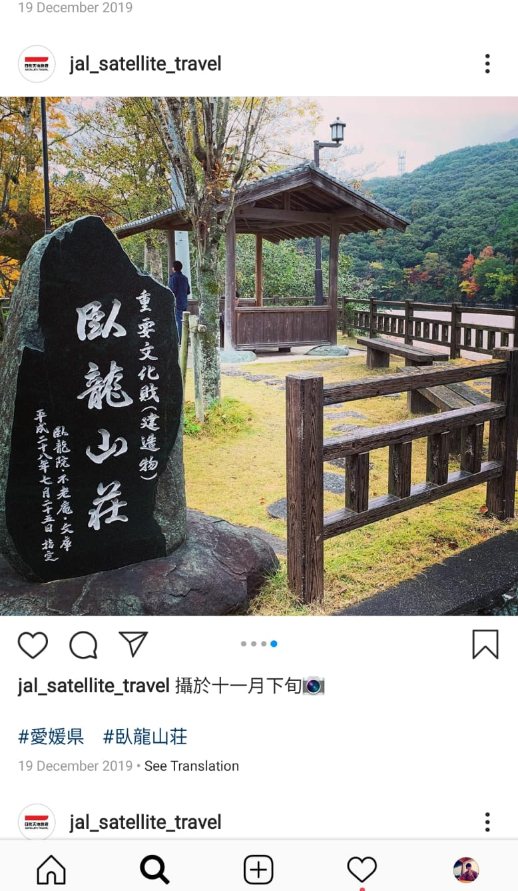
No more details about the photos. Hashtag not clearly shown.

Slide 18
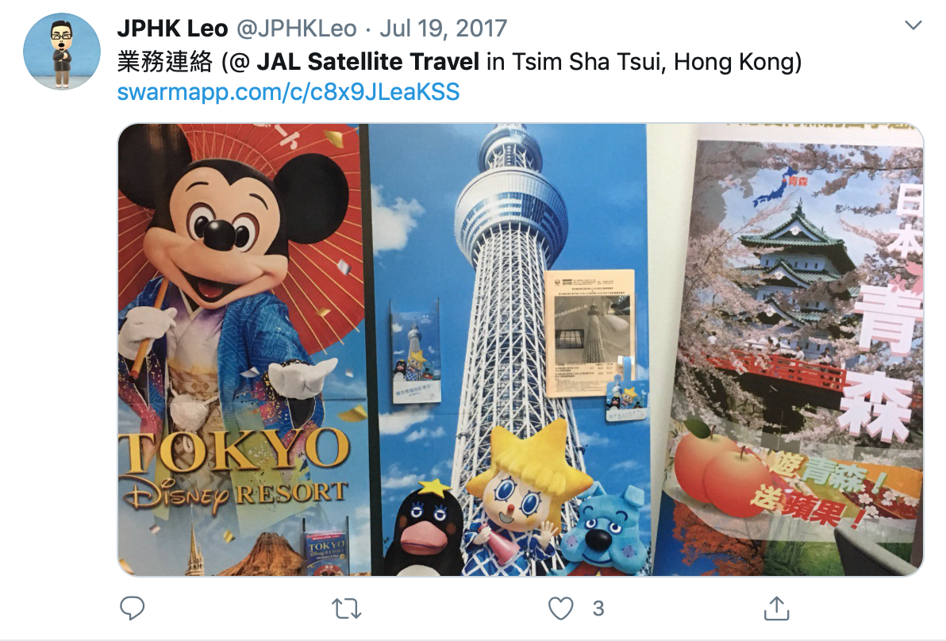
Not easy to find JAL Satellite Travel at Twitter.

Slide 19
Suggestions

Slide 20
Promotional video can be inserted in cover photo area.

Slide 21
Attractive photos with related caption.

Slide 22
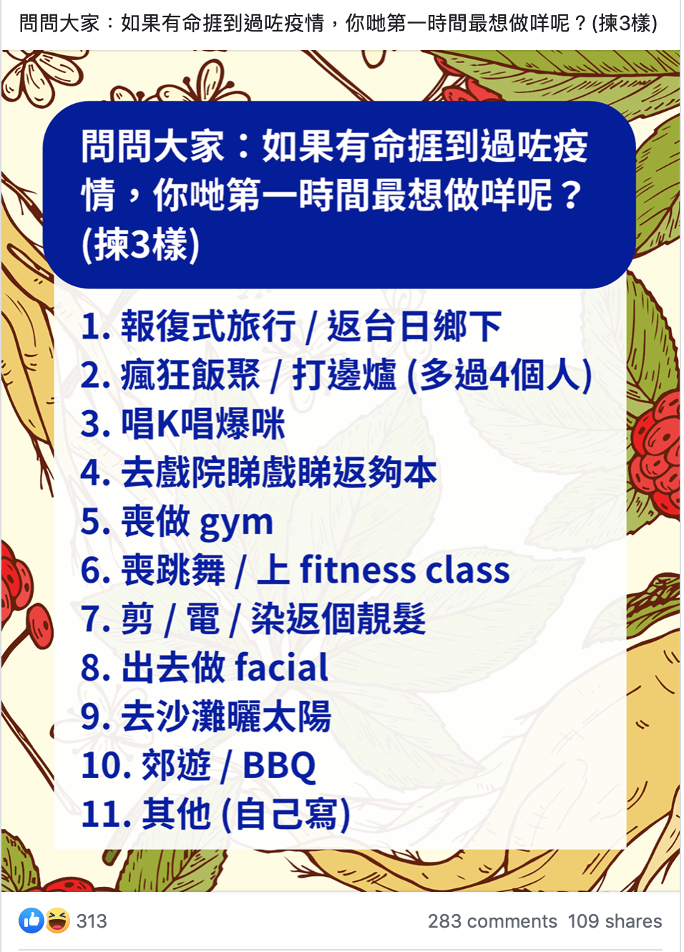
Some Travel tips can be post. Aim to raise awareness.

Slide 23
Market news for fans.

Slide 24
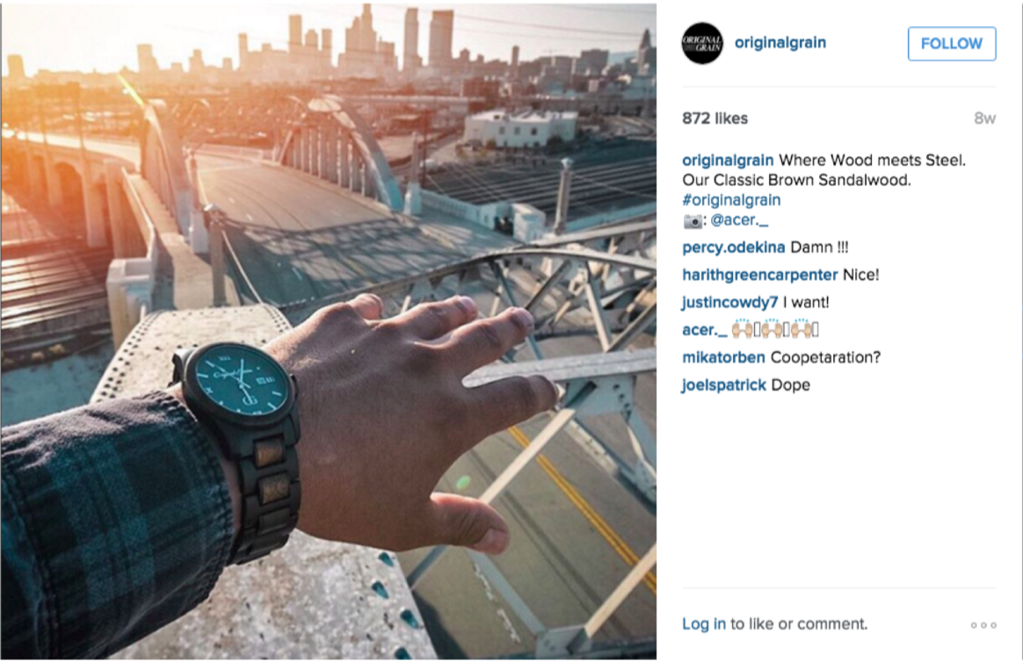
Visual Storytelling on Instagram
Photo now support landscape
Video now supports landscape and up to ：30
Carousel include of first frame

Slide 25
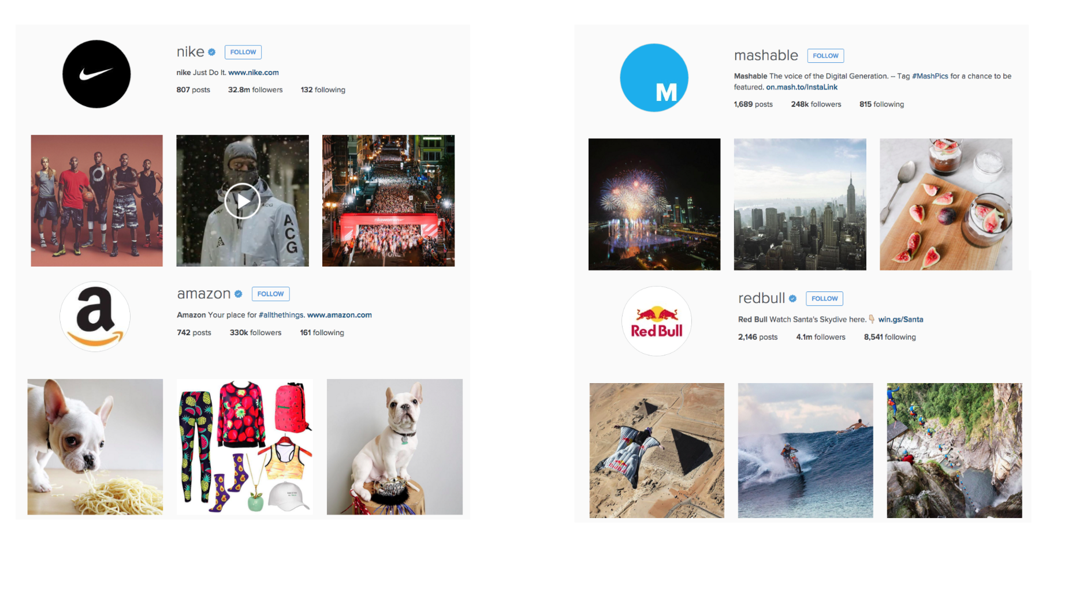
Post Consistently & Strategy

Slide 26
Use Hashtags Wisely

Slide 27
Interact

Slide 28
Use Video Wisely

Slide 29
Call to action

Slide 31
Our service

Slide 32
Social Media Management service
Social Media Management
Management Fee: $22,000/ month
Creative, graphic design, editorial write-up (video production not included)
3-4 newsfeed weekly in Facebook, IG
1-2 newsfeed weekly in Twitter
Interact with commenters and/ or message
Online Ad placement “(mobile version)
Quarterly report
Key Performance Indicator:
Increase followers every month
Increase response rate/ interactive for every post
Lead to sales

Slide 33
Video Production Service for Social Media
Video production Fee (Optional):
Creative, video shooting and editing, posting on social media
Production cost: $50,000-100,000
Key Performance Indicator:
Video views, cost per video view
Link click, cost per link click

Slide 34
Media Buy Service
Media Fee, Sponsor Ad (Optional):
Select suitable format and platform
Media cost: $8,000/month
Key Performance Indicator:
Increase response rate/ interactive for every post
Lead to sales

Slide 35
Annually SKD
Jun
Jul
Aug
Sep
Oct
Nov
Dec
Jan
Feb
Mar
Apr
May
Admin
Initial consulting
Quarter
review
Quarter
review
Quarter
review
Annual
review
Business travel
Winter Vacation
Long term marketing
Chinese new year
Spring holiday
Easter holiday
Dragon Boat Festival
New year
Easter
Anniversary of founding
Chinese
New year
Event
HKG SAR
Memorial Ceremony
Christmas
Sakura

Slide 36
Monthly SKD
Privies month
Current month
Following month
Strategy meeting
Strategy meeting
Strategy meeting
*Privies month report
*Following month contents meeting
*Following month contents check
Contents Final adjust
Contents Preparation
Contents Final adjust
Post
Post
Post
Post
Post
Facebook
Post
Post
Twitter

Slide 37
Summary of Budget Plan
Item | Details | Fee
IT Consultation | Working meeting, Monitoring and consultation | 10% per each IT project <$2,000/month (min. charge)>
Social Media Management | Set-Up, Write-Up, Basic graphic, regular review | $22,000/ month
Video production Fee (Optional) | Creative, Shooting, Post-production | $50,000-100,000/ video with 2 cutdowns
Media Fee, Sponsor Ad (Optional) | Management, Ad booking and review | $8,000/month

Slide 38
Government Funding
Pilot Information Technology Development Matching Fund Scheme for Travel Agents
http://www.tichk.org/public/website/en/industry_subsidy_scheme/IT_matching_fund/IT_matching_fund/html
Technology Voucher Programme (TVP)
https://www.itf.gov.hk/l-eng/TVP.asp
Distance Business Programme (“D-Biz Programme”)
https://www.hkpc.org/en/distance-business-programme
SME Export Marketing Fund (EMF)
https://www.smefund.tid.gov.hk/english/emf/emf_objective.html

Slide 39
Thank you!
Contact: 2338 0505
E-mail: production@salonmedia.com

