Slide 1
In Focus
Location

Slide 2
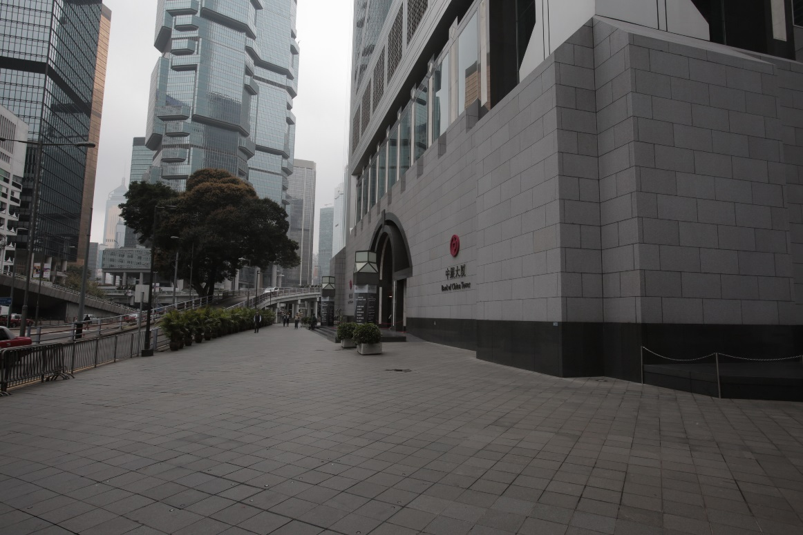
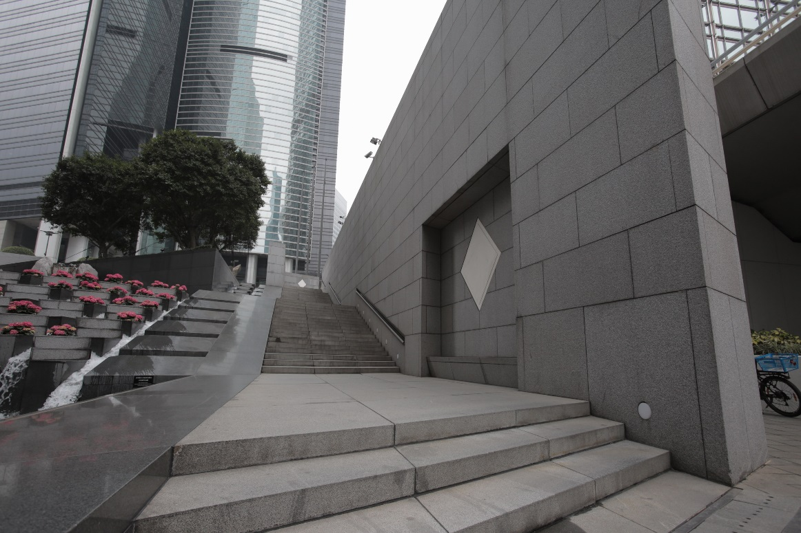
In Focus
Location:
Central, Hong Kong
Bank of China – New

Slide 3
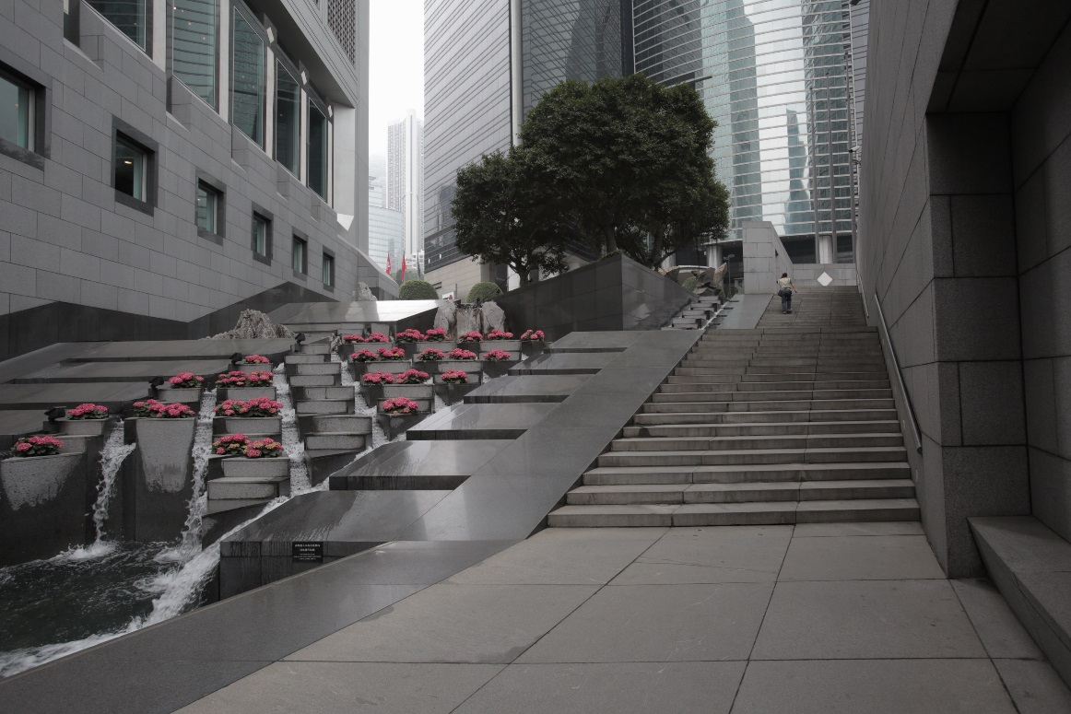
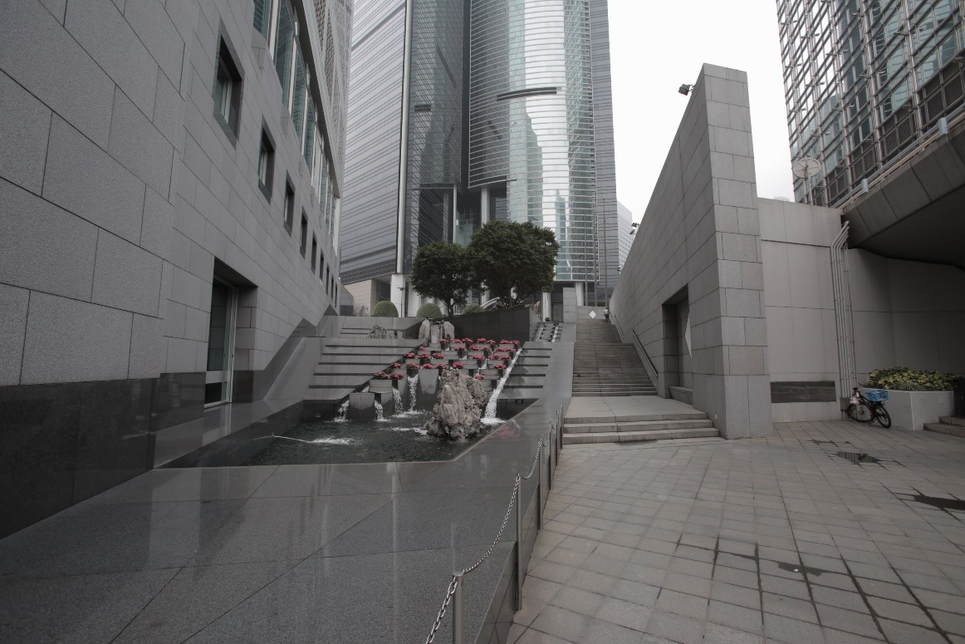
In Focus
Location:
Central, Hong Kong
Bank of China – New

Slide 4
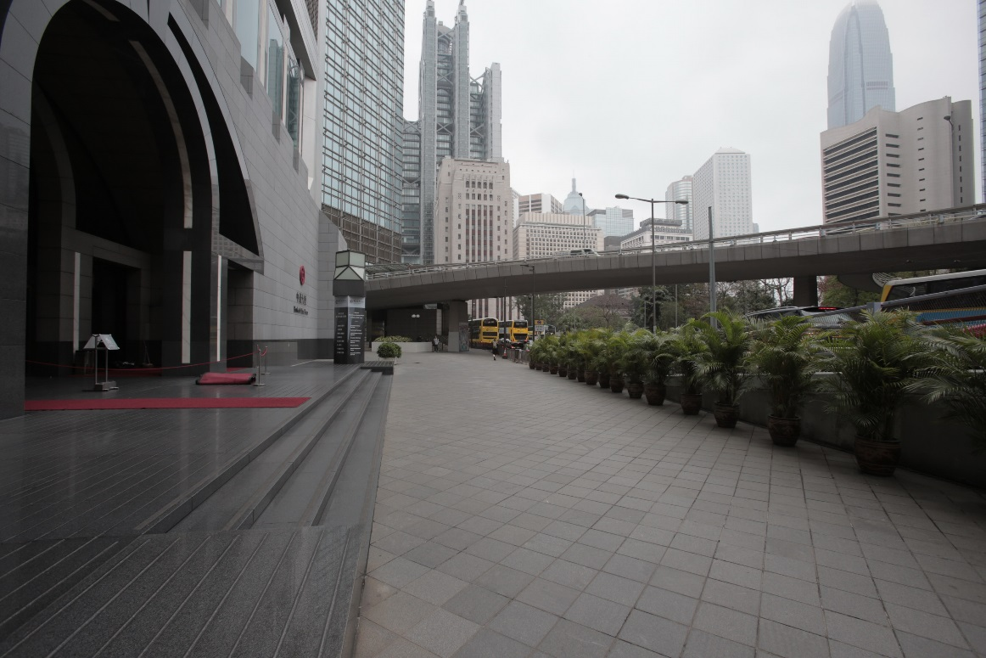
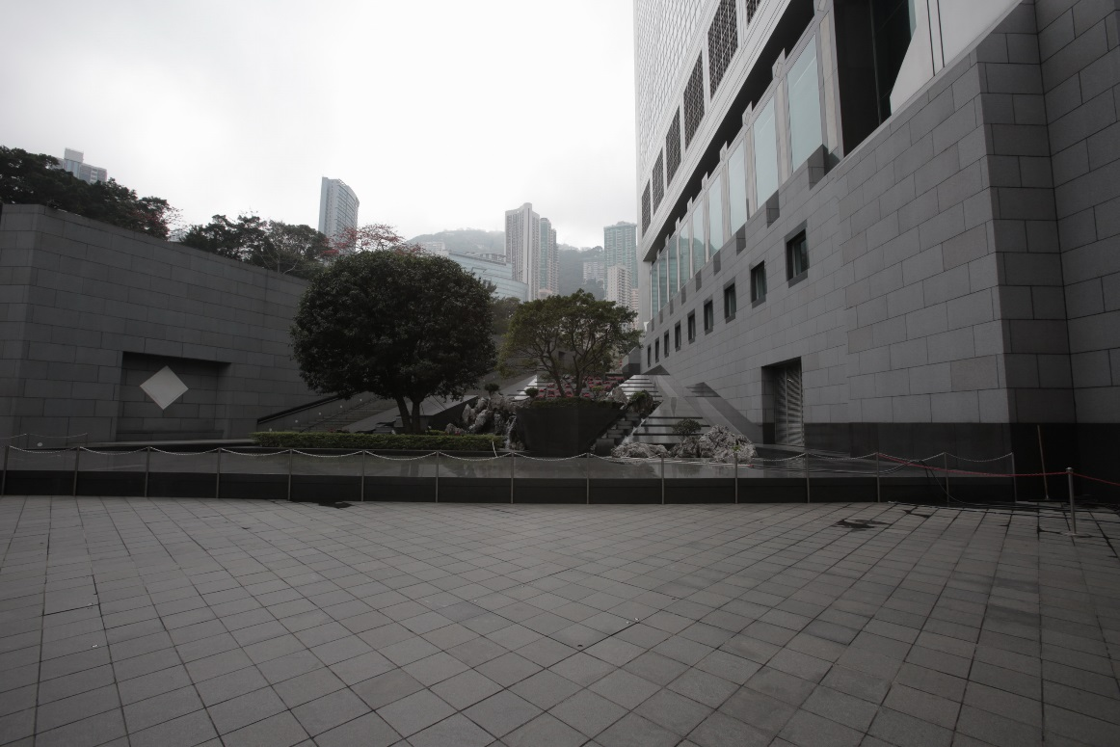
In Focus
Location:
Central, Hong Kong
Bank of China – New

Slide 5
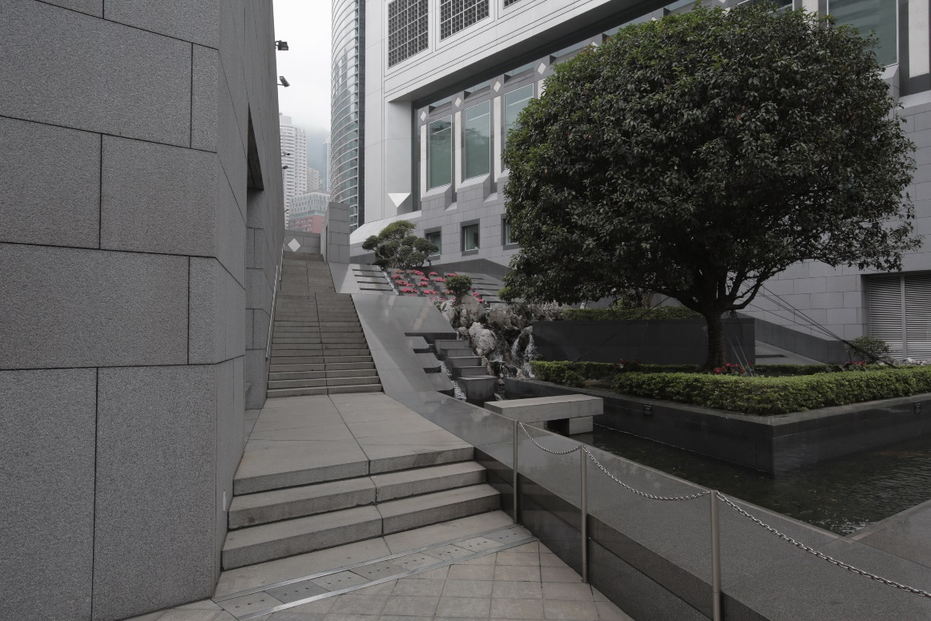
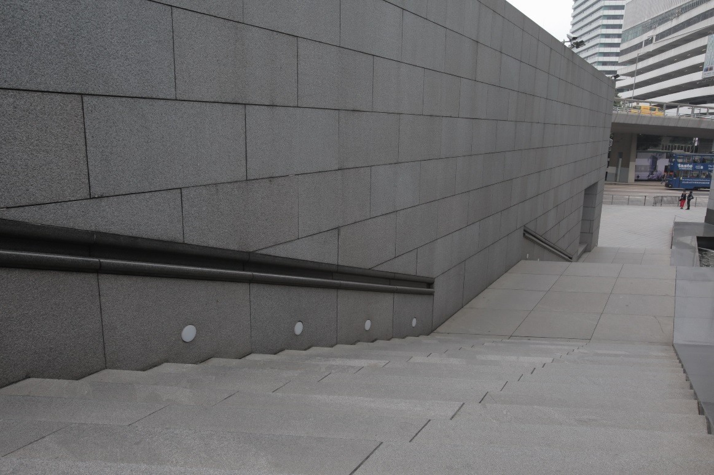
In Focus
Location:
Central, Hong Kong
Bank of China – New

Slide 6
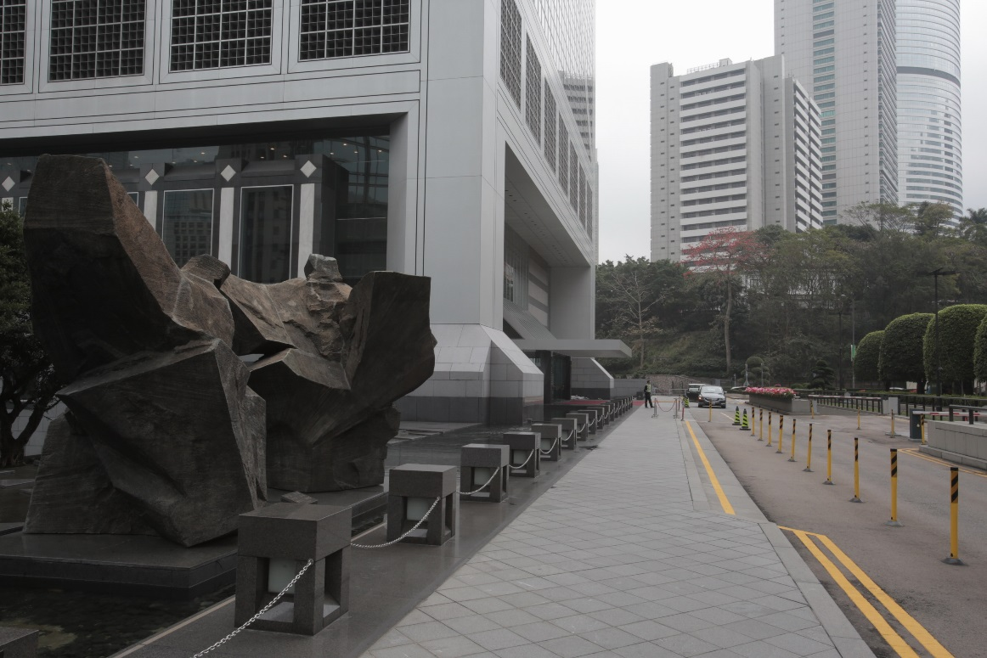
In Focus
Location:
Central, Hong Kong
Bank of China – New

Slide 7
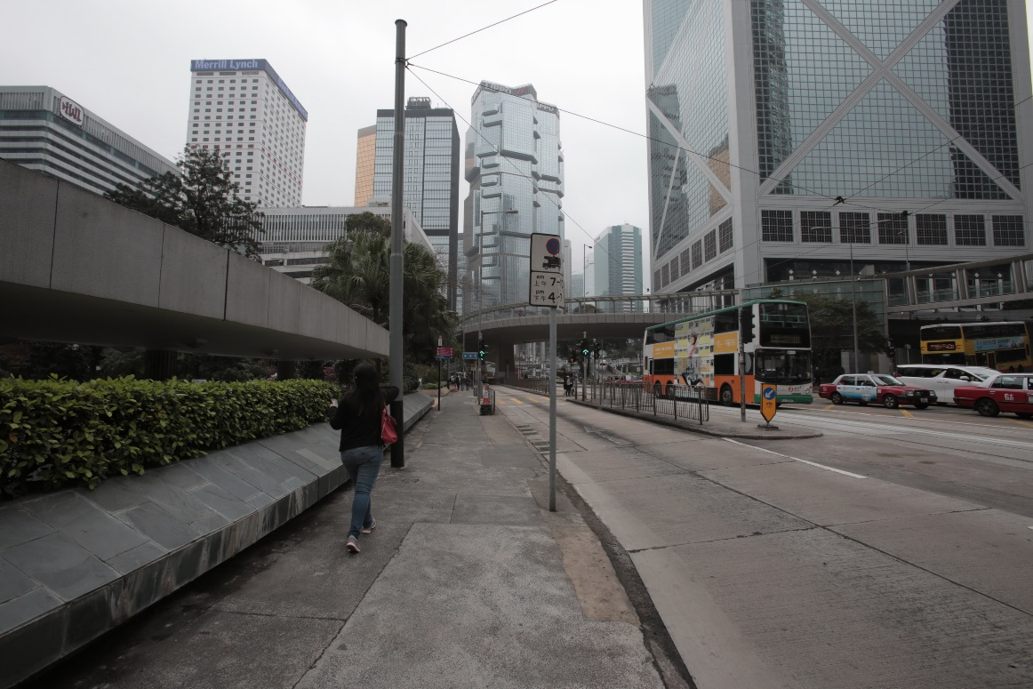
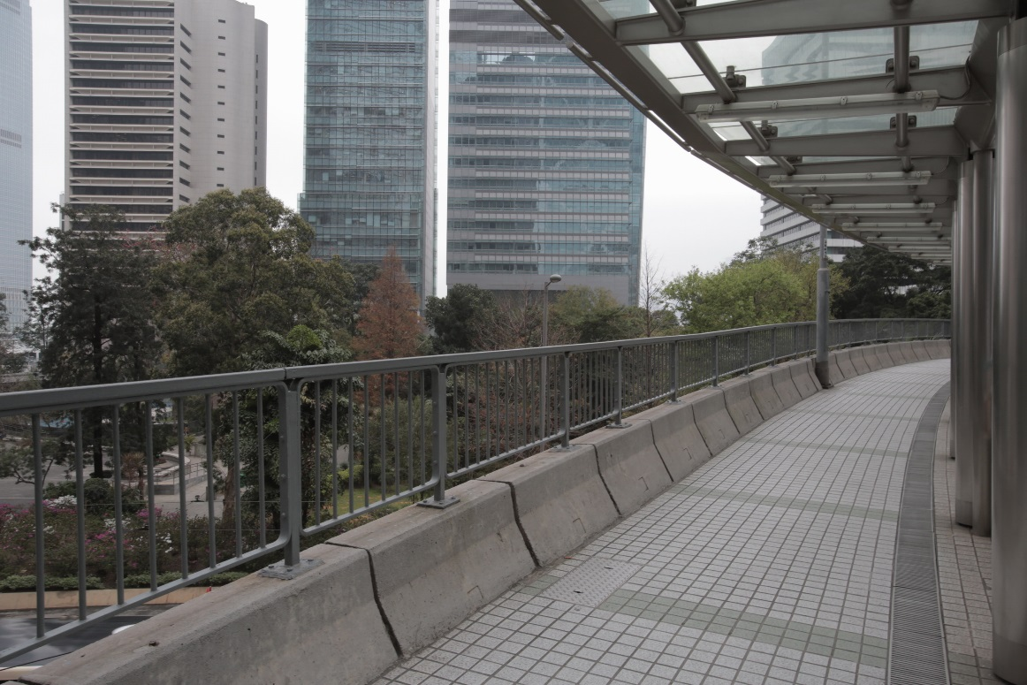
In Focus
Location:
Central, Hong Kong
Bank of China – New (city view)

Slide 8
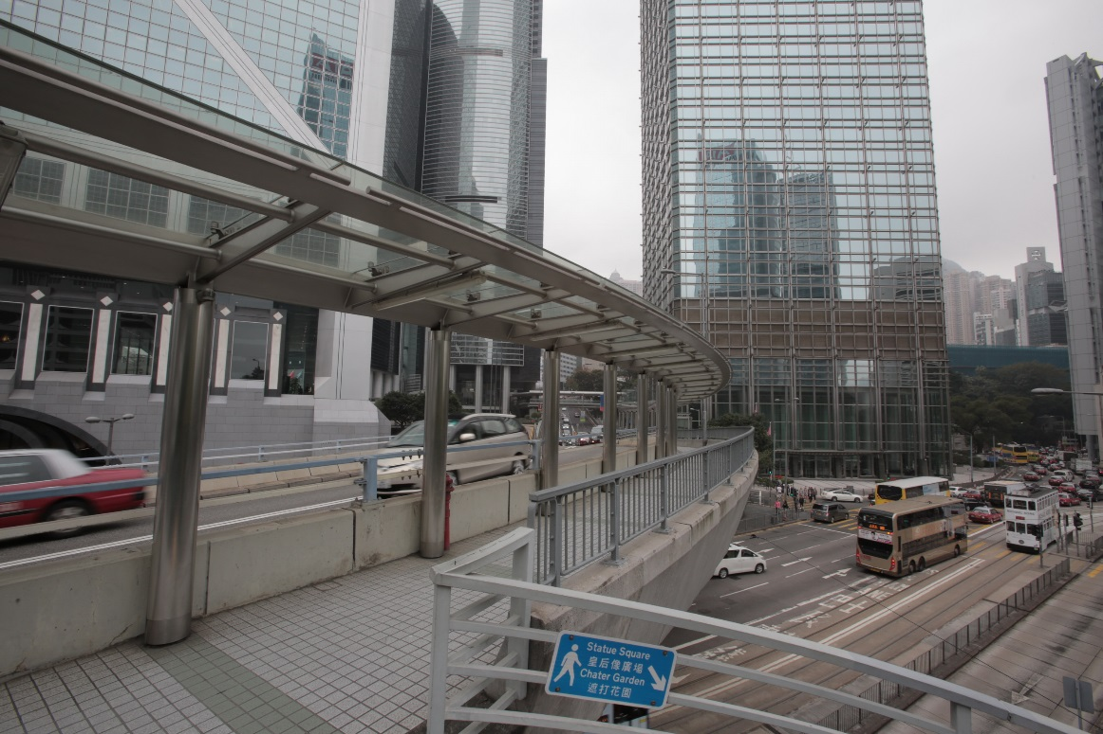
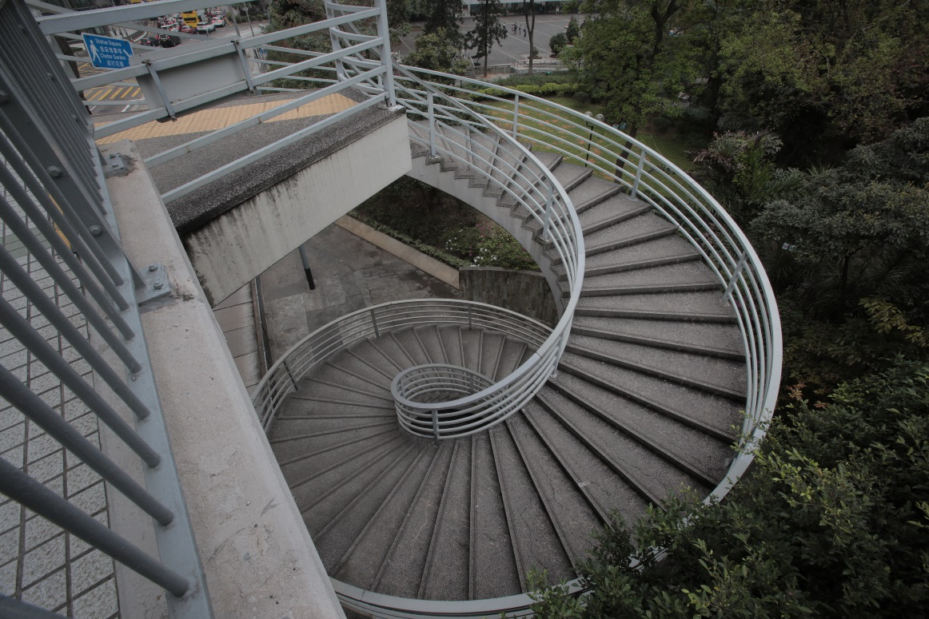
In Focus
Location:
Central, Hong Kong
Bank of China – New (city view)

