Slide 1


In Focus
Location

Slide 2
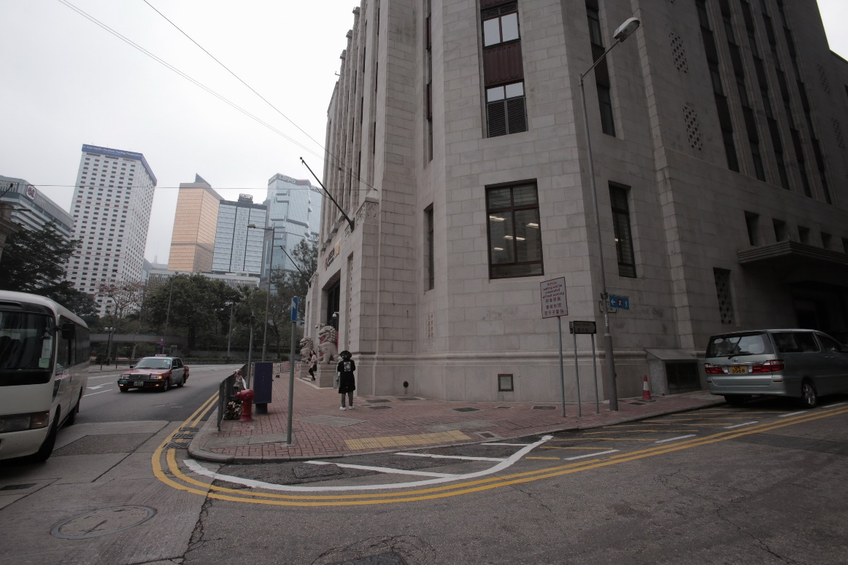
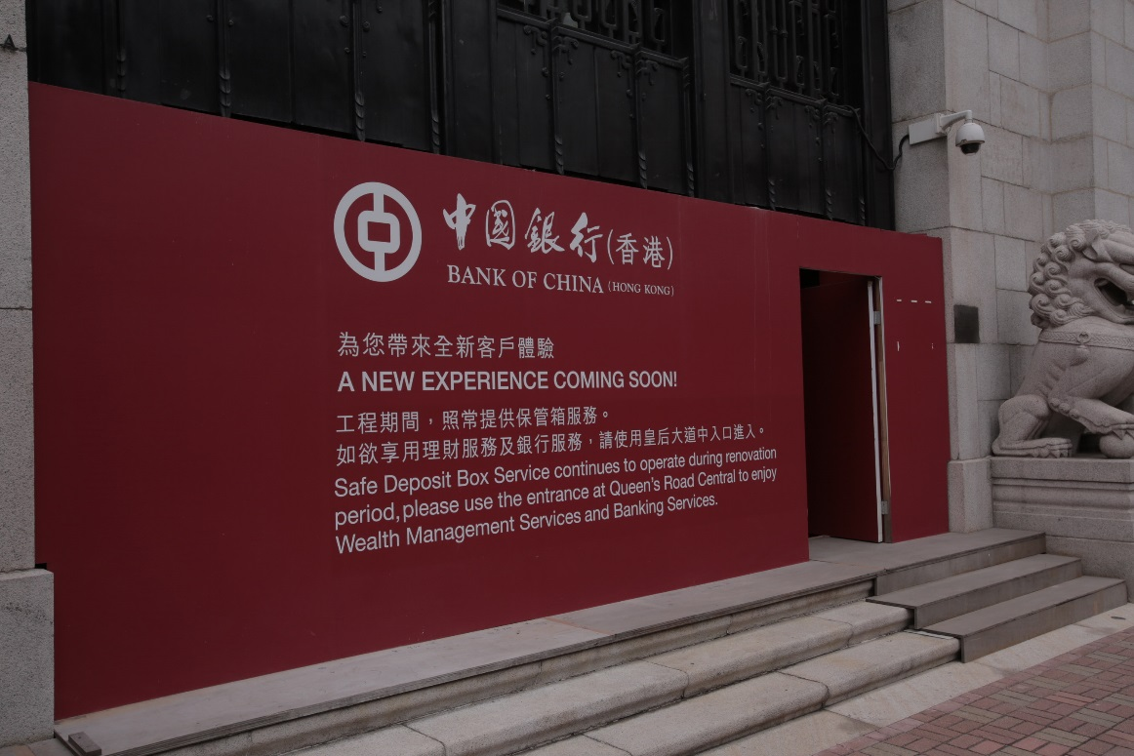
In Focus
Location:
Central, Hong Kong
Bank of China – Old

Slide 3
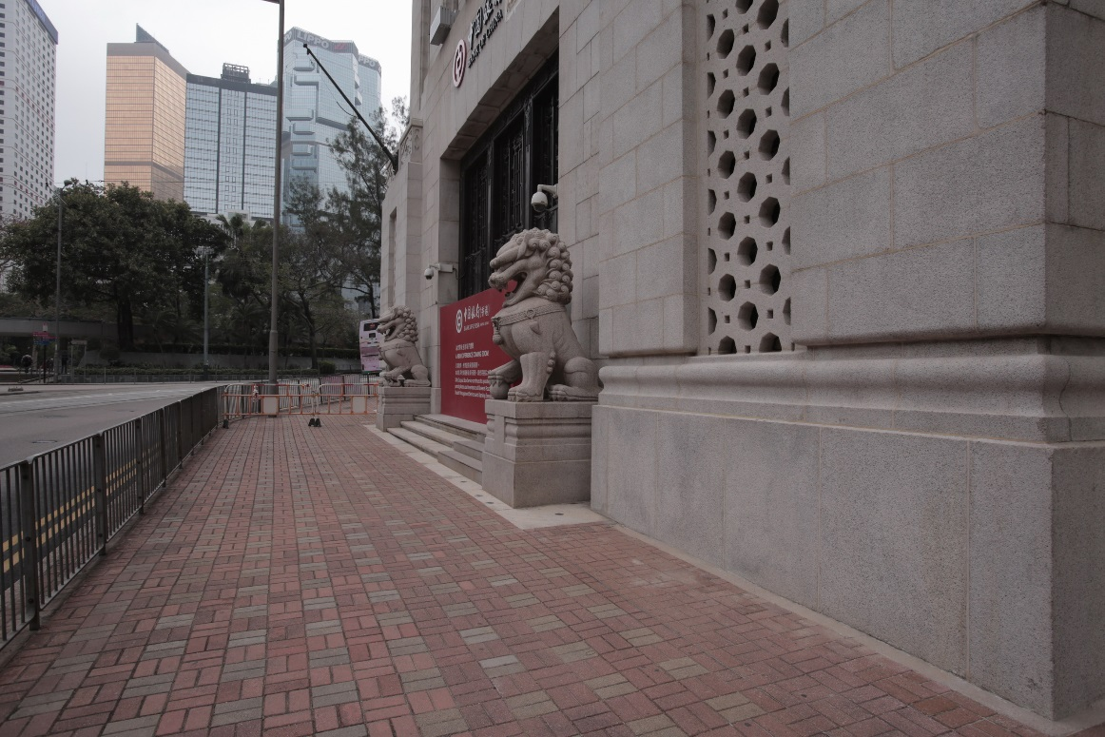
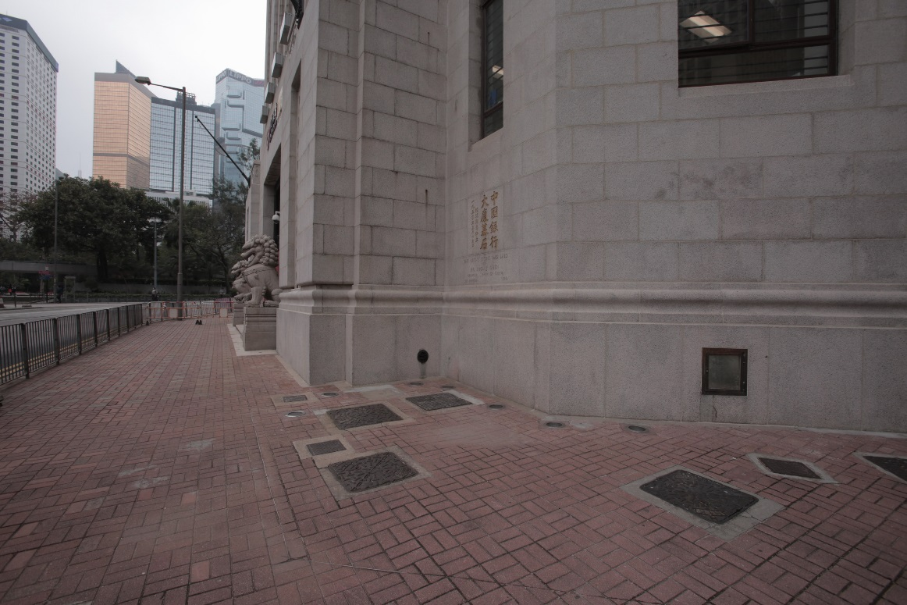
In Focus
Location:
Central, Hong Kong
Bank of China – Old

Slide 4
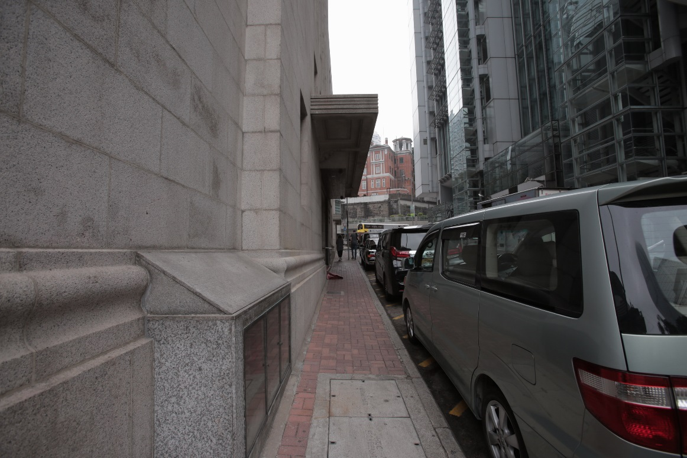
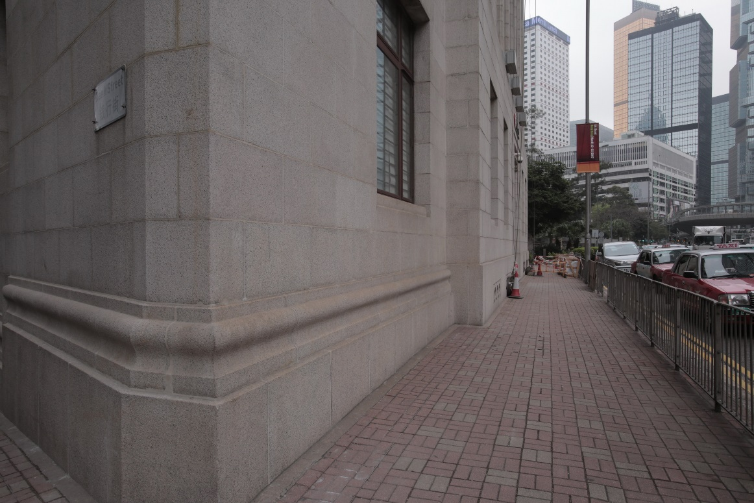
In Focus
Location:
Central, Hong Kong
Bank of China – Old

Slide 5
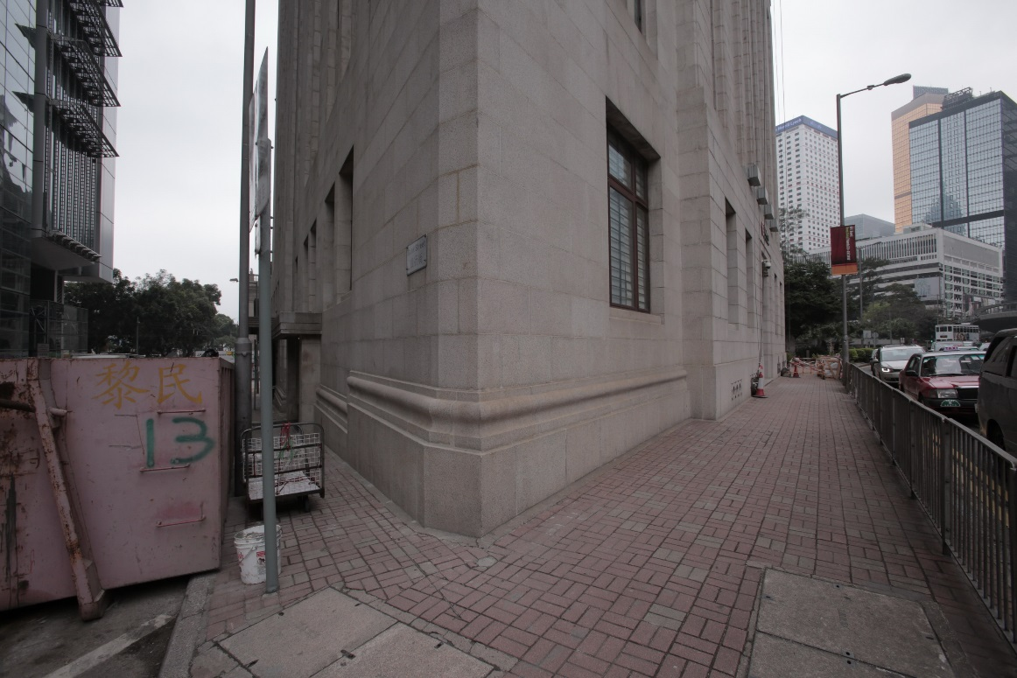
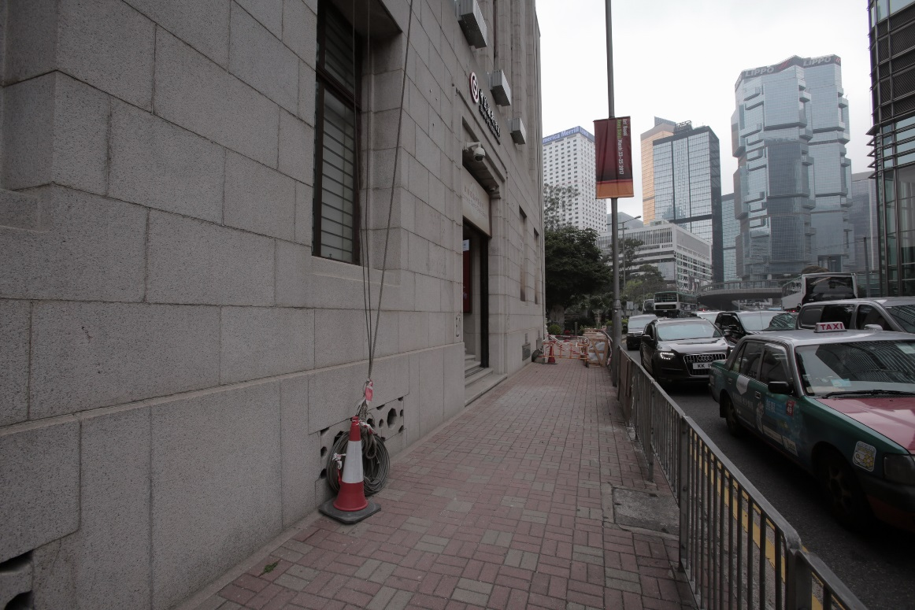
In Focus
Location:
Central, Hong Kong
Bank of China – Old

Slide 6
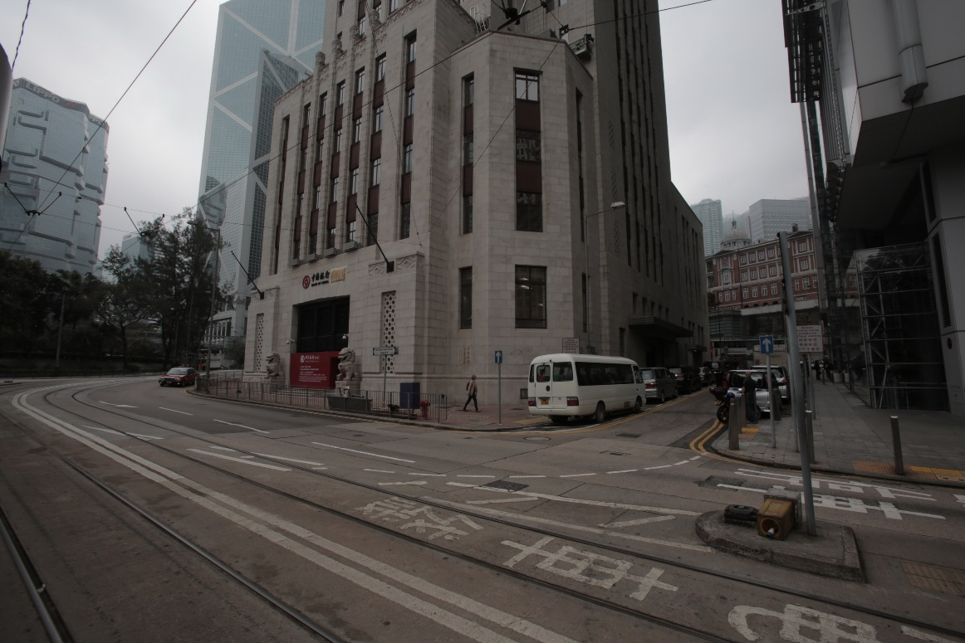
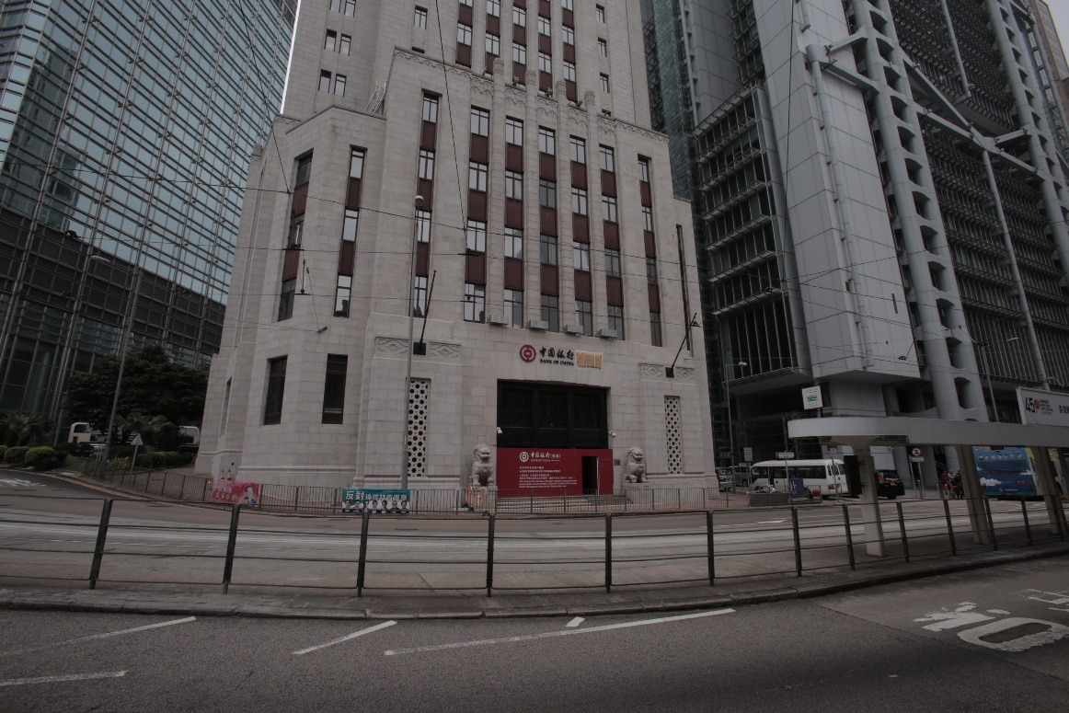
In Focus
Location:
Central, Hong Kong
Bank of China – Old

Slide 7
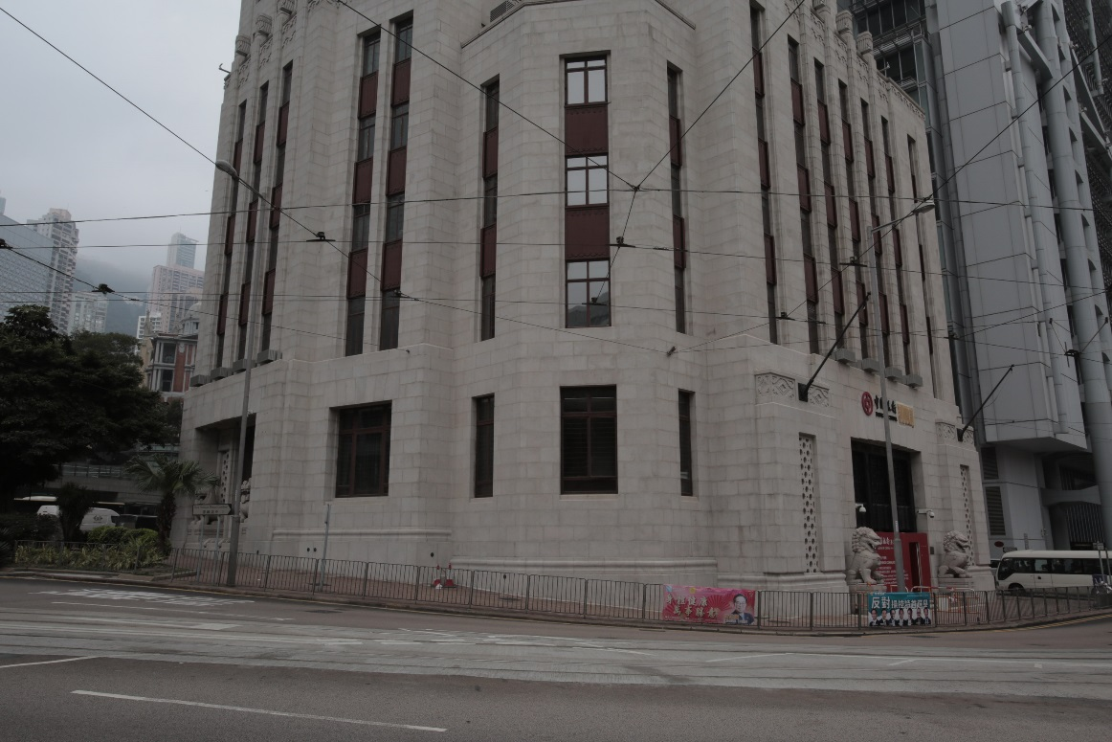
In Focus
Location:
Central, Hong Kong
Bank of China – Old

Slide 8
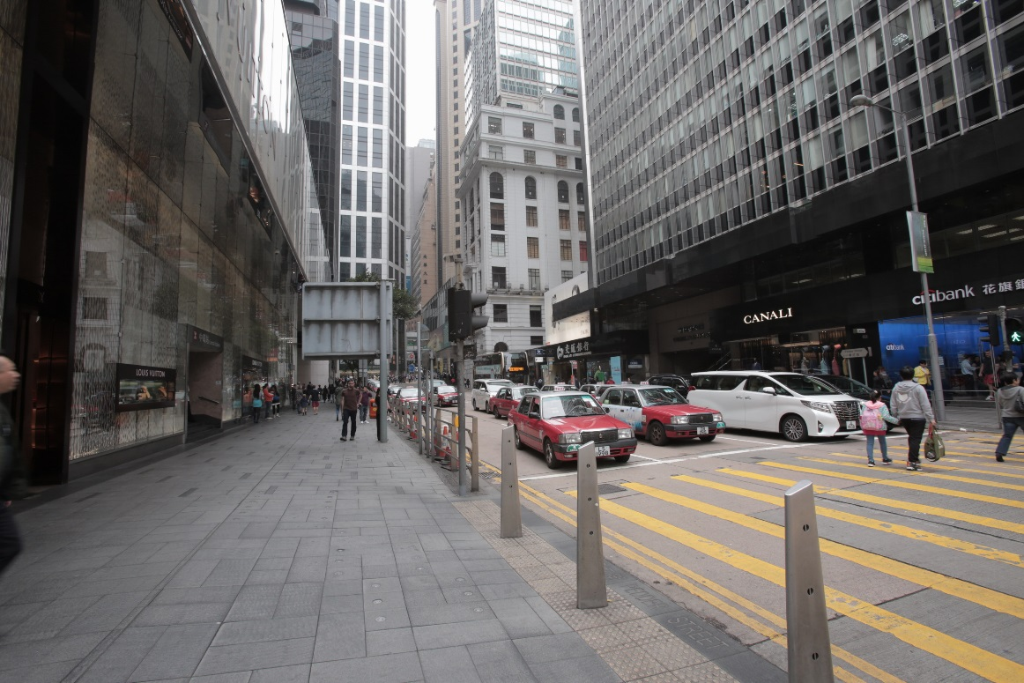
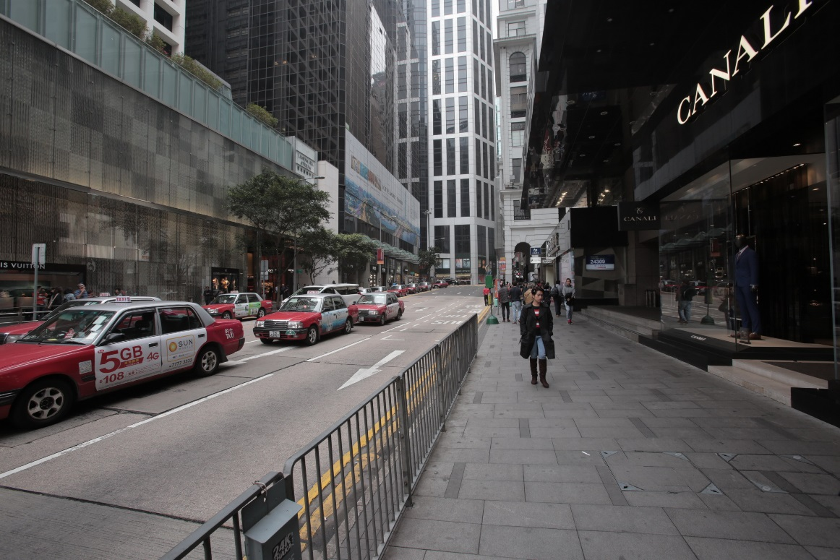
In Focus
Location:
Central, Hong Kong
Bank of China – Old (city view)

Slide 9
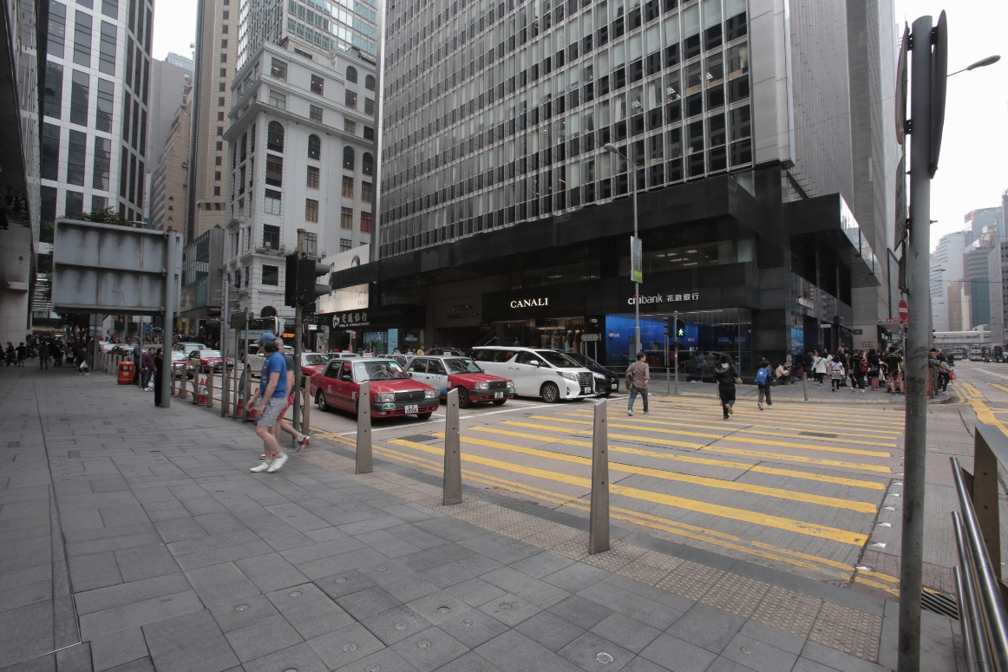
In Focus
Location:
Central, Hong Kong
Bank of China – Old (city view)

