Slide 1
In Focus
Location

Slide 2
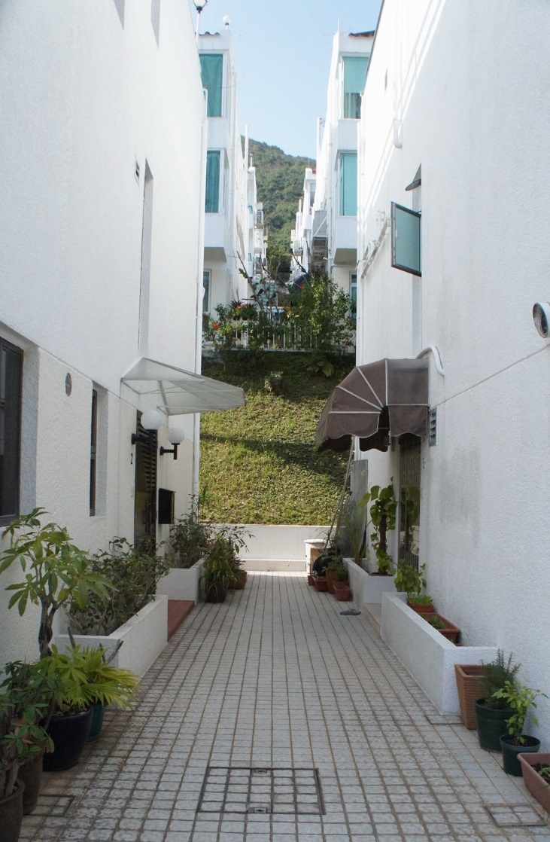
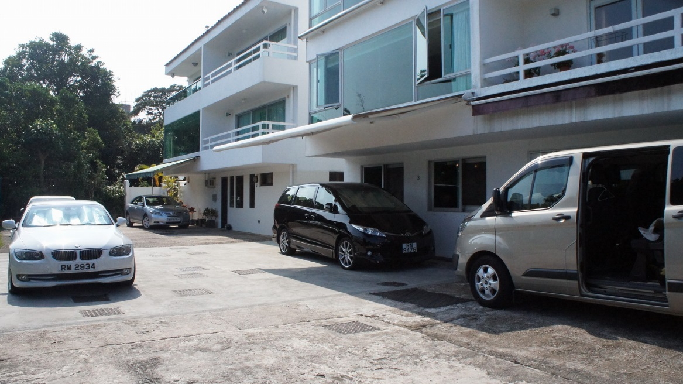
In Focus
Location:
Sai Kung, N.T
Interview – House 1

Slide 3
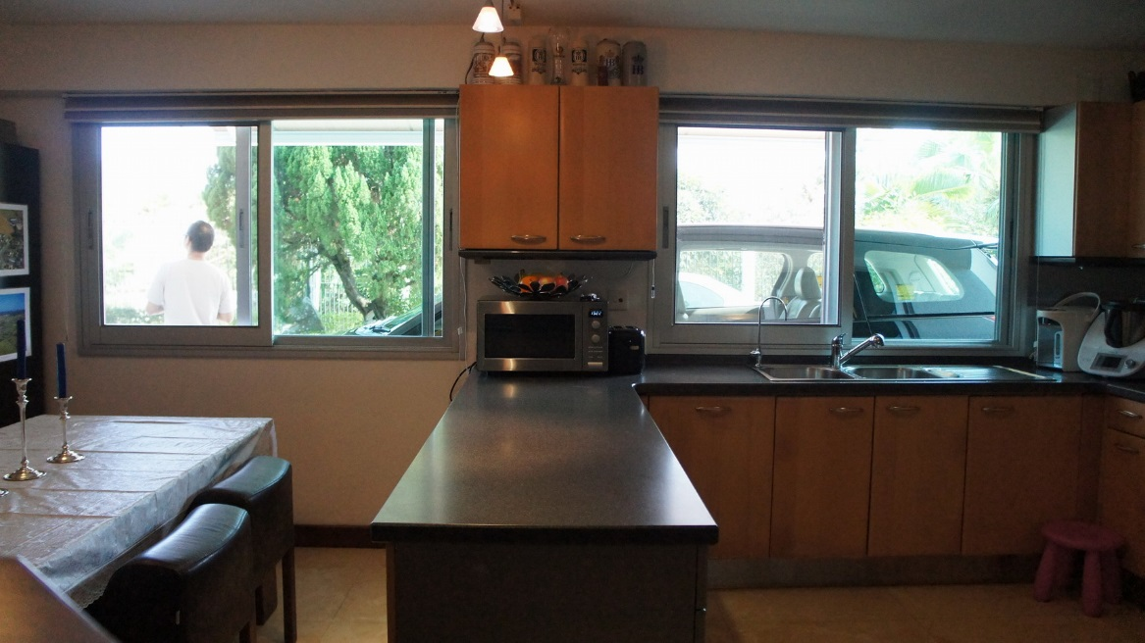
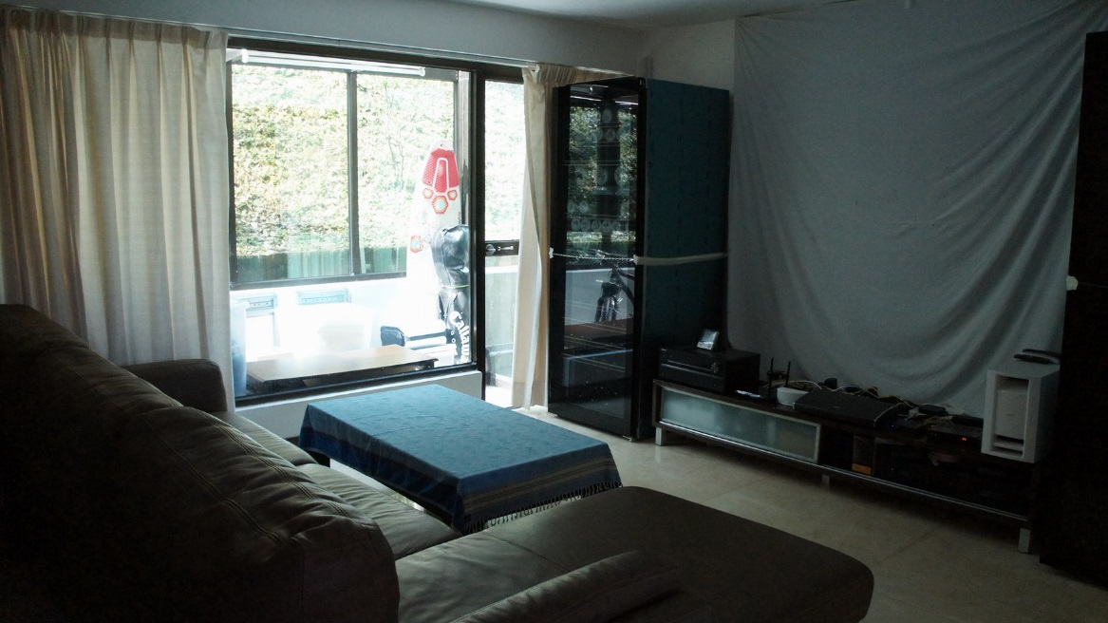
In Focus
Location:
Sai Kung, N.T
Interview – House 1

Slide 4
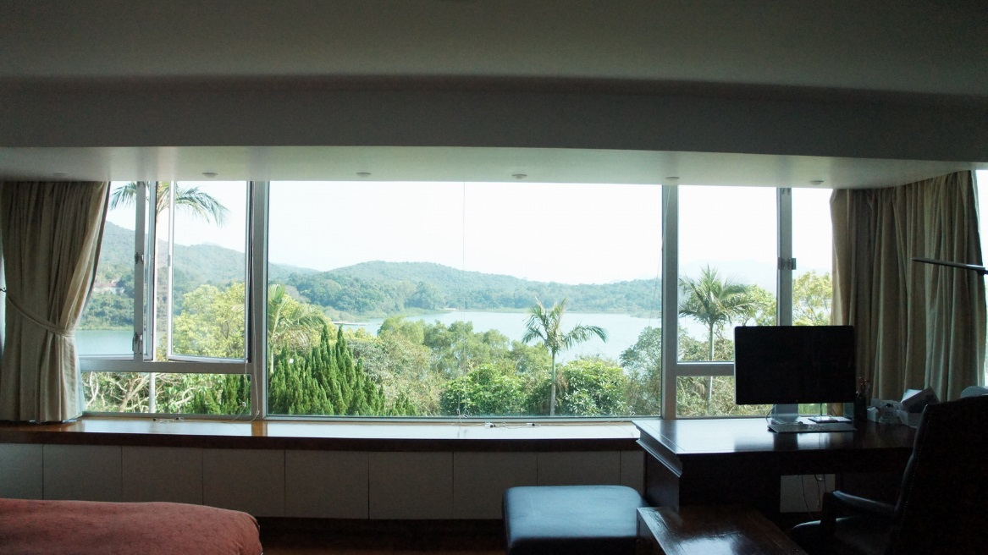
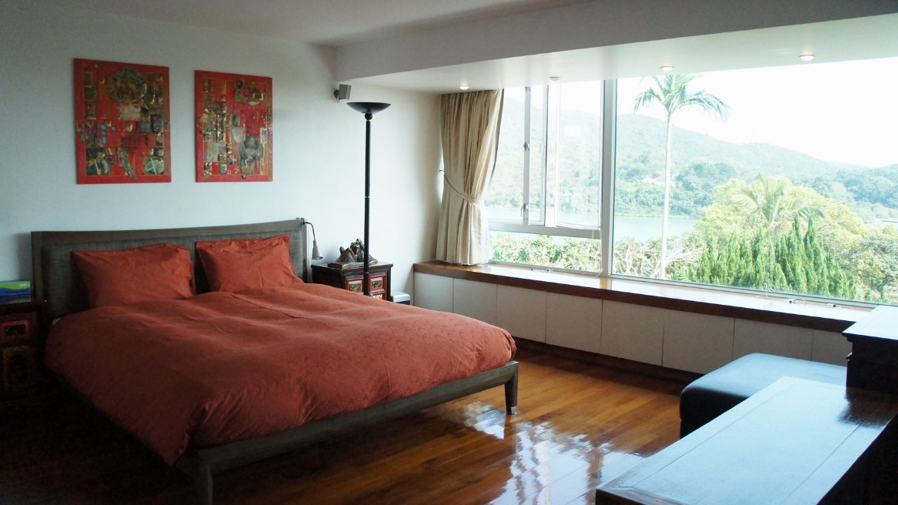
In Focus
Location:
Sai Kung, N.T
Interview – House 1

Slide 5
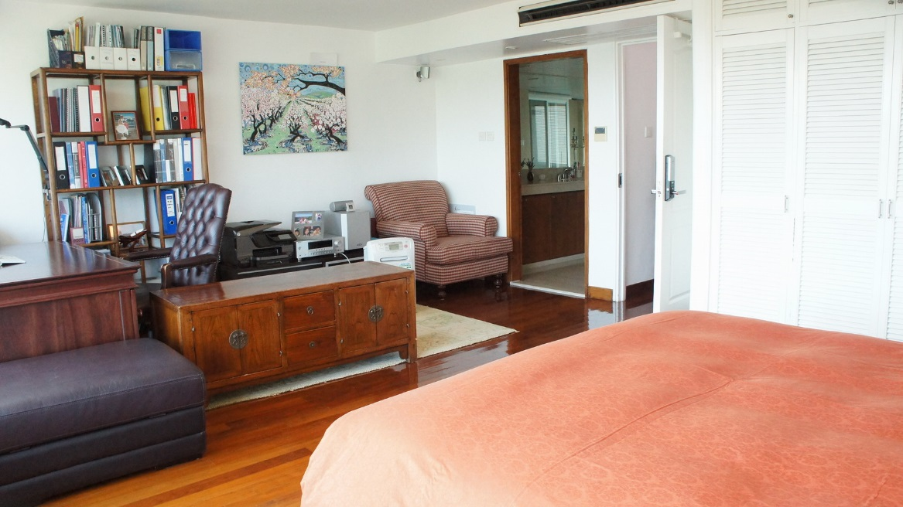
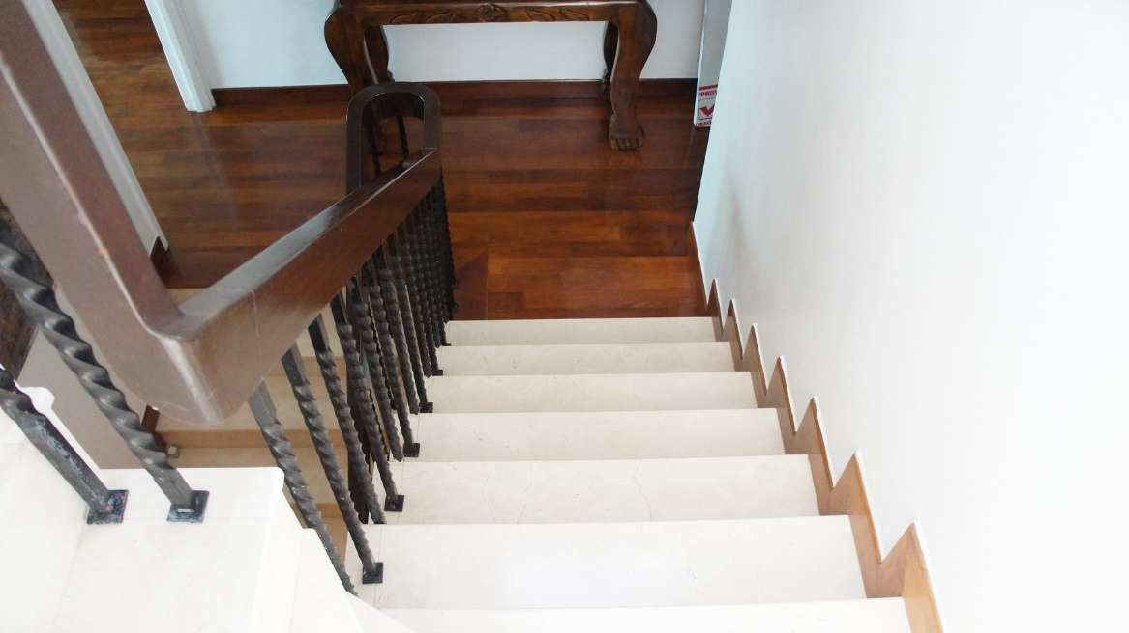
In Focus
Location:
Sai Kung, N.T
Interview – House 1

Slide 6
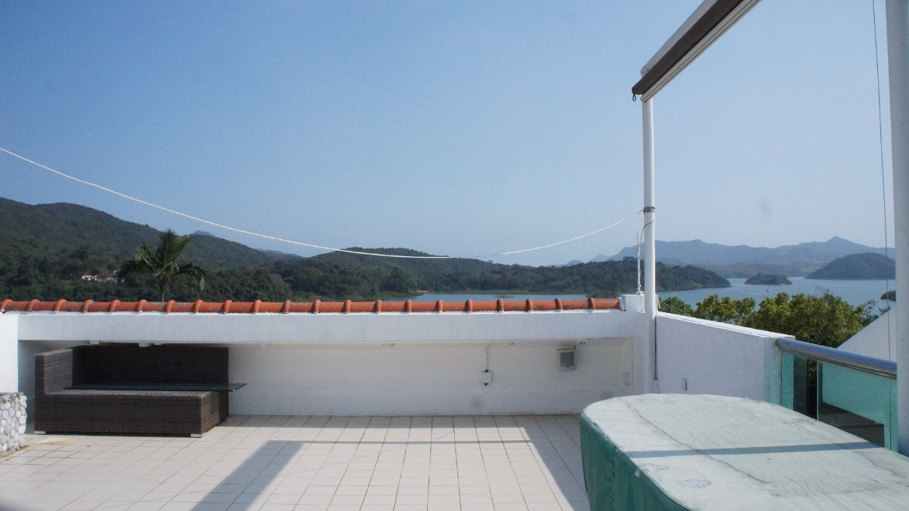
In Focus
Location:
Sai Kung, N.T
Interview – House 1

Slide 7
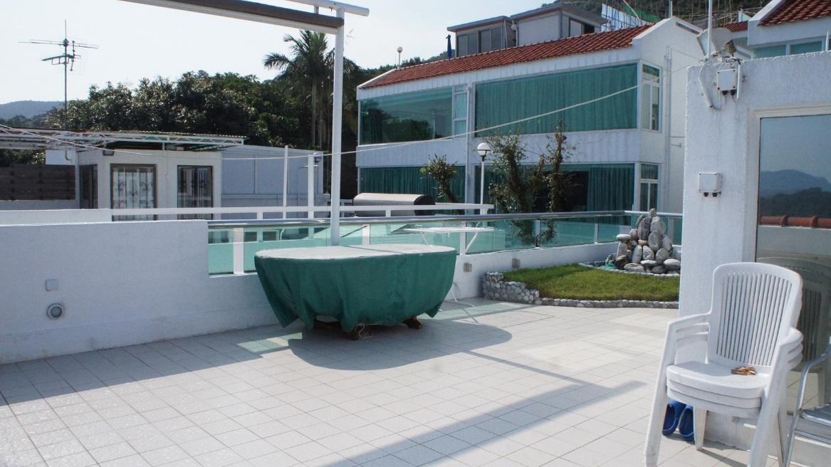
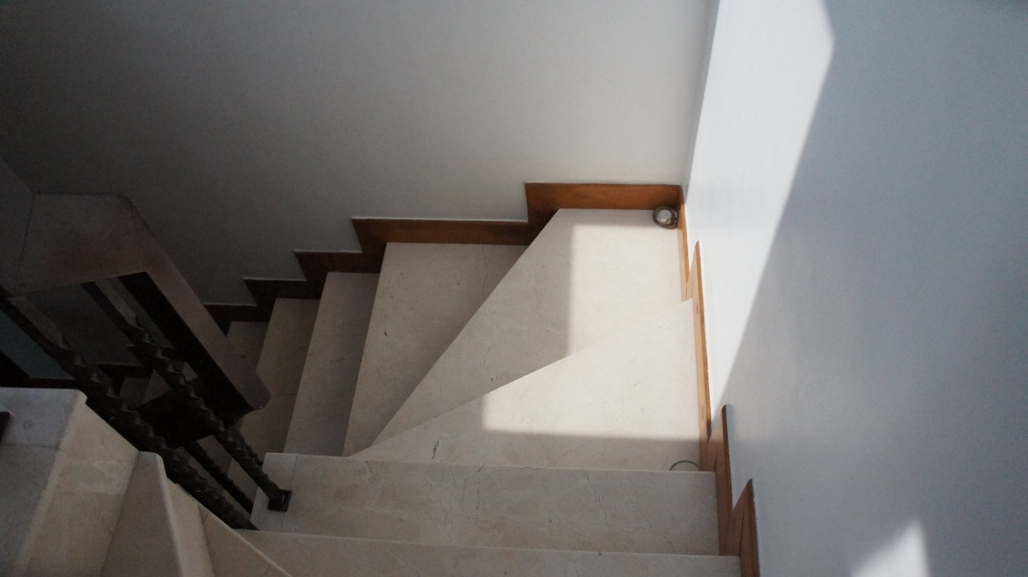
In Focus
Location:
Sai Kung, N.T
Interview – House 1

