Slide 1
In Focus
Location

Slide 2
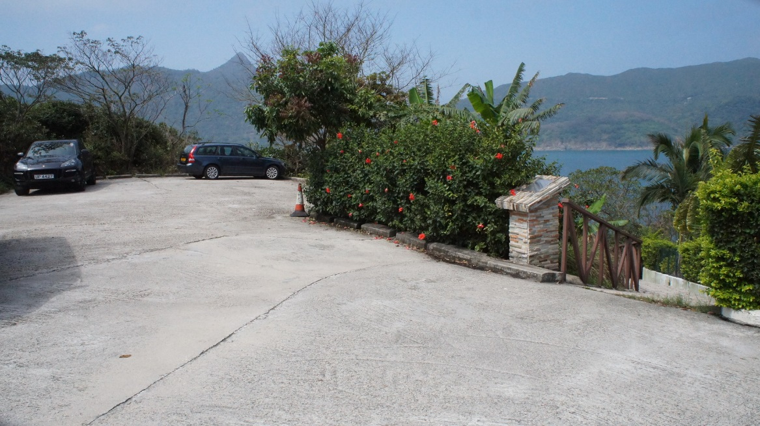
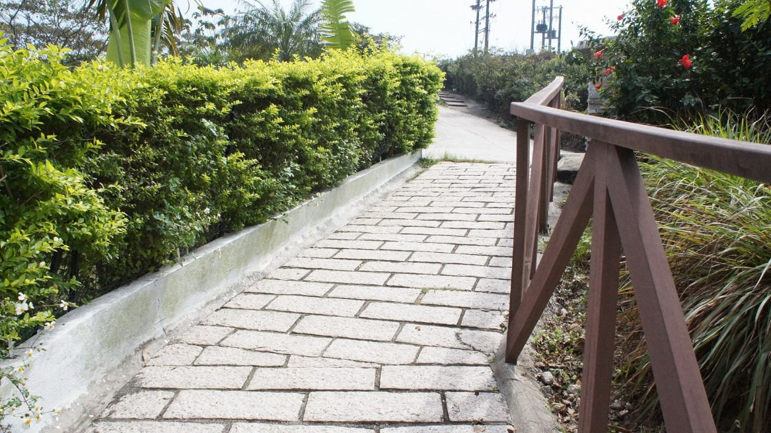
In Focus
Location:
Sai Kung, N.T
Interview – House 2

Slide 3
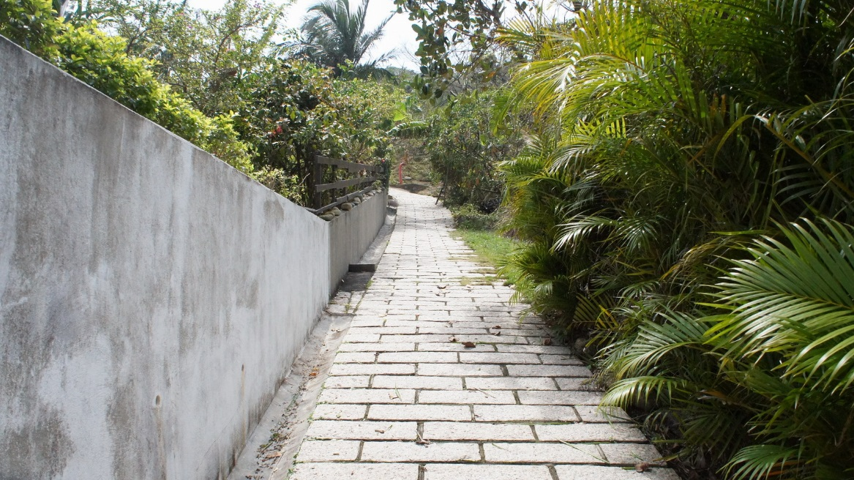
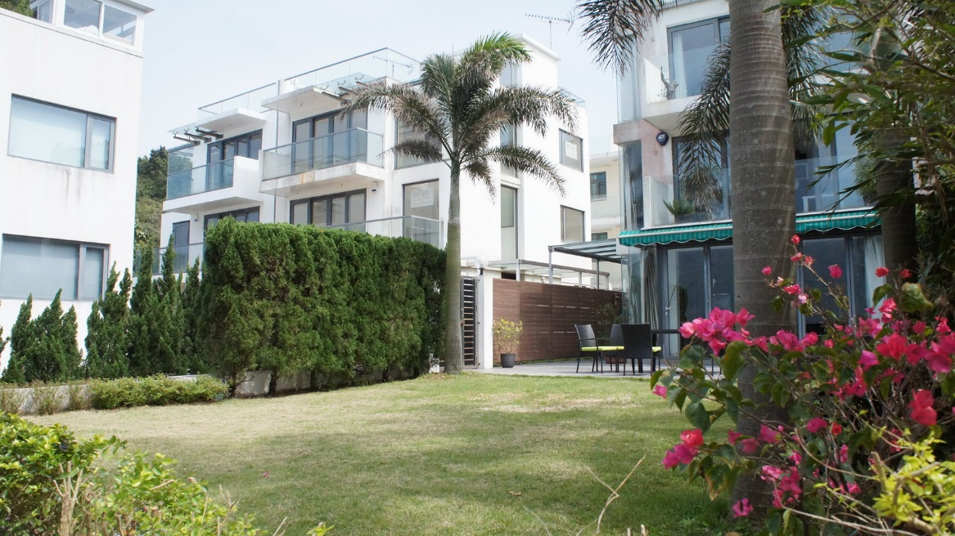
In Focus
Location:
Sai Kung, N.T
Interview – House 2

Slide 4
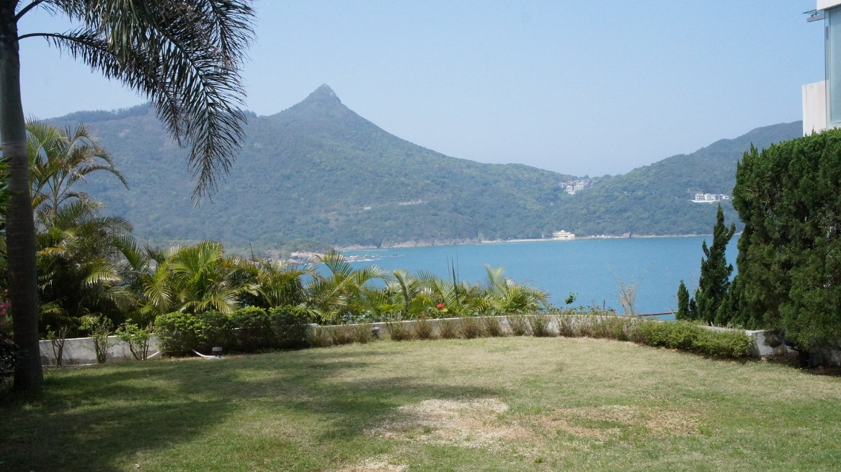
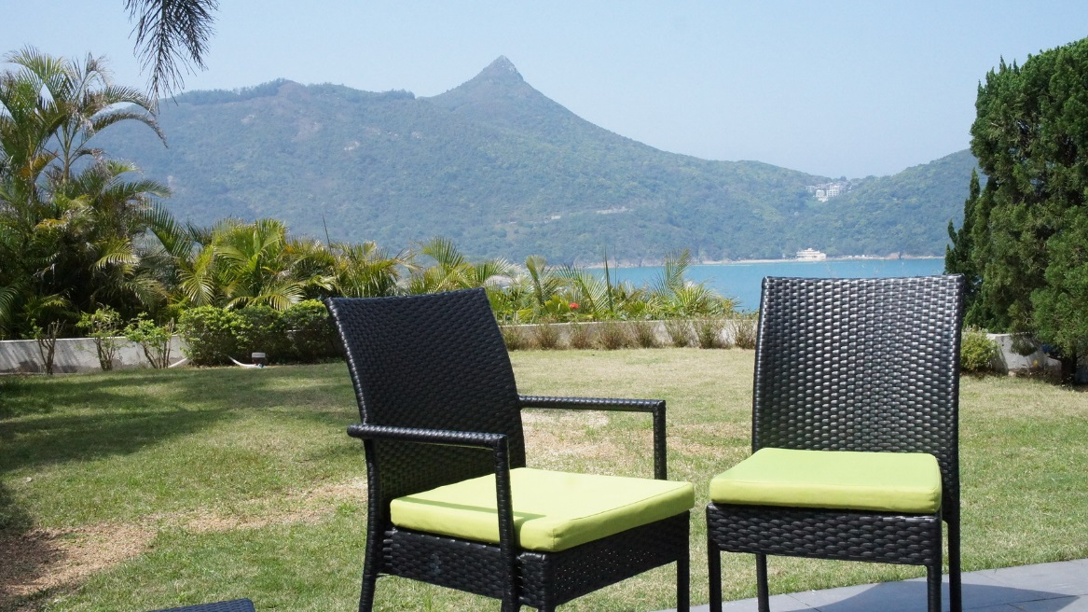
In Focus
Location:
Sai Kung, N.T
Interview – House 2

Slide 5
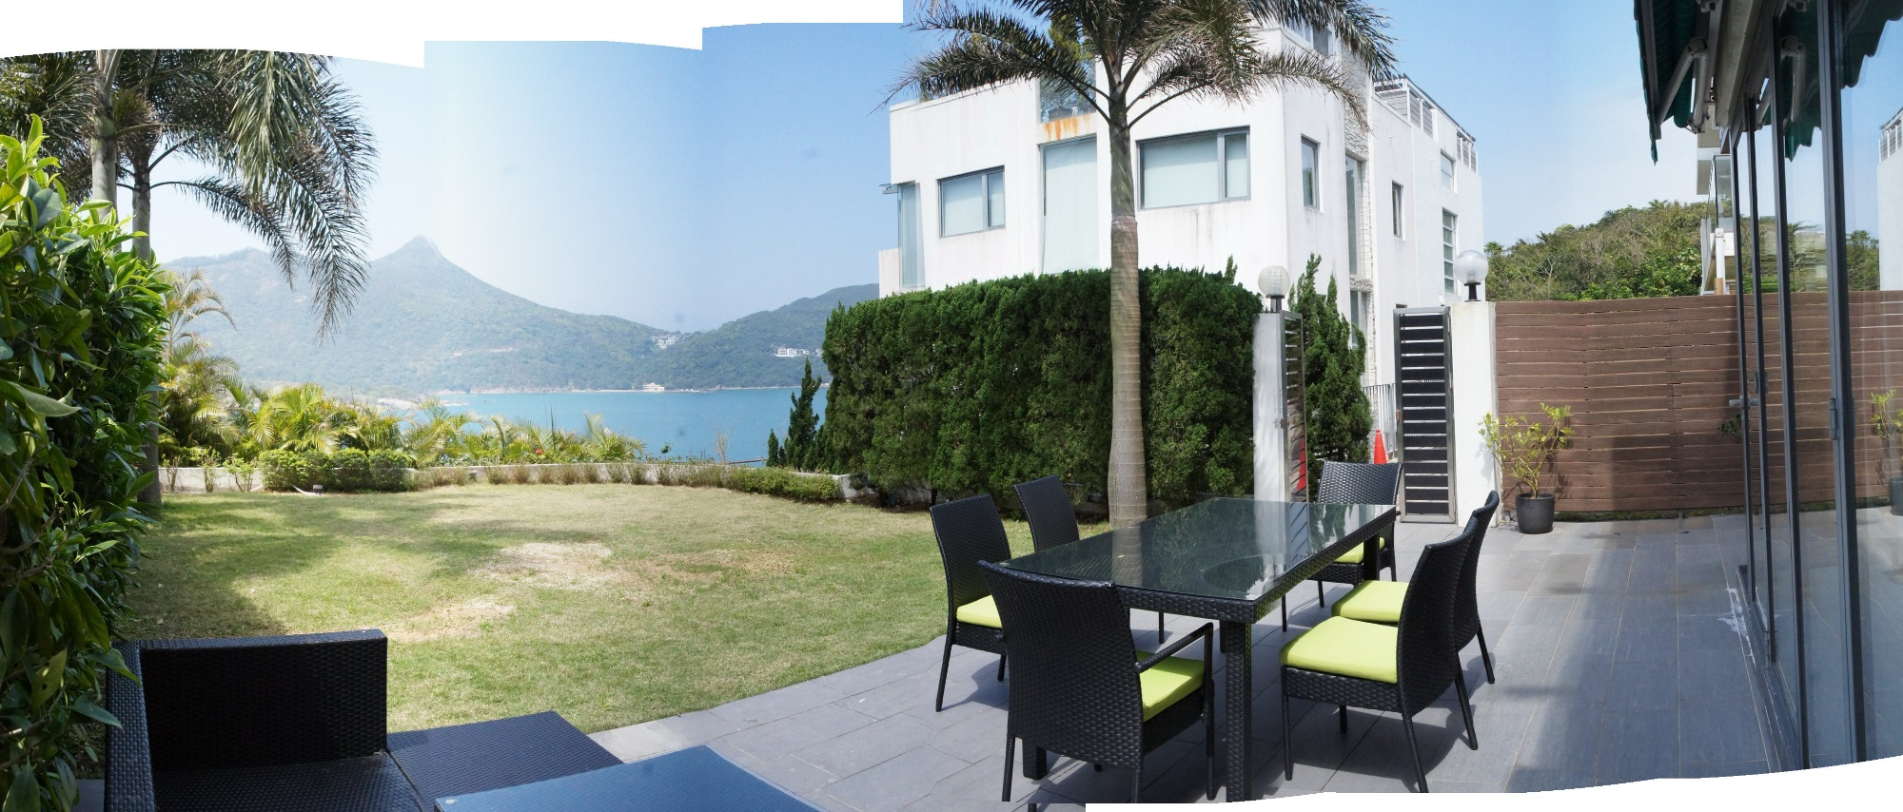
In Focus
Location:
Sai Kung, N.T
Interview – House 2

Slide 6
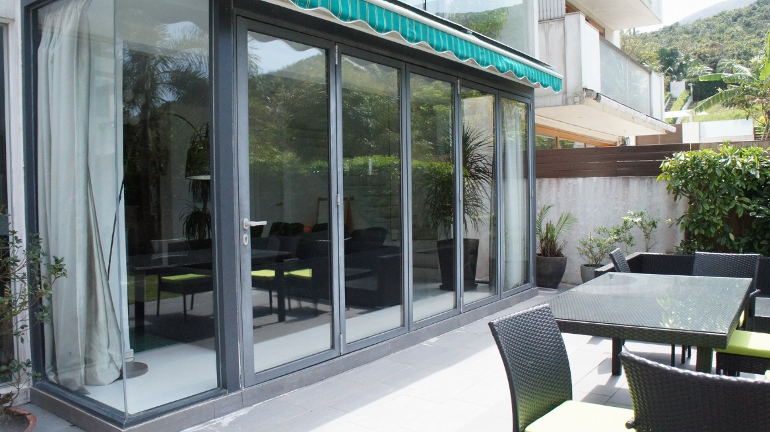
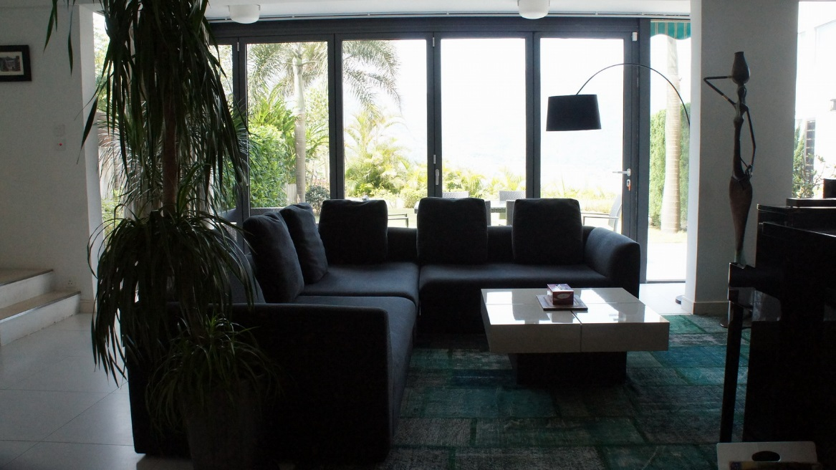
In Focus
Location:
Sai Kung, N.T
Interview – House 2

Slide 7
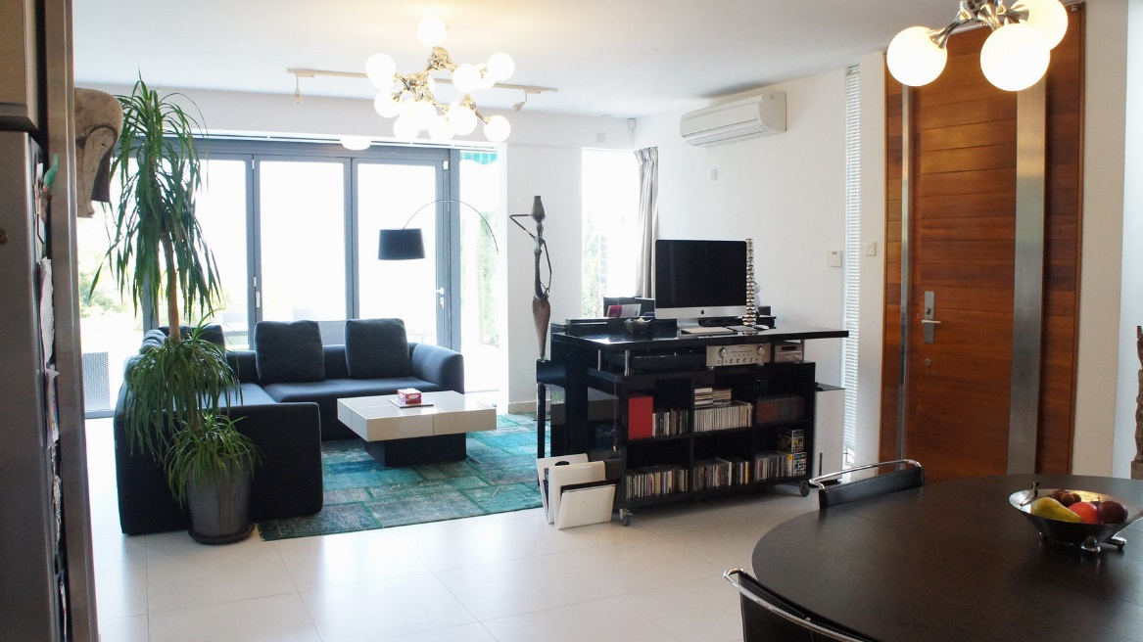
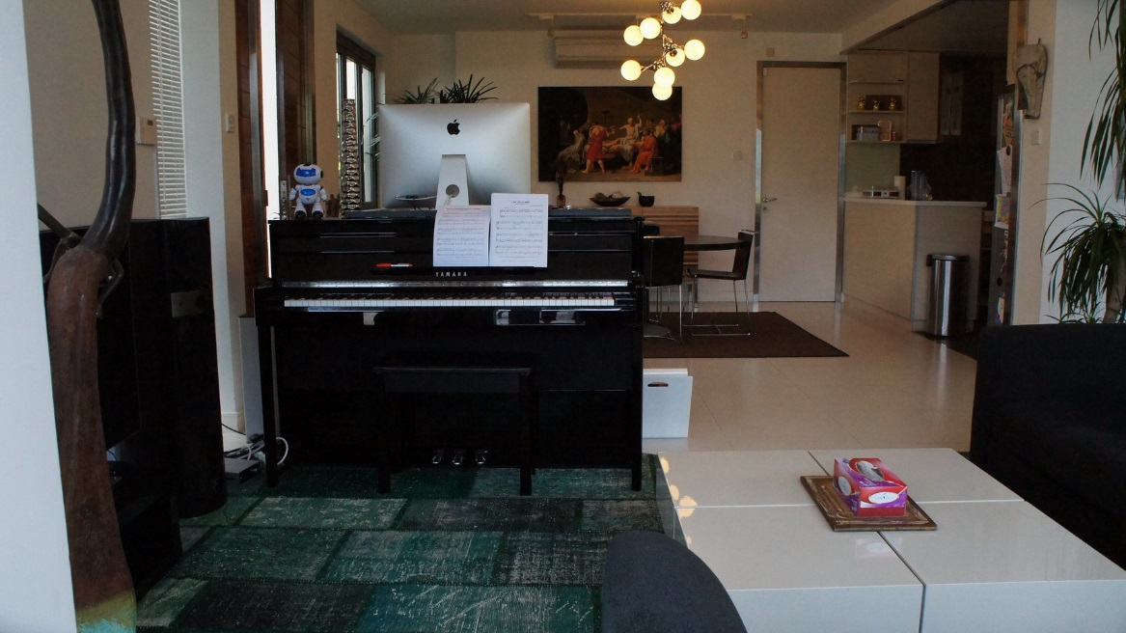
In Focus
Location:
Sai Kung, N.T
Interview – House 2

Slide 8
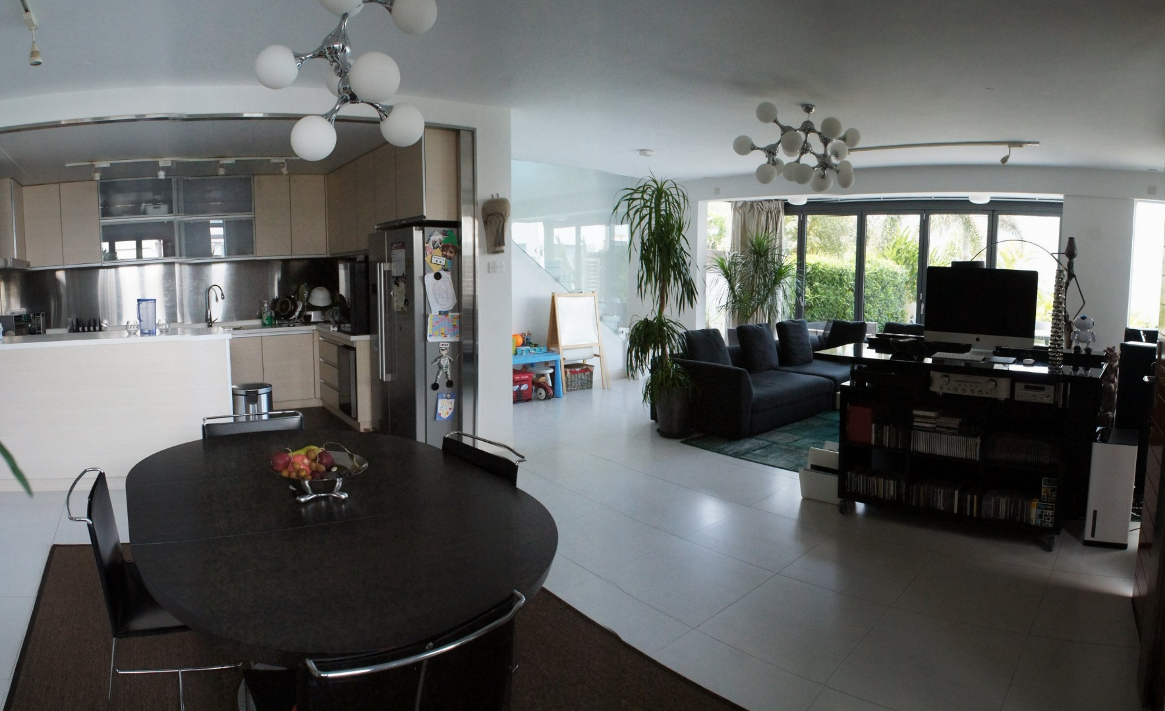
In Focus
Location:
Sai Kung, N.T
Interview – House 2

Slide 9
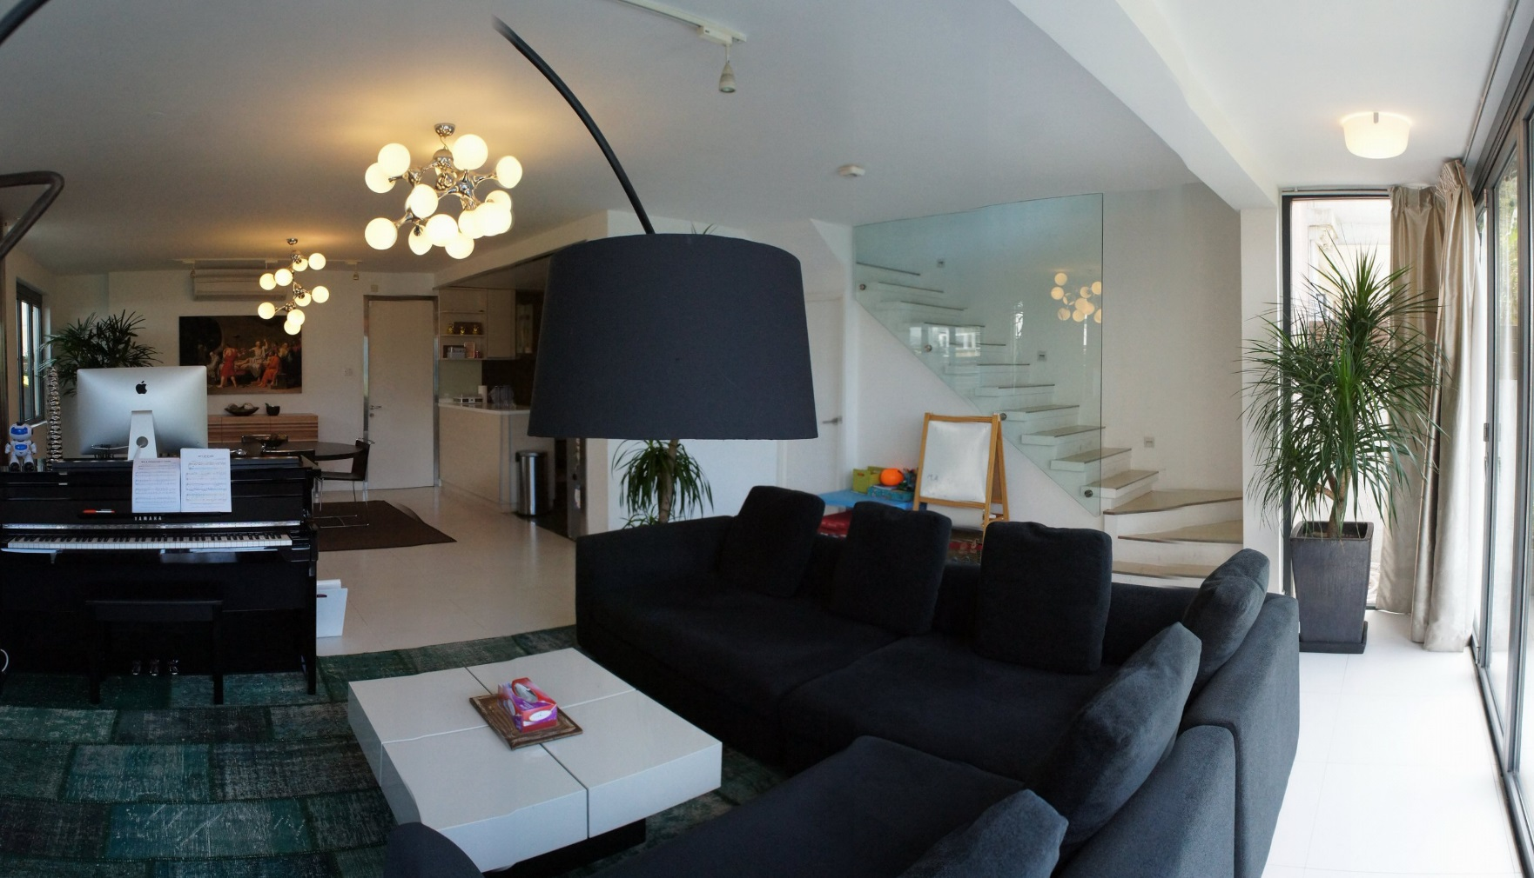
In Focus
Location:
Sai Kung, N.T
Interview – House 2

Slide 10
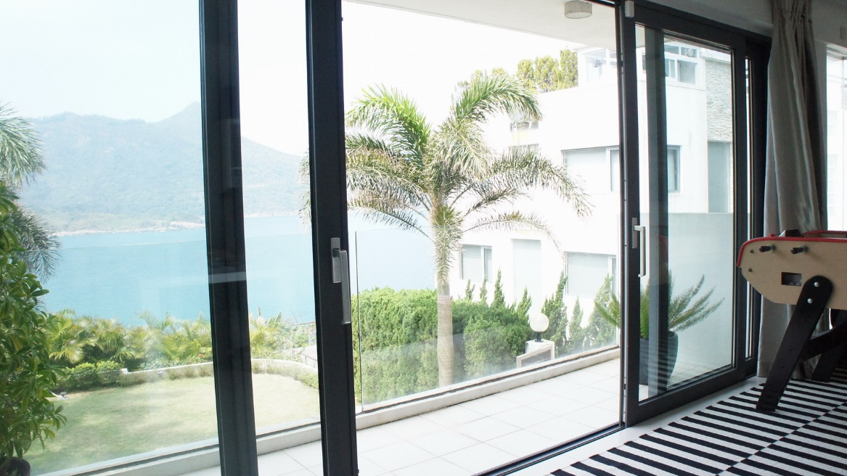
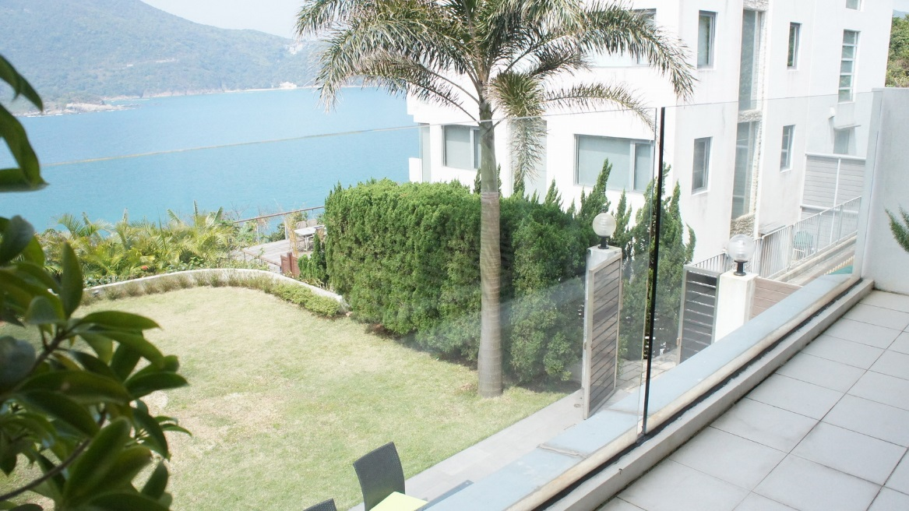
In Focus
Location:
Sai Kung, N.T
Interview – House 2

Slide 11
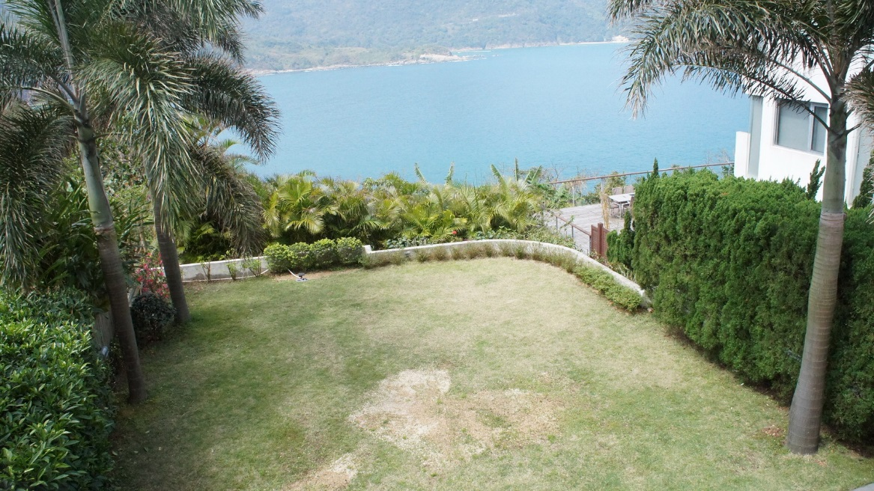
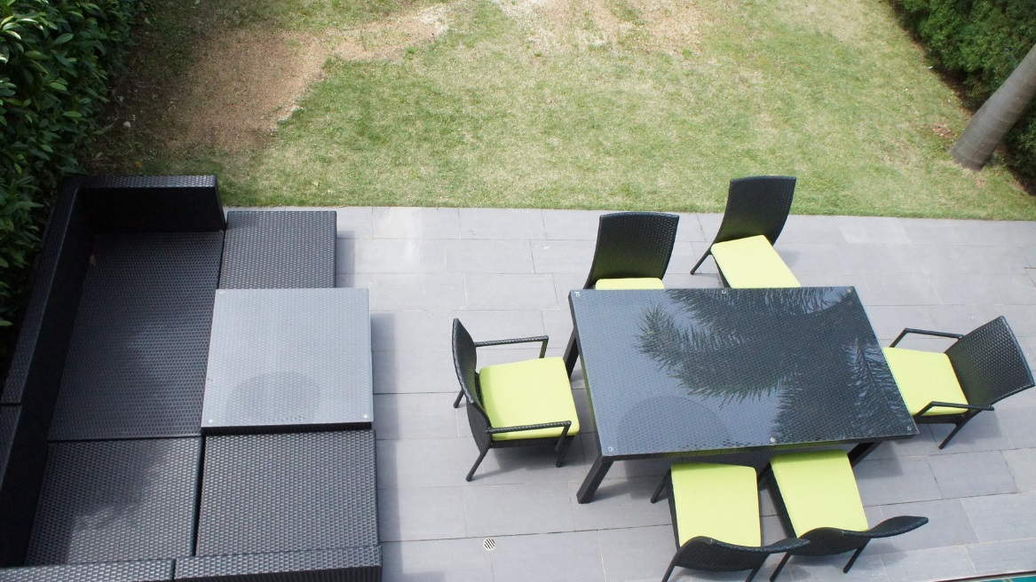
In Focus
Location:
Sai Kung, N.T
Interview – House 2

Slide 12
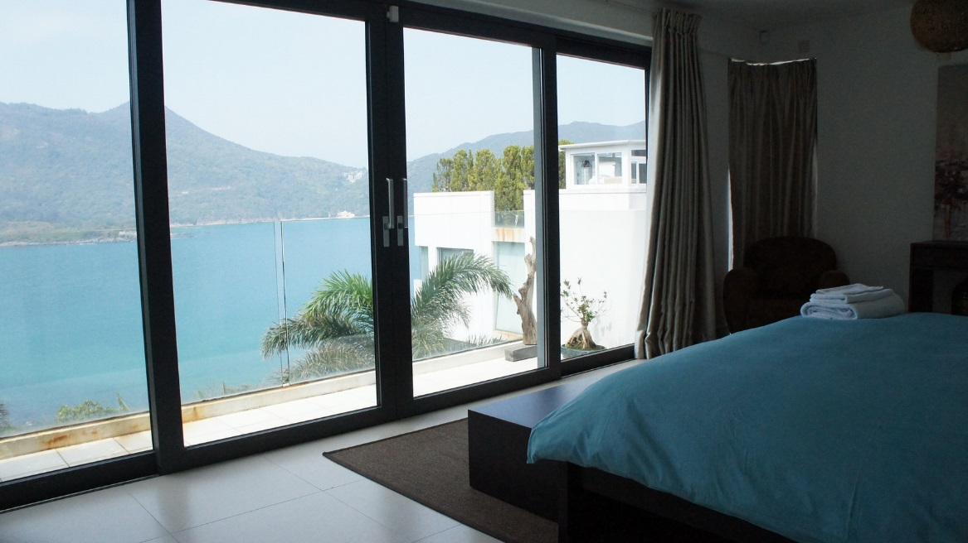
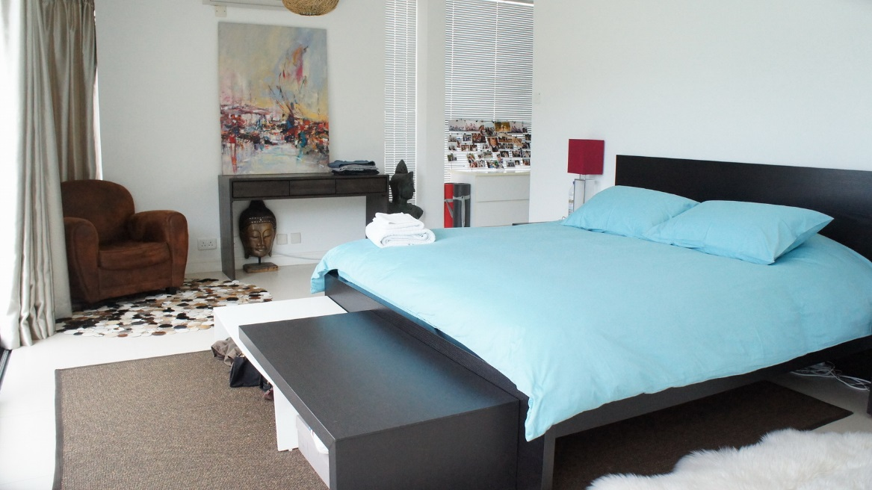
In Focus
Location:
Sai Kung, N.T
Interview – House 2

Slide 13
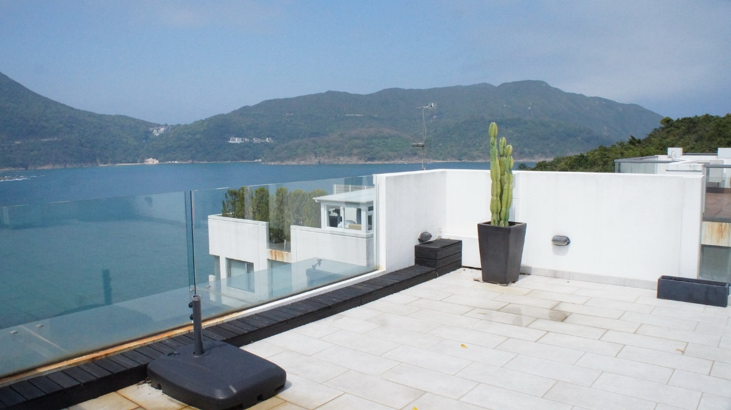
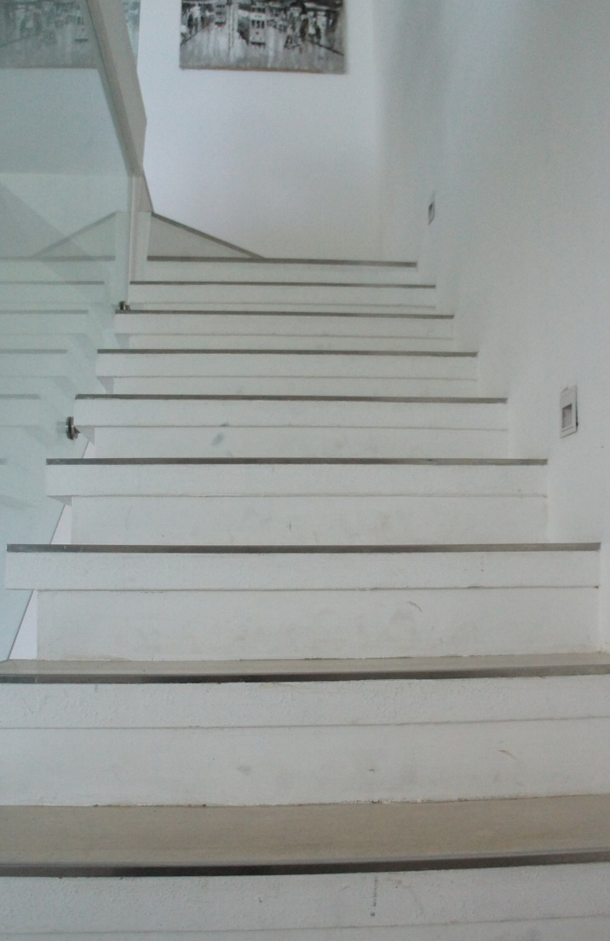
In Focus
Location:
Sai Kung, N.T
Interview – House 2

