Slide 1
In Focus
Casting

Slide 2
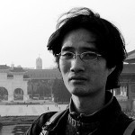
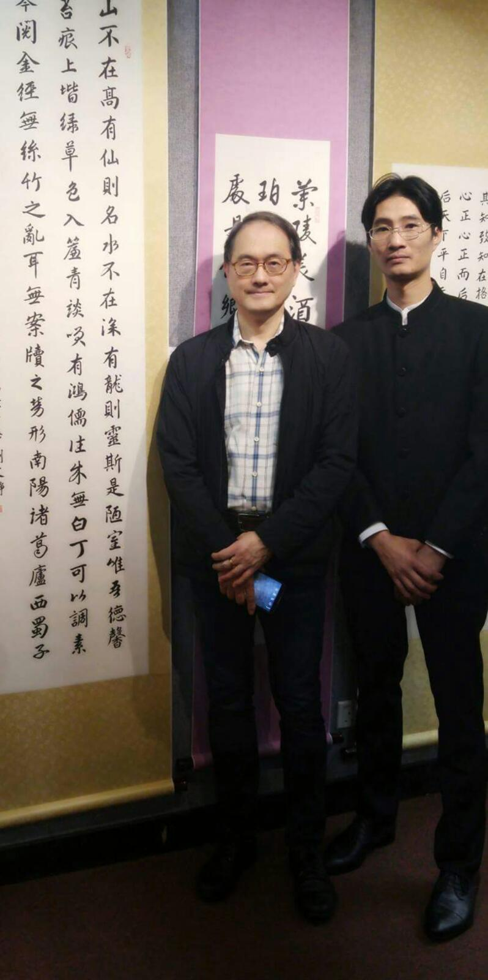
In Focus
Chinese Watercolor Painting Master #2
Ken Lee is a Chinese painting and calligraphy instructor. He graduated from the School of Continuing and Professional Studies, CUHK Diploma in Chinese Calligraphy and Higher Diploma in Chinese Painting. International collectors often collect his works. He is currently a member of the Hong Kong Arts club and The Fringe Club.

Slide 3
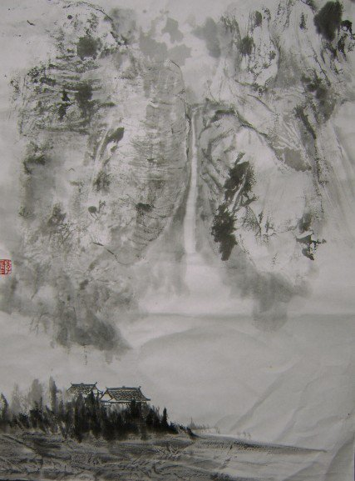
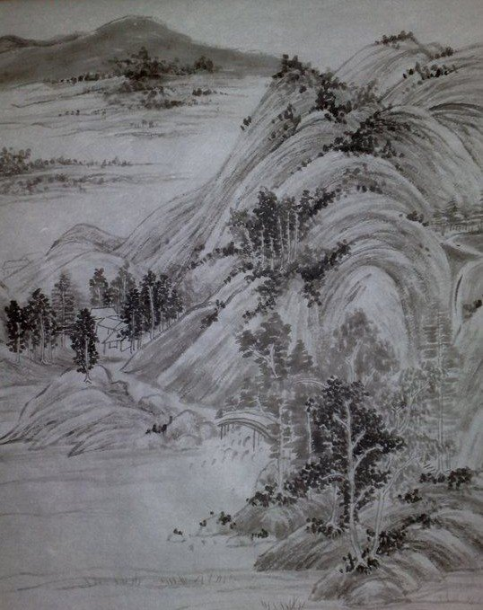
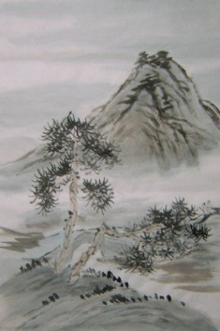
In Focus
Chinese Watercolor Painting Master #2

Slide 4
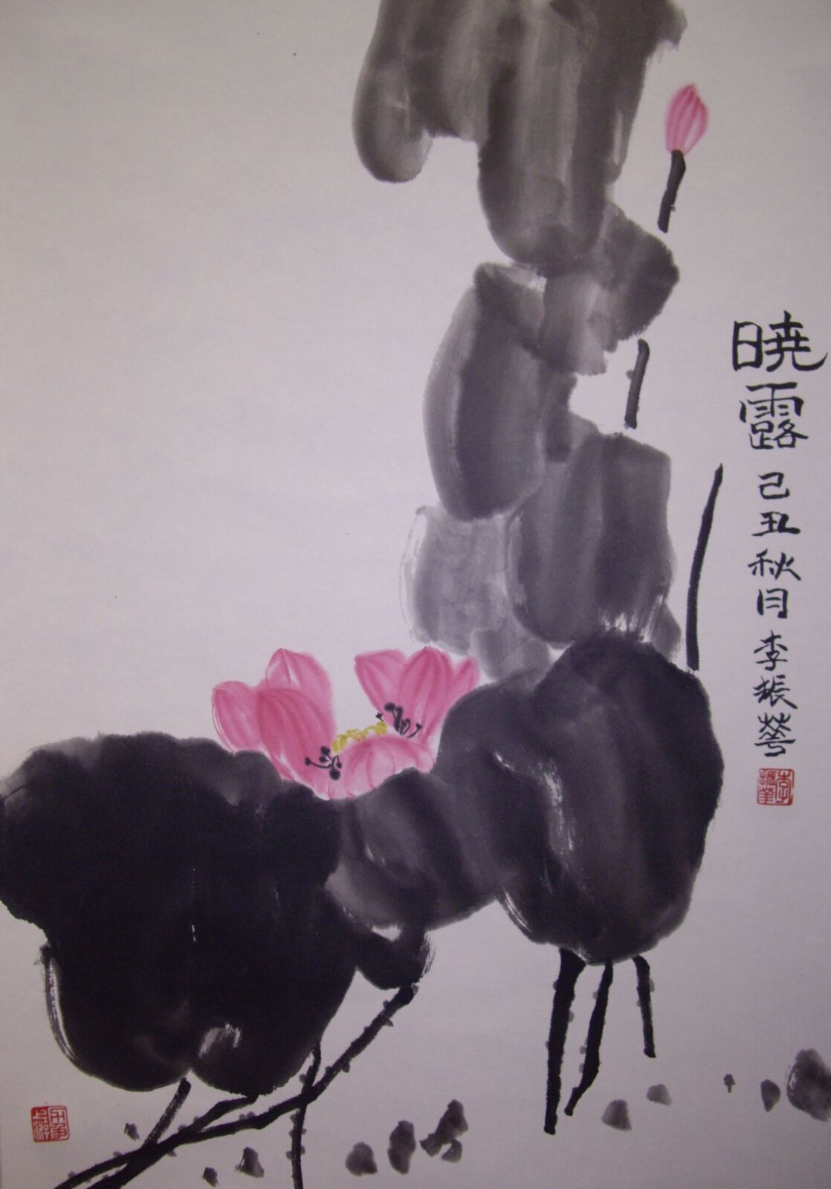
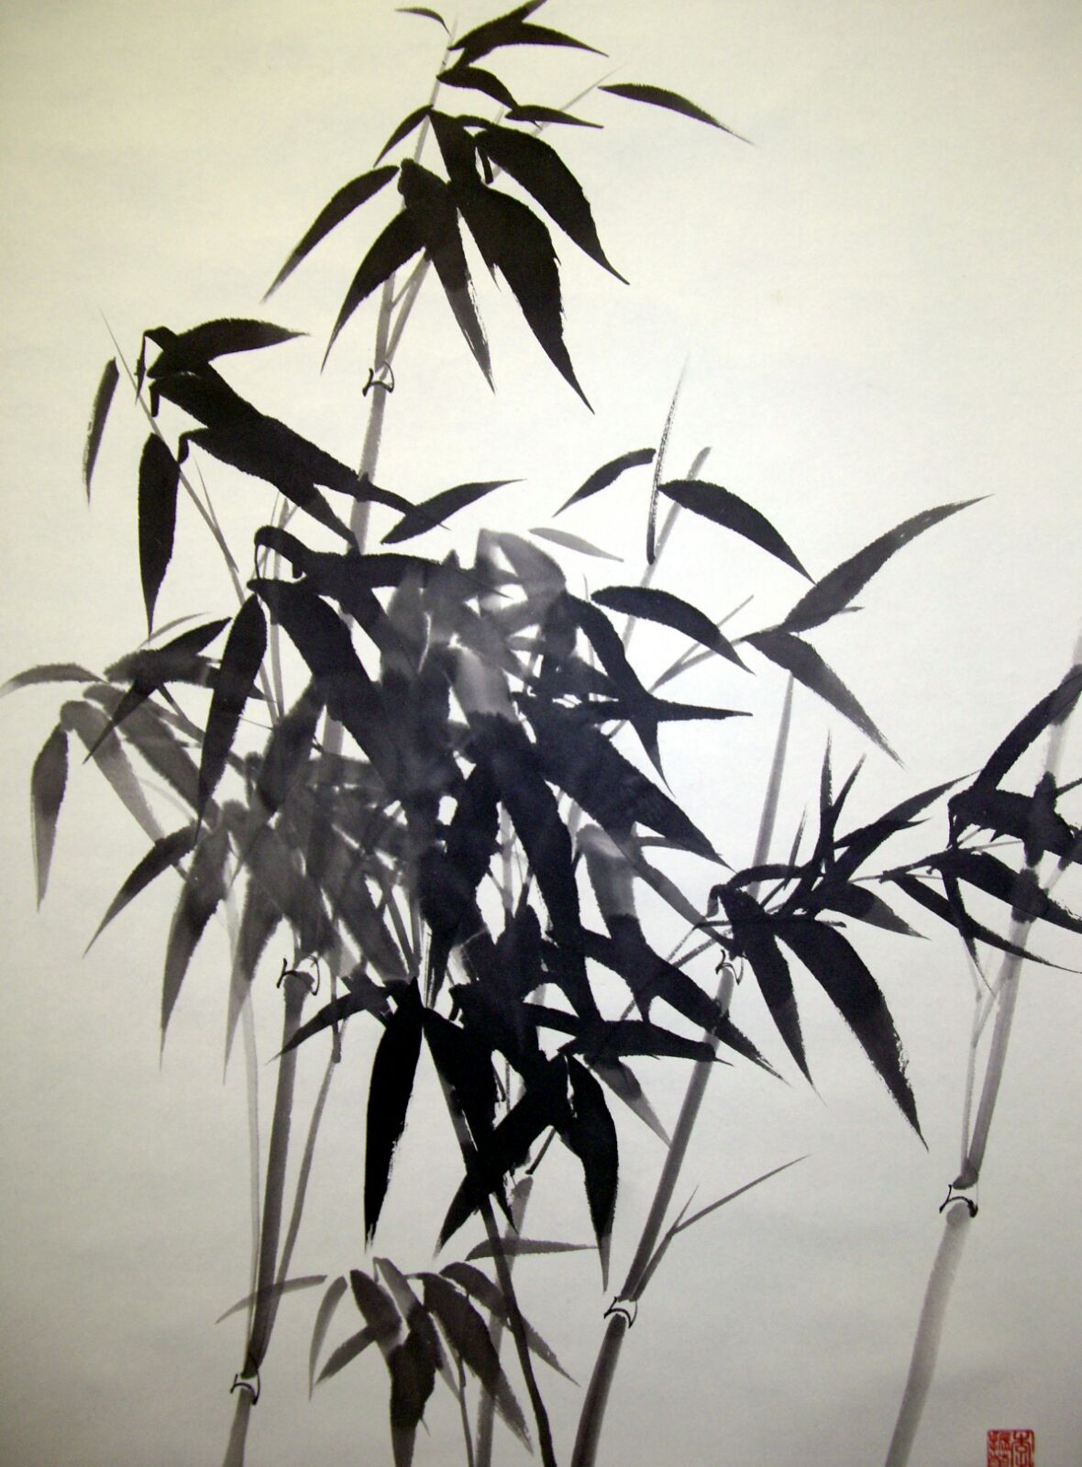
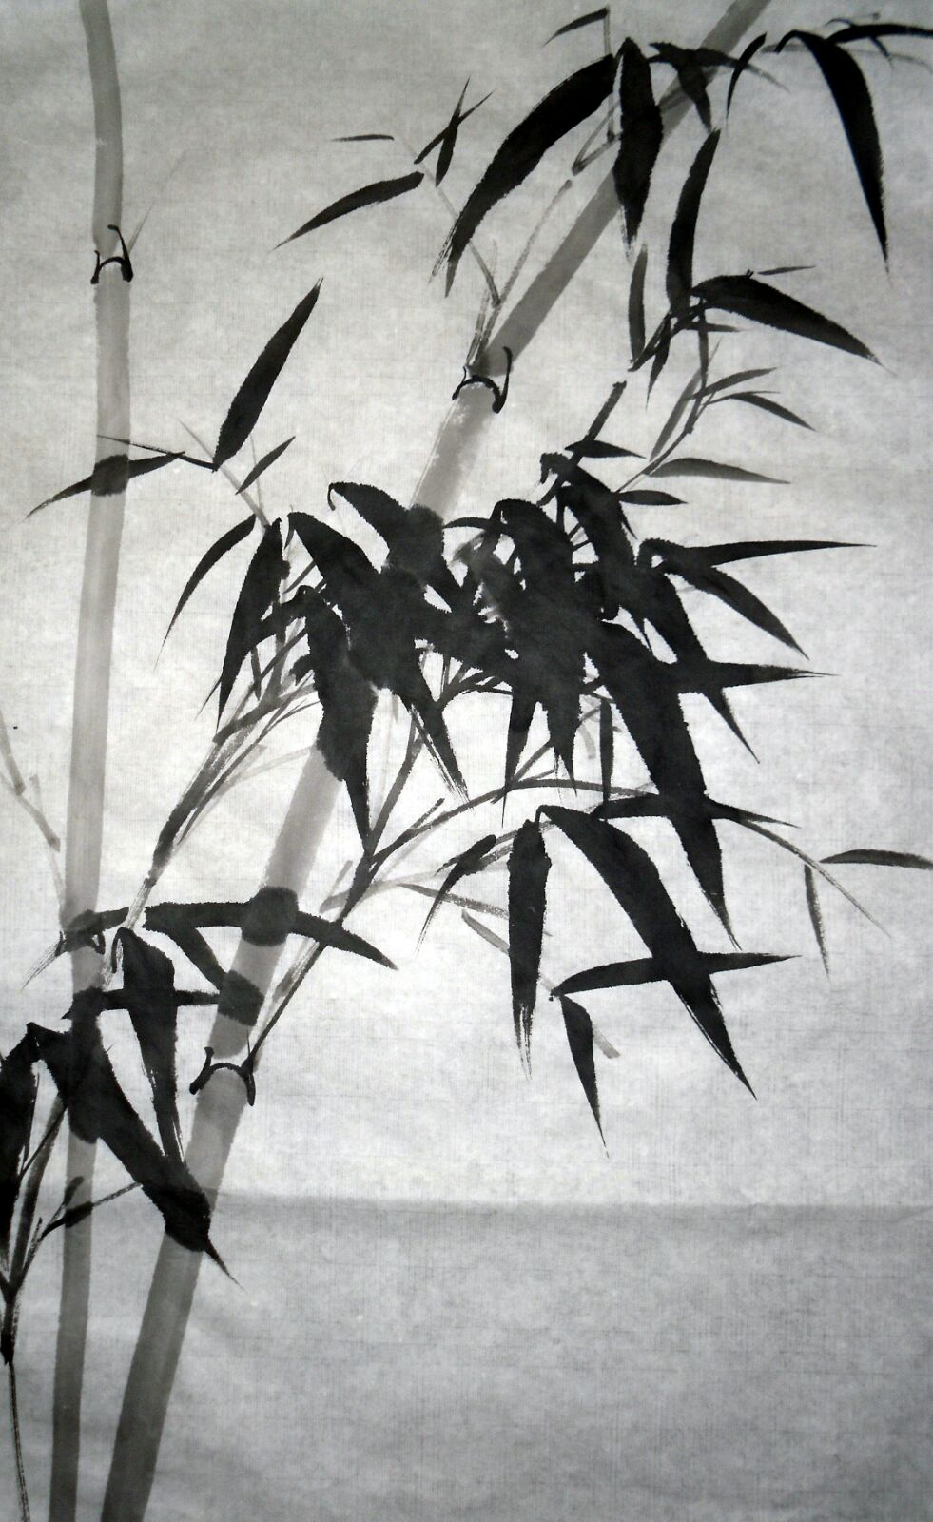
In Focus
Chinese Watercolor Painting Master #2

