Slide 1
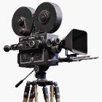
In Focus
Location

Slide 2
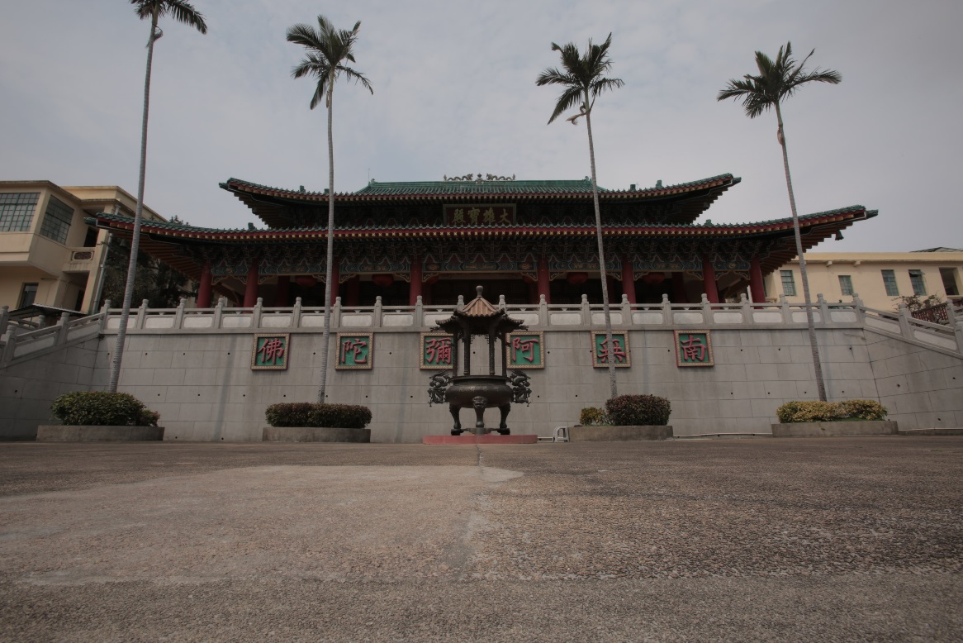
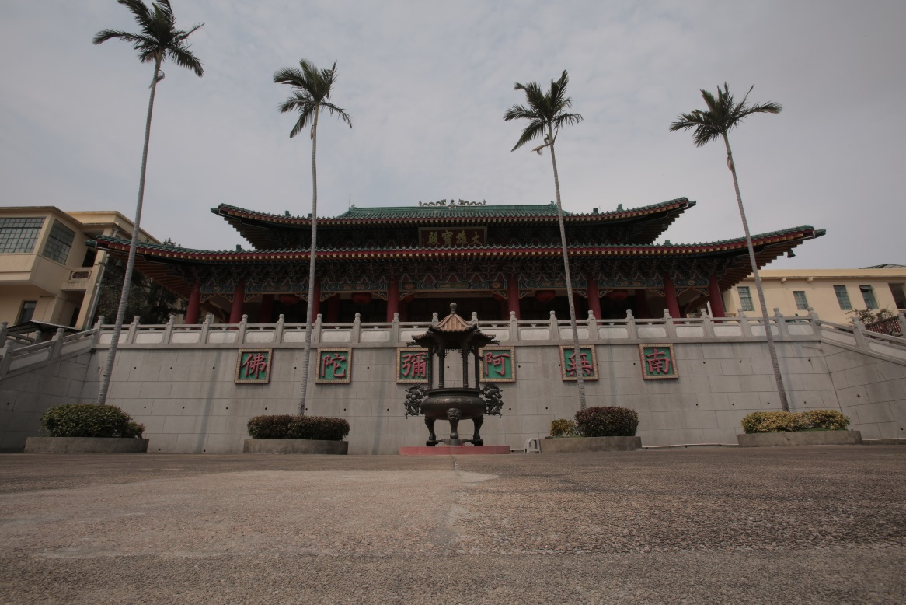
In Focus
Location:
Lo Wai Road, Tsuen Wan
Wuxia Shoot – Chuk Lam Sim Yuen

Slide 3
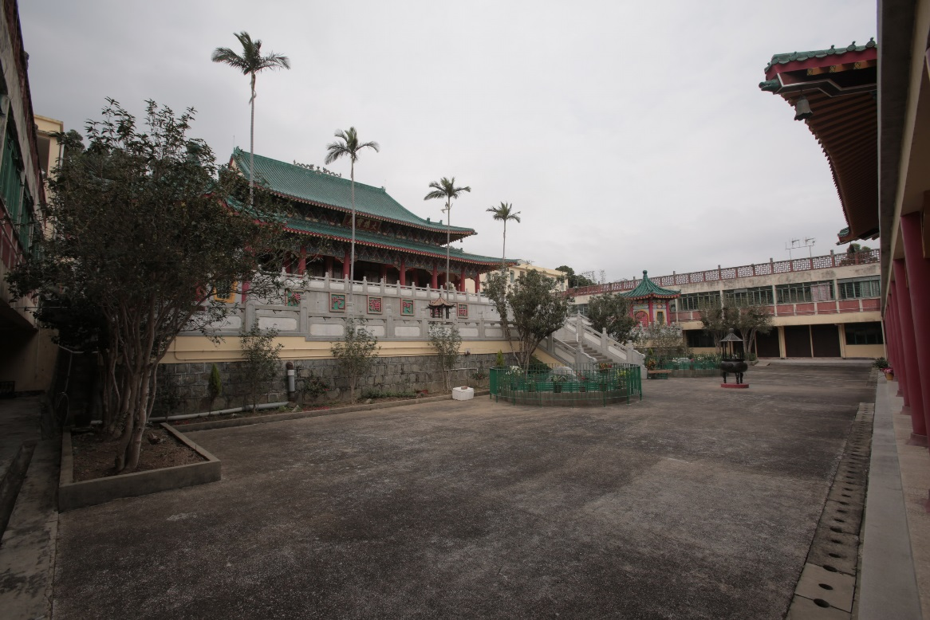
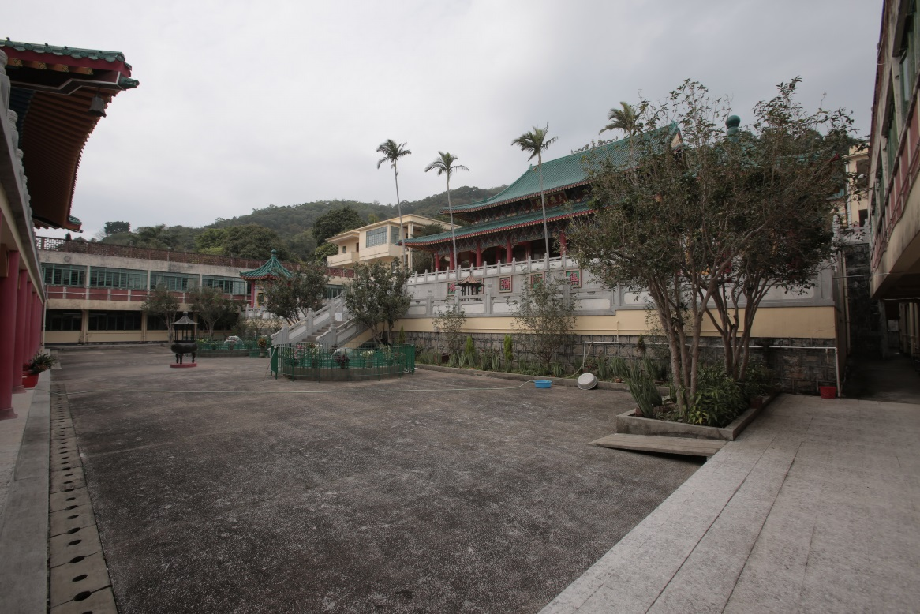
In Focus
Location:
Lo Wai Road, Tsuen Wan
Wuxia Shoot – Chuk Lam Sim Yuen

Slide 4
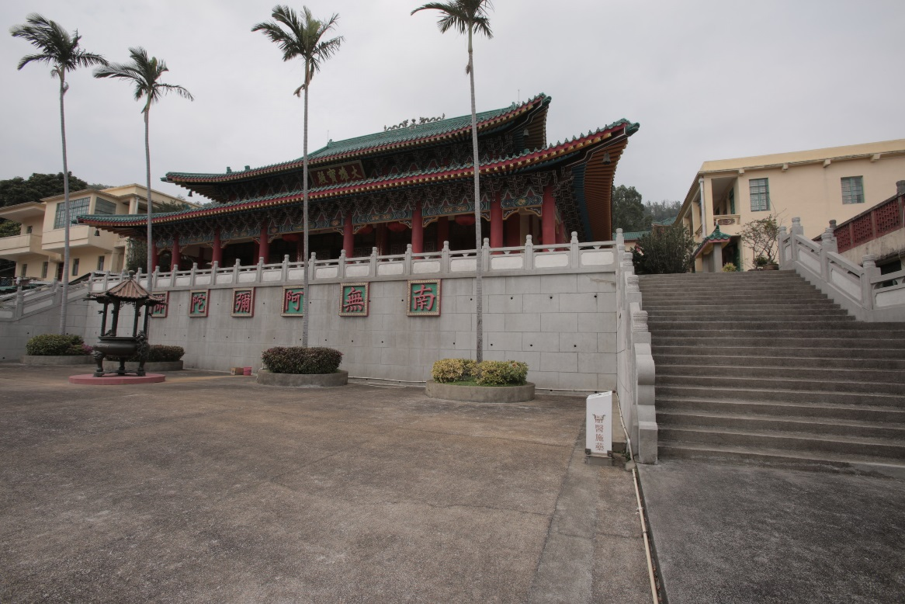
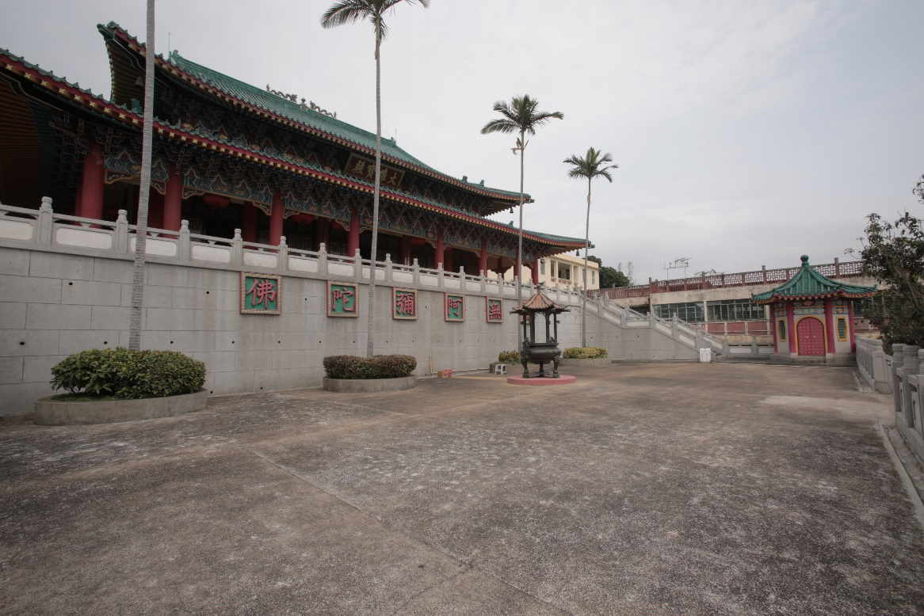
In Focus
Location:
Lo Wai Road, Tsuen Wan
Wuxia Shoot – Chuk Lam Sim Yuen

Slide 5
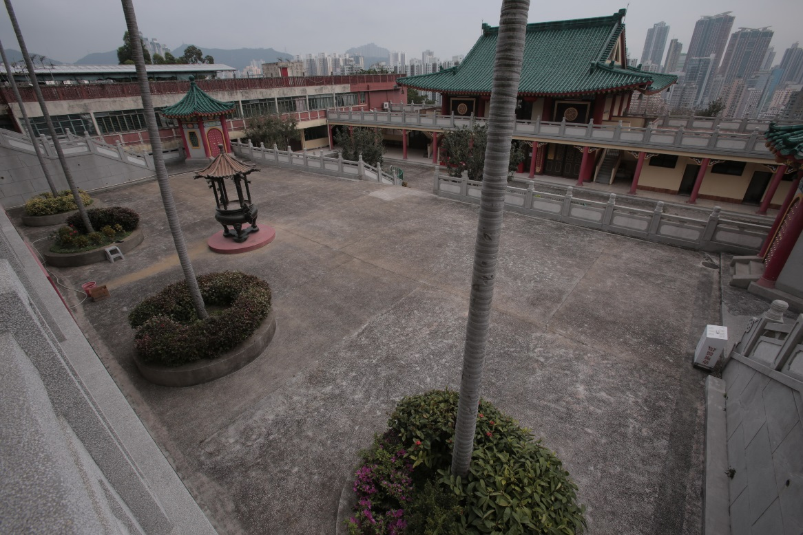
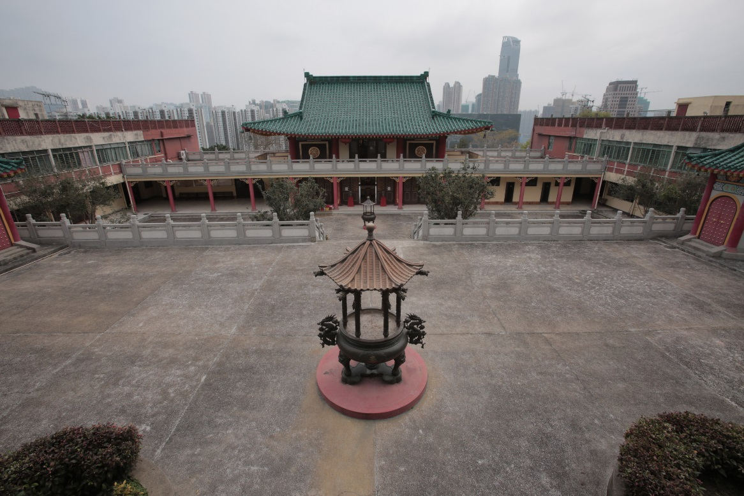
In Focus
Location:
Lo Wai Road, Tsuen Wan
Wuxia Shoot – Chuk Lam Sim Yuen

Slide 6
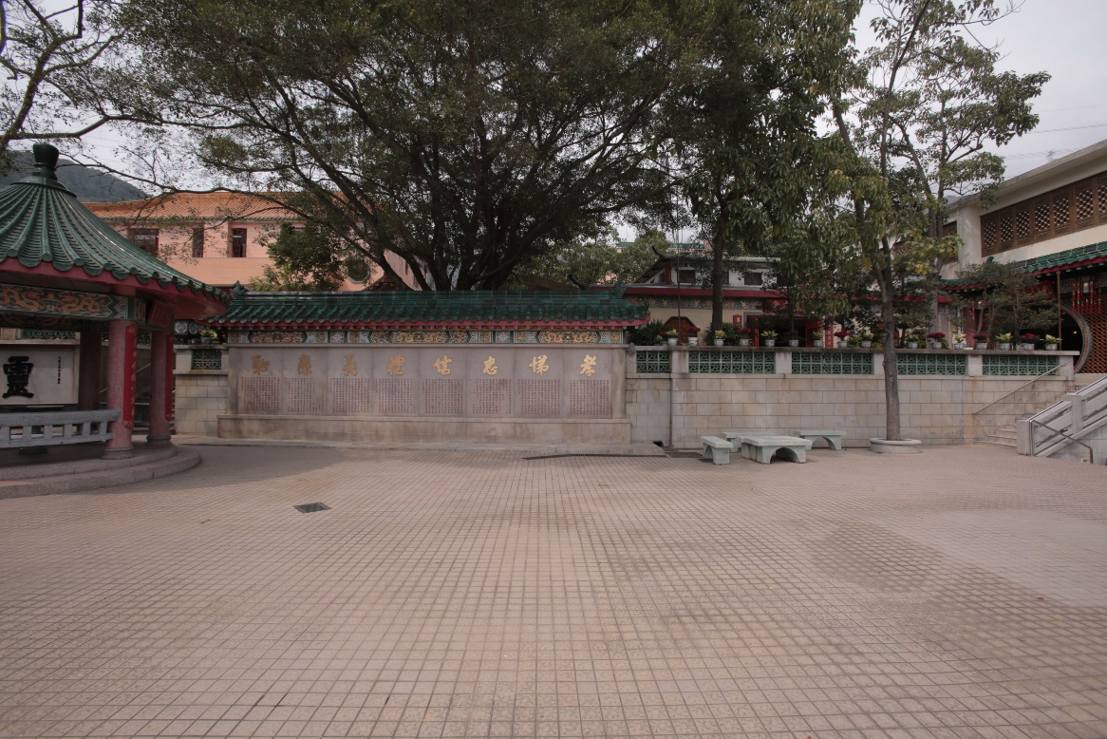
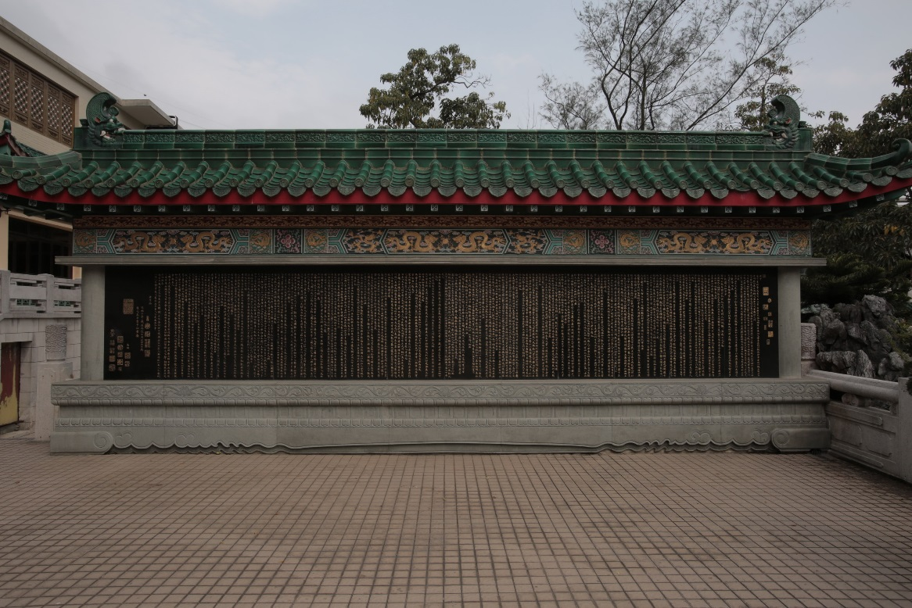
In Focus
Location:
Fu Yung Shan, Tsuen Wan
Wuxia Shoot – Yuen Yuen Institute

Slide 7
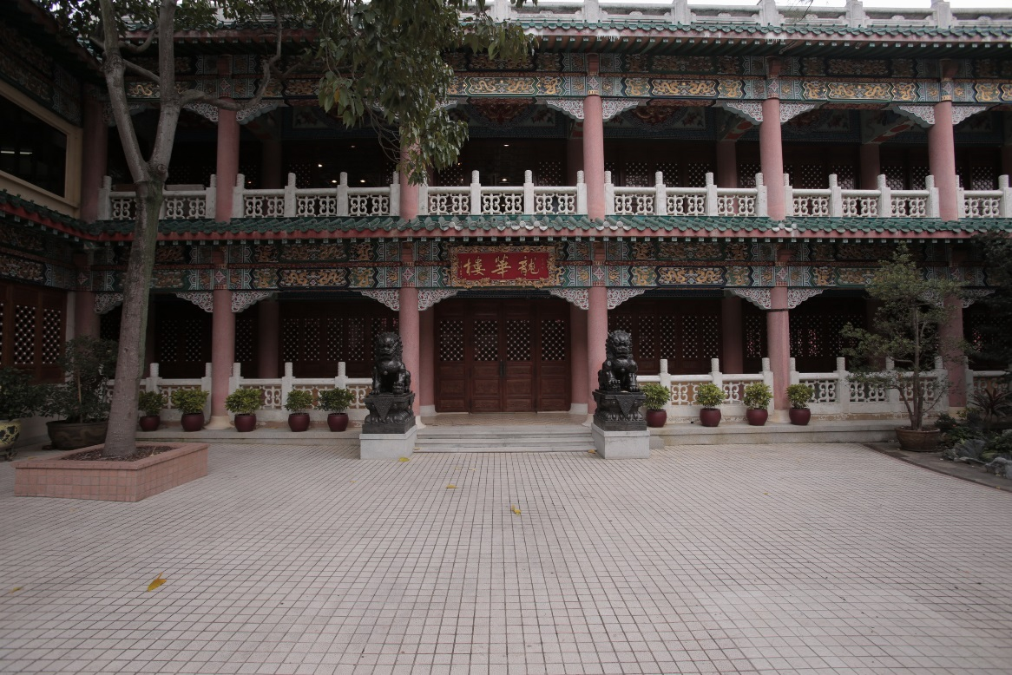
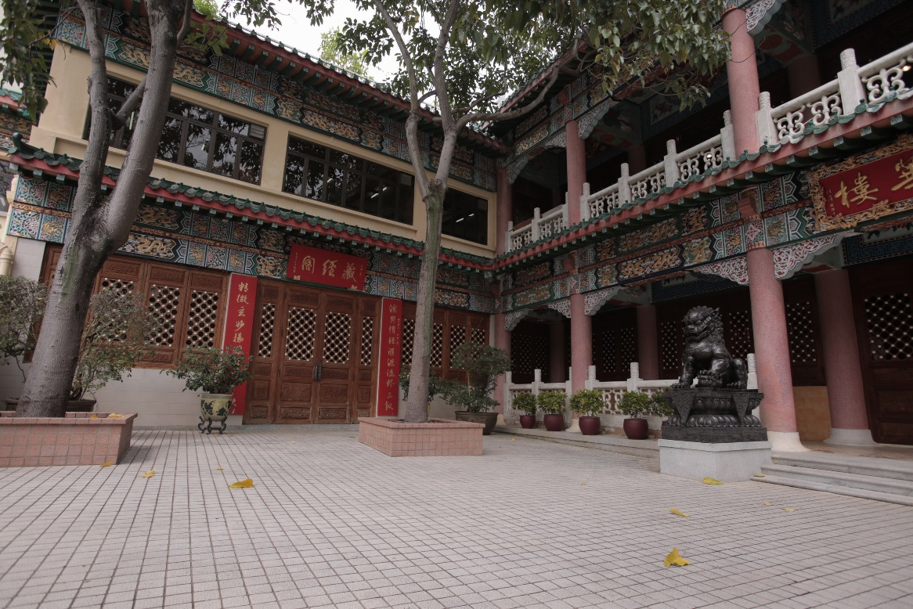
In Focus
Location:
Fu Yung Shan, Tsuen Wan
Wuxia Shoot – Yuen Yuen Institute

Slide 8
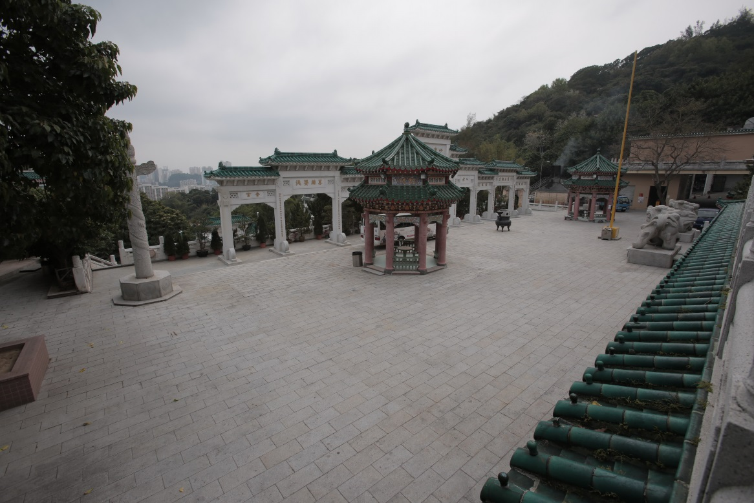
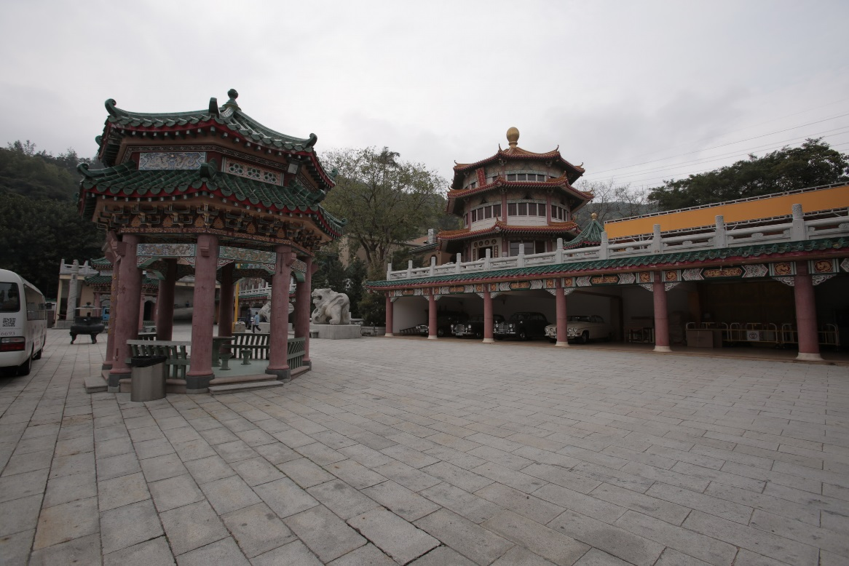
In Focus
Location:
Fu Yung Shan, Tsuen Wan
Wuxia Shoot – Yuen Yuen Institute

Slide 9
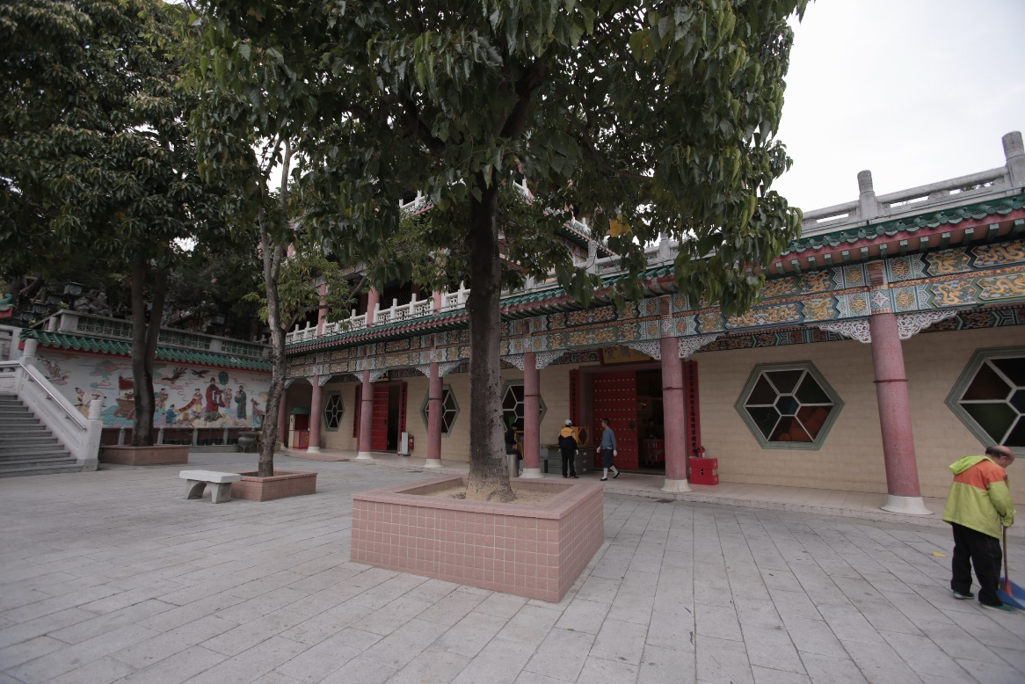
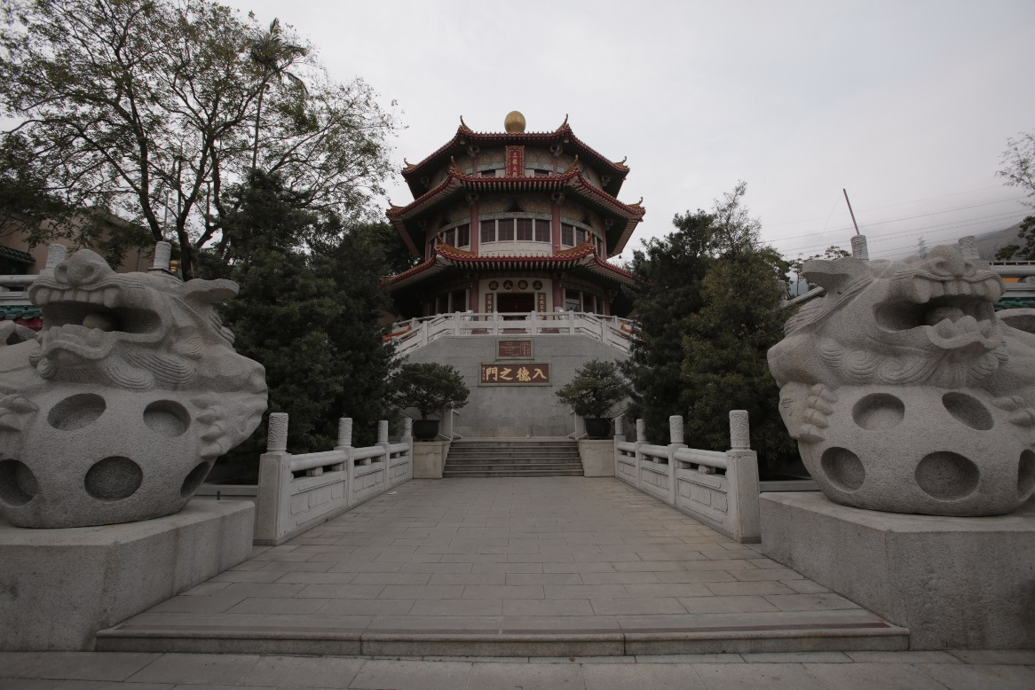
In Focus
Location:
Fu Yung Shan, Tsuen Wan
Wuxia Shoot – Yuen Yuen Institute

