Slide 1
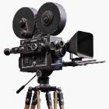
In Focus
Location

Slide 2
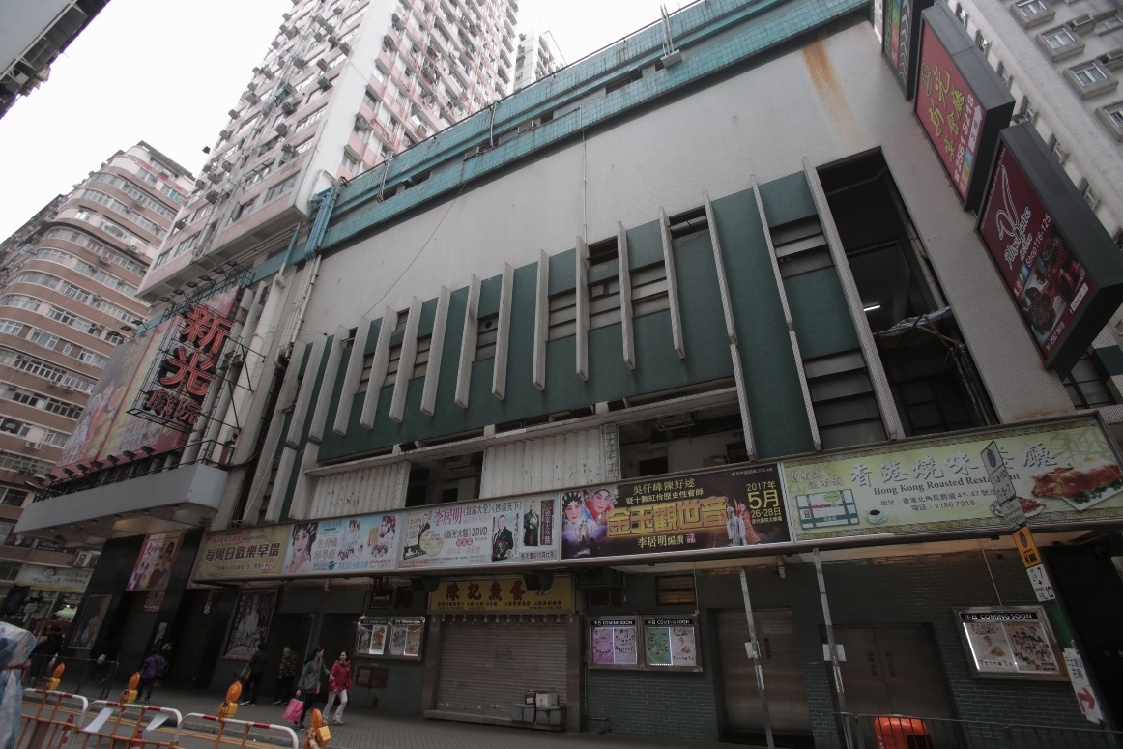
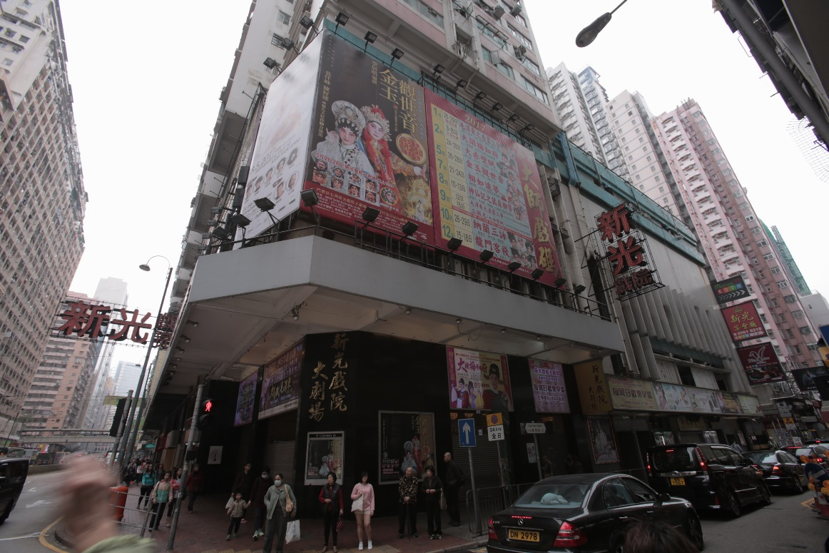
In Focus
Location:
North Point, Hong Kong
Hong Kong Theatres – Sunbeam Theatre

Slide 3
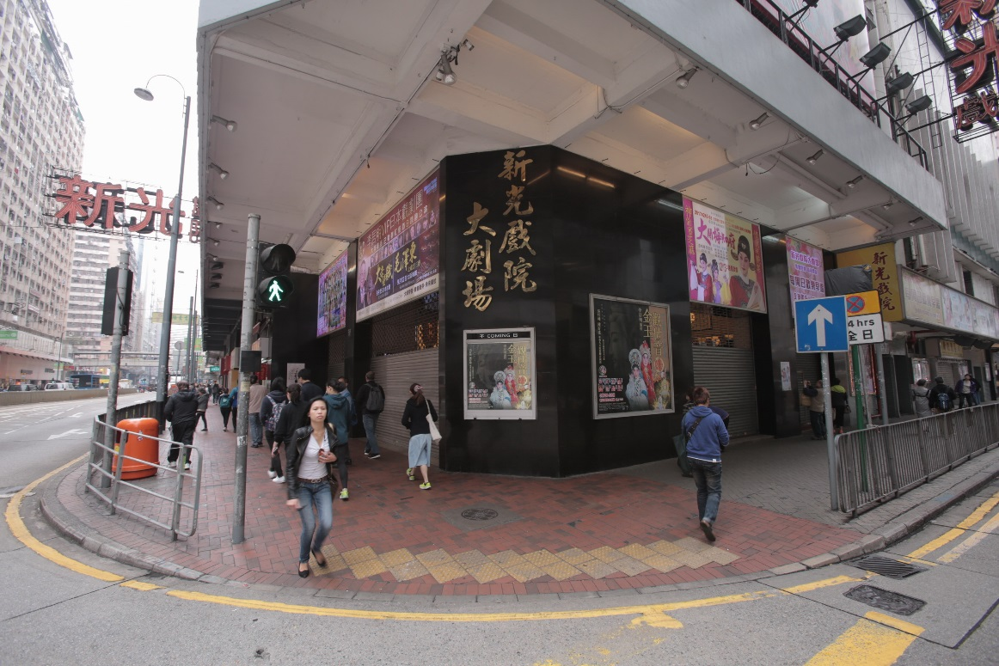
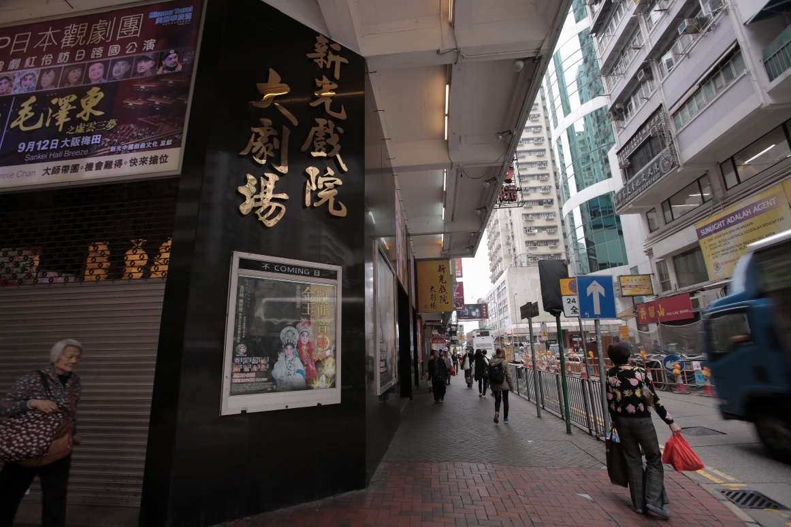
In Focus
Location:
North Point, Hong Kong
Hong Kong Theatres – Sunbeam Theatre

Slide 4
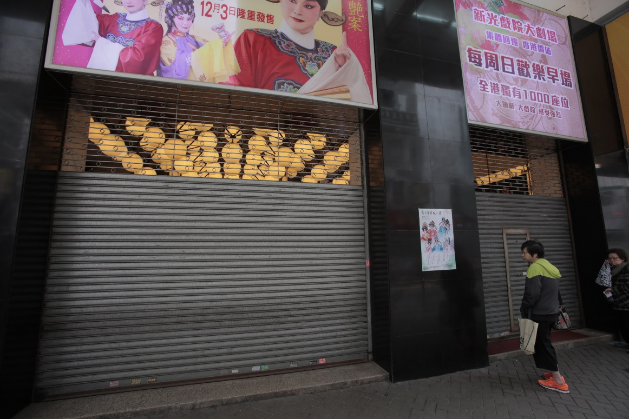
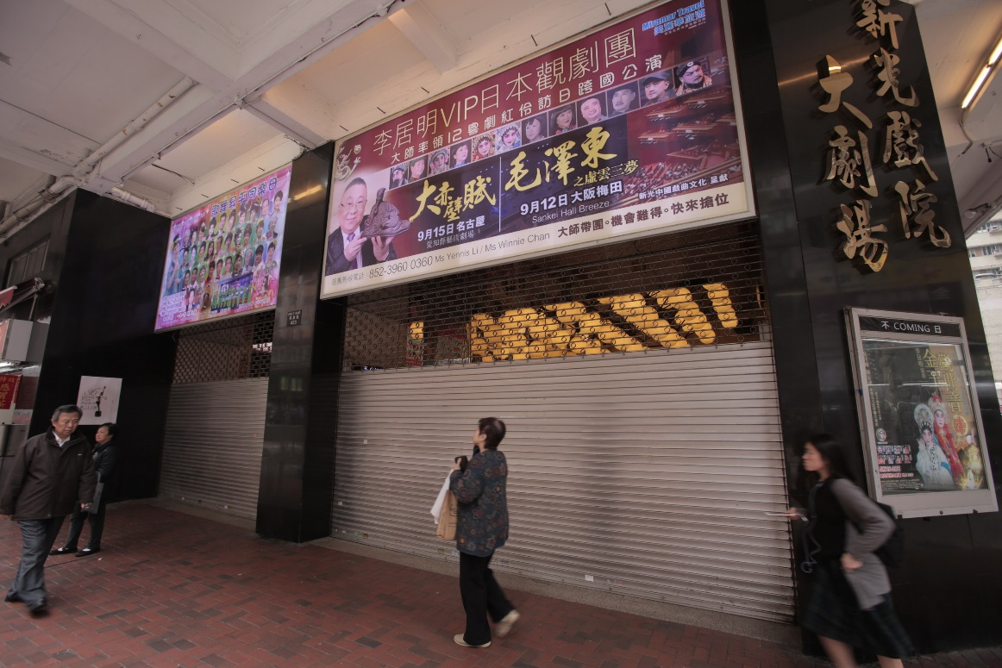
In Focus
Location:
North Point, Hong Kong
Hong Kong Theatres – Sunbeam Theatre

Slide 5
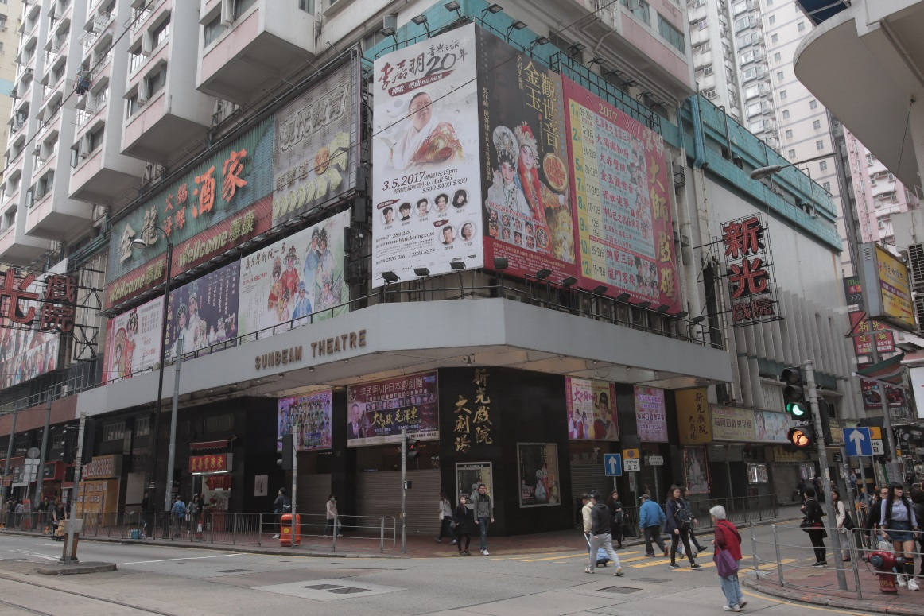
In Focus
Location:
North Point, Hong Kong
Hong Kong Theatres – Sunbeam Theatre

