Slide 1
In Focus
Location

Slide 2
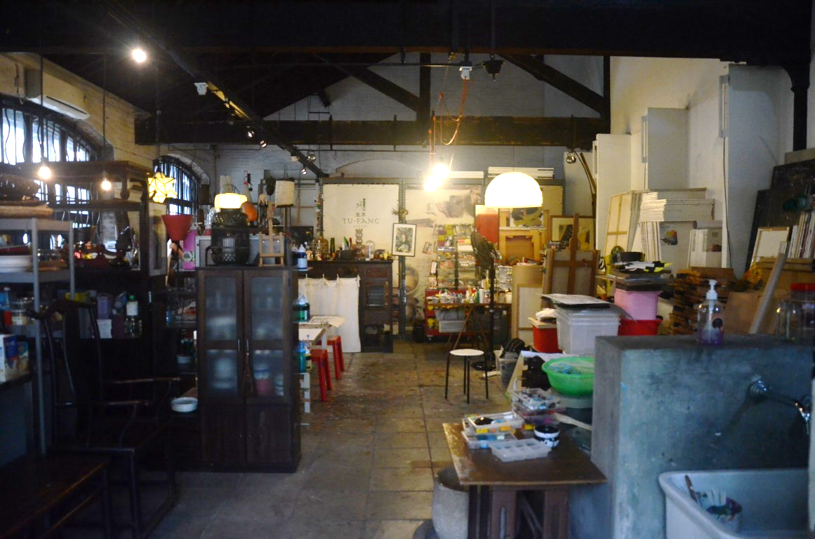
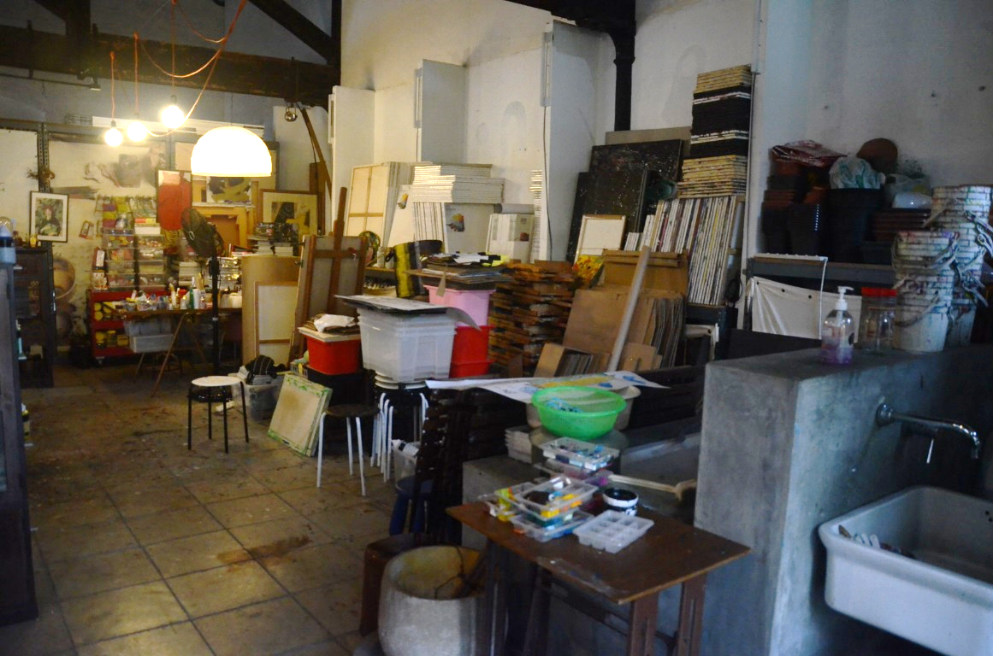
In Focus
Location:
To Kwa Wan, Kowloon
Chinese Watercolor Paintings Studio – Tu-Fang

Slide 3
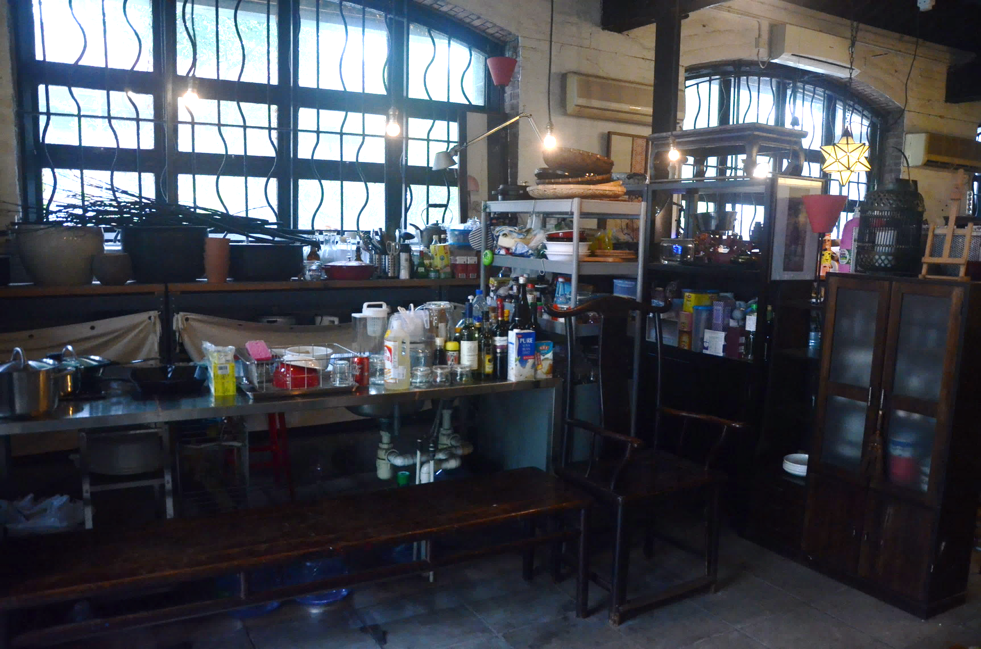
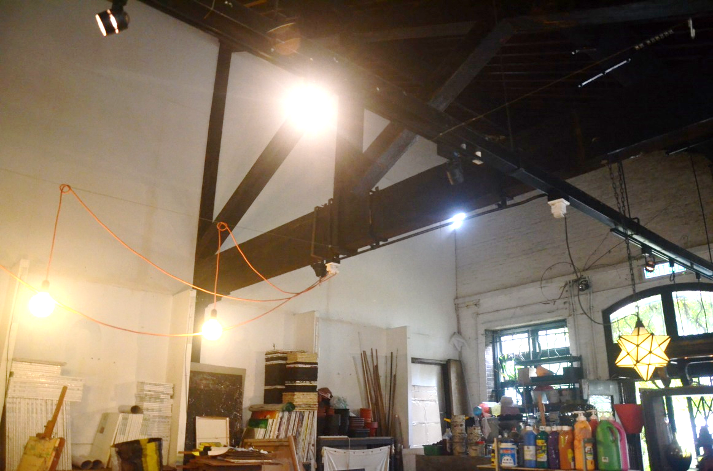
In Focus
Location:
To Kwa Wan, Kowloon
Chinese Watercolor Paintings Studio – Tu-Fang

Slide 4
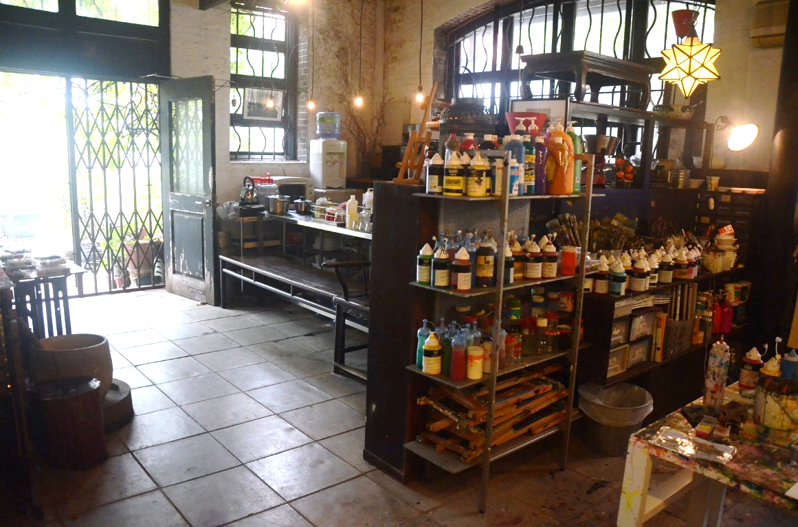
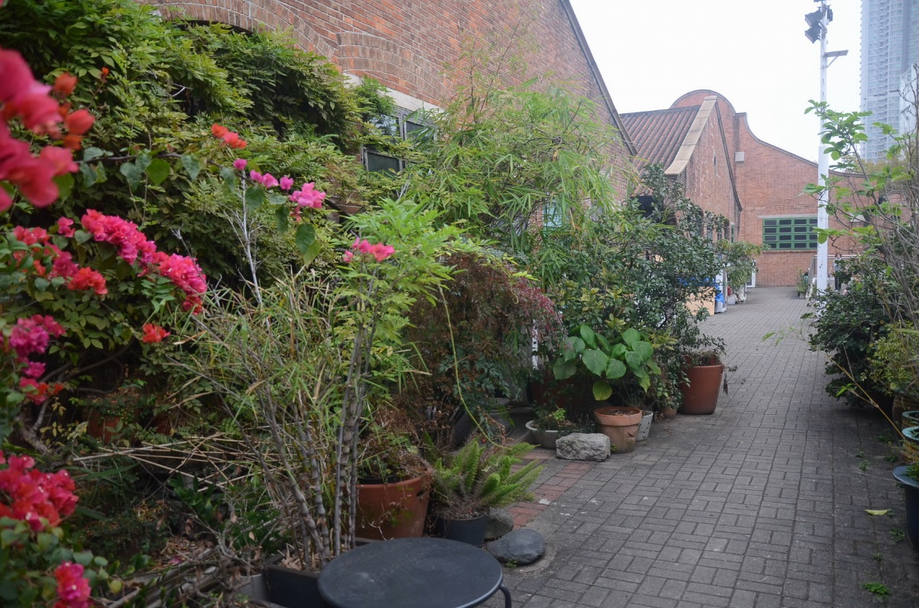
In Focus
Location:
To Kwa Wan, Kowloon
Chinese Watercolor Paintings Studio – Tu-Fang

Slide 5
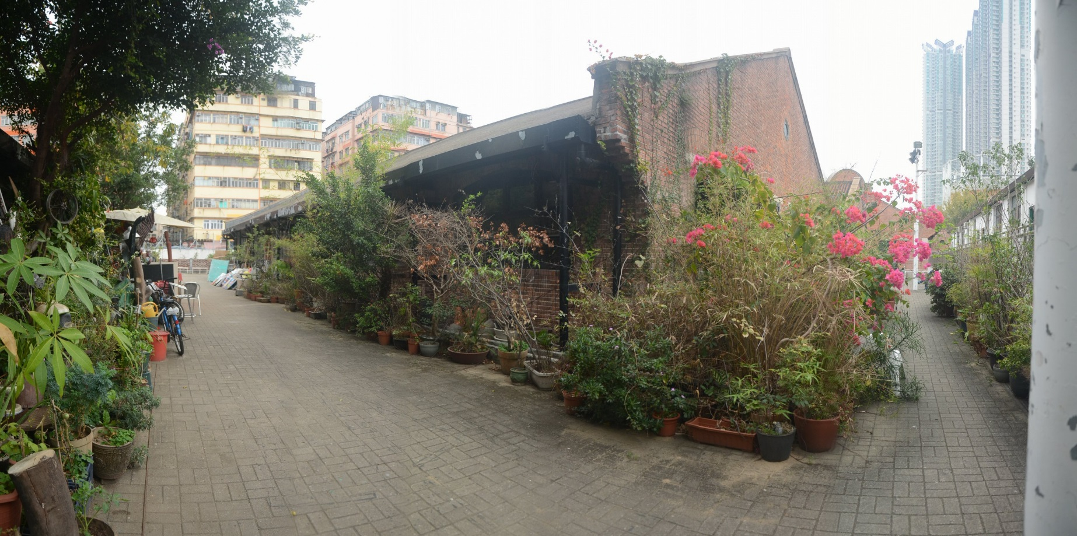
In Focus
Location:
To Kwa Wan, Kowloon
Chinese Watercolor Paintings Studio – Tu-Fang

Slide 6
In Focus
Location:
To Kwa Wan, Kowloon
Chinese Watercolor Paintings Studio – Tu-Fang

Slide 7
In Focus
Location:
To Kwa Wan, Kowloon
Chinese Watercolor Paintings Studio – Tu-Fang

Slide 8
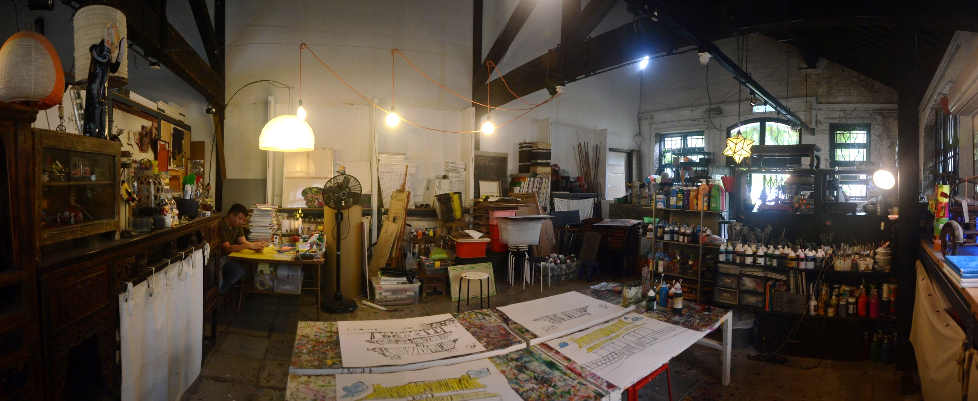
In Focus
Location:
To Kwa Wan, Kowloon
Chinese Watercolor Paintings Studio – Tu-Fang

