Slide 1
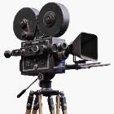
In Focus
Location

Slide 2
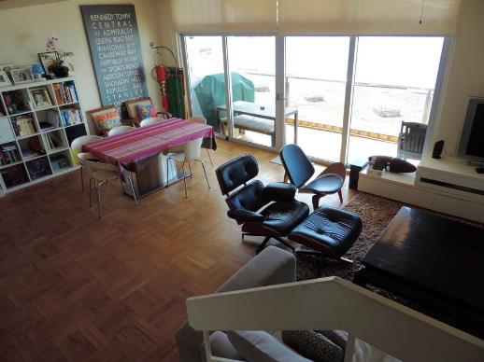
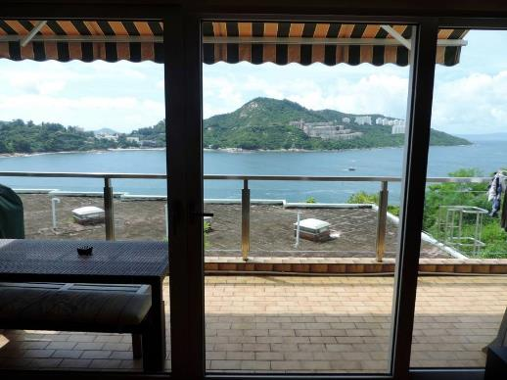
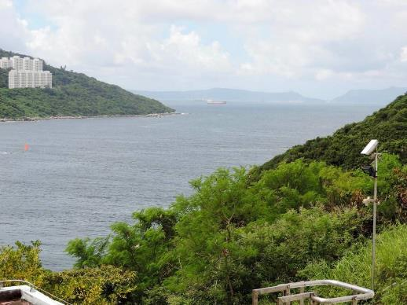
In Focus
Interview – House 2
Location:
Stanley, Hong Kong

Slide 3
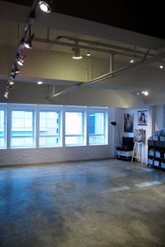
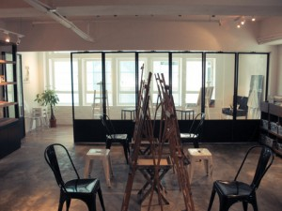
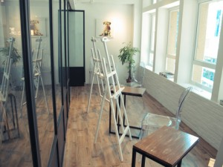
In Focus
Chinese Watercolor Paintings Studio – Studio83
Location:
Central, Hong Kong

Slide 4
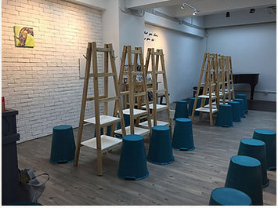
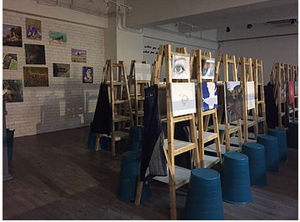
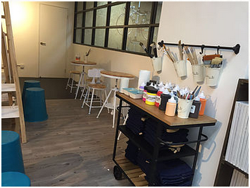
In Focus
Chinese Watercolor Paintings Studio – Platform Art
Location:
San Po Kong, Kowloon

Slide 5
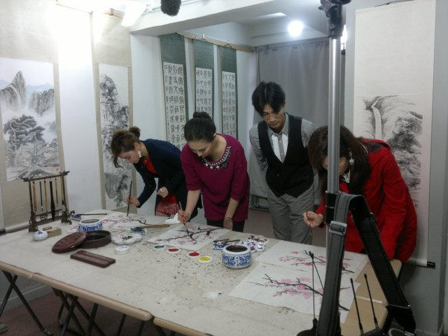
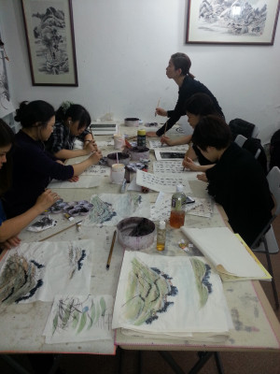
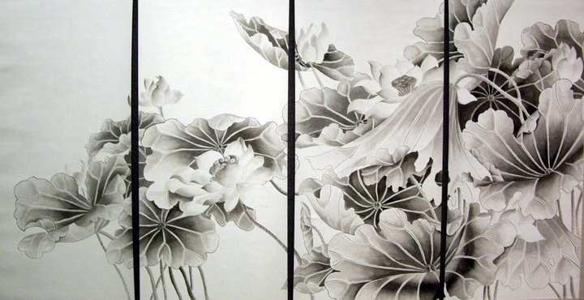
In Focus
Chinese Watercolor Paintings Studio – Aries Art Studio
Location:
Mong Kok, Kowloon

Slide 6
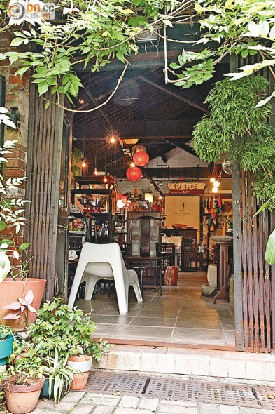
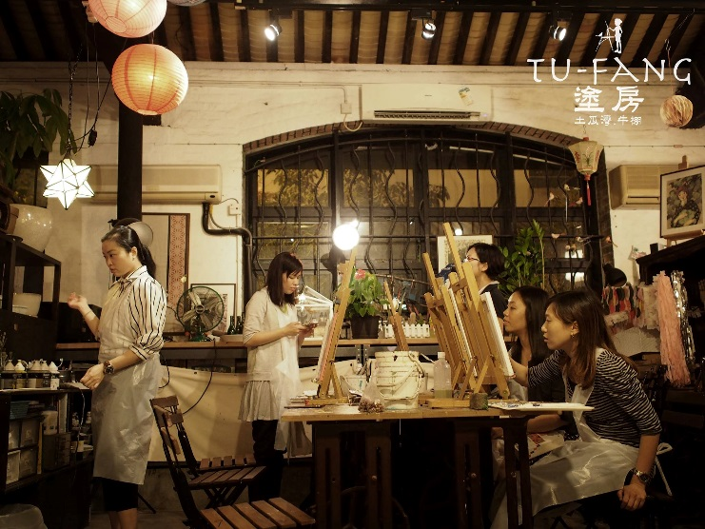
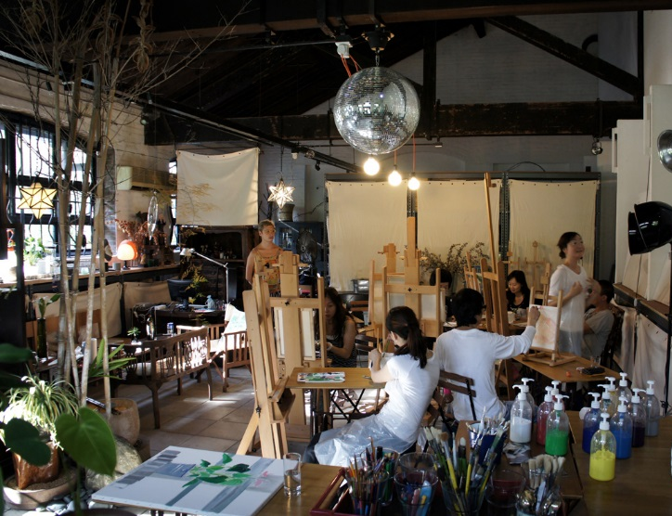
In Focus
Chinese Watercolor Paintings Studio – Tu-Fang
Location:
To Kwa Wan, Kowloon

Slide 7
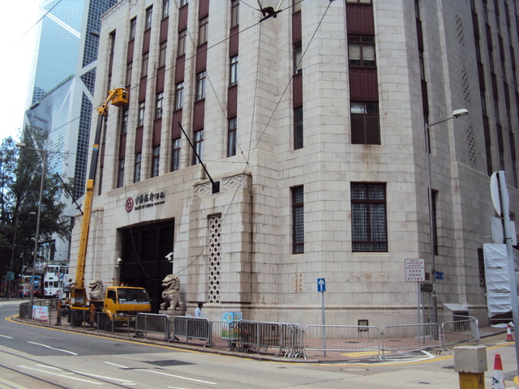
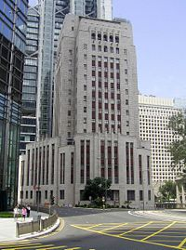
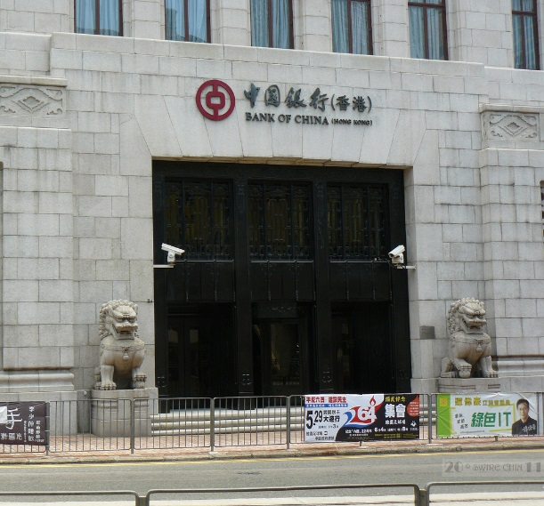
In Focus
Bank of China – Outside 1
Location:
Central, Hong Kong

Slide 8
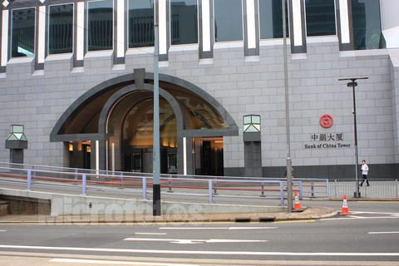
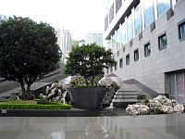
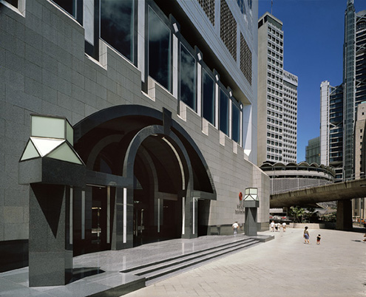
In Focus
Bank of China – Outside 2
Location:
Central, Hong Kong

Slide 9
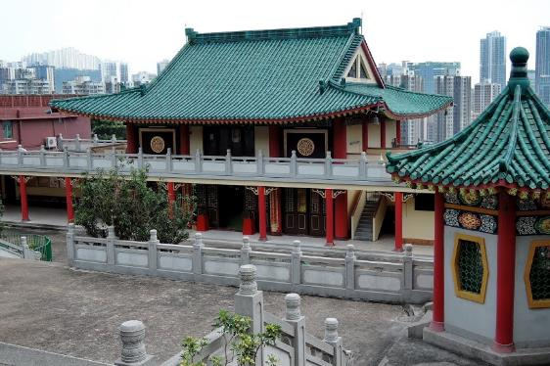
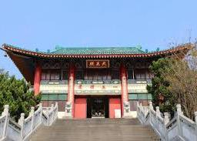
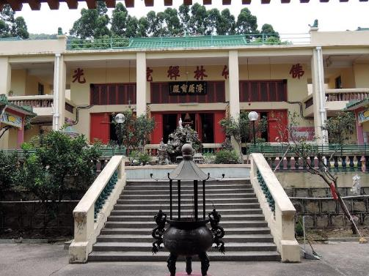
In Focus
Wuxia Shoot – Chuk Lam Sim Yuen
Location:
Fu Yung Shan, Tsuen Wan

Slide 10
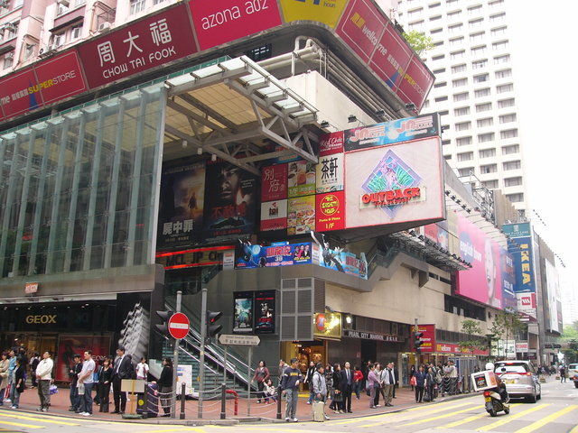
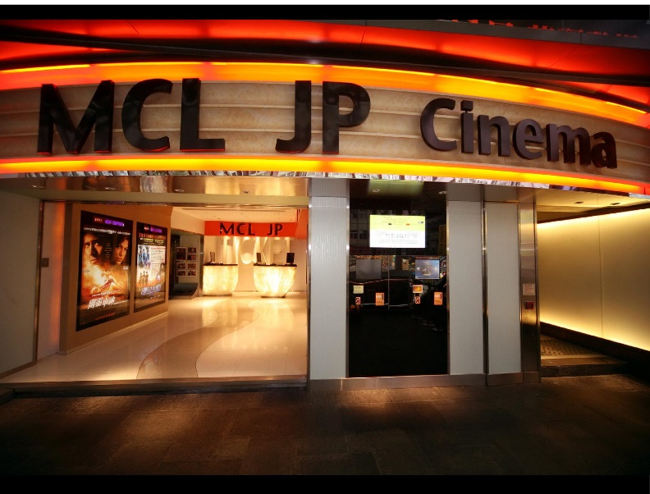
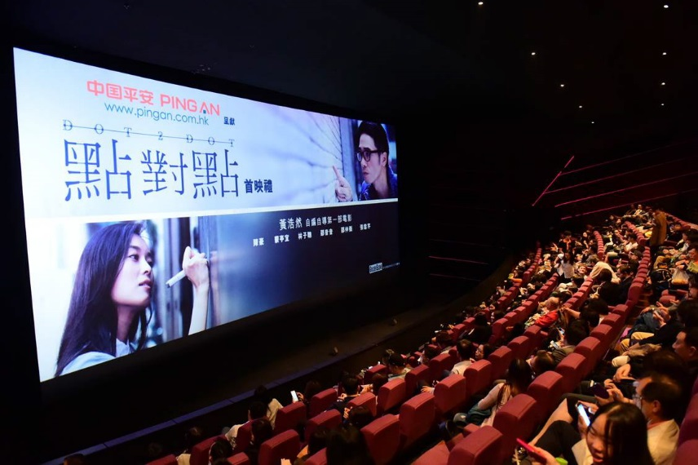
In Focus
Hong Kong Theatres – MCL JP
History:
Jade & Pearl was first established in 1969 and 1971, MCL took over it from 1999 till now.
House Size:
House 1 – 380 seat , House 2 – 278 seat
Address:
JP Plaza, 22-36 Paterson Street, Causeway Bay, Hong Kong

Slide 11
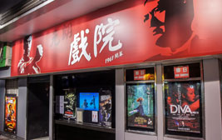
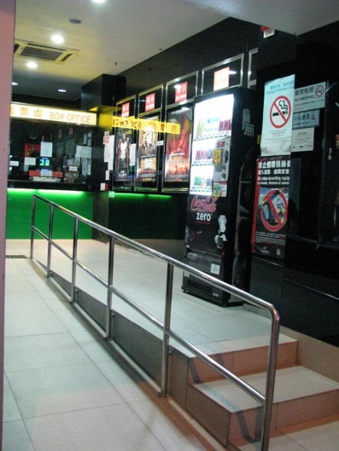
In Focus
Hong Kong Theatres – Yuen Long Cinema
History:
Yuen Long Cinema was first established in 1961, reconstruct in 2008.
House Size:
House 1 – 130 seat , House 2 – 138 seat , House 3 – 52 seat
Address:
8 Pau Cheung Square, Yuen Long, N.T

Slide 12
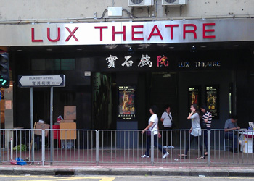
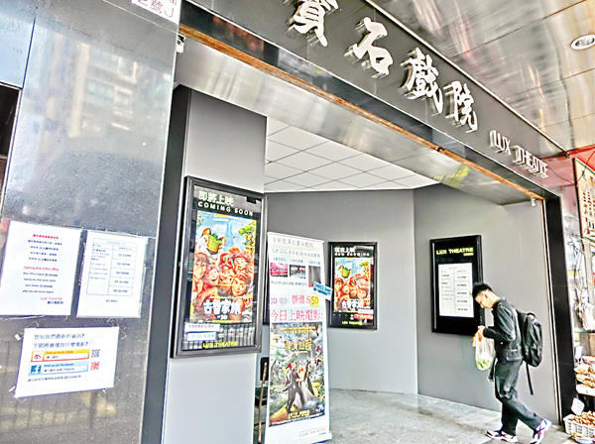
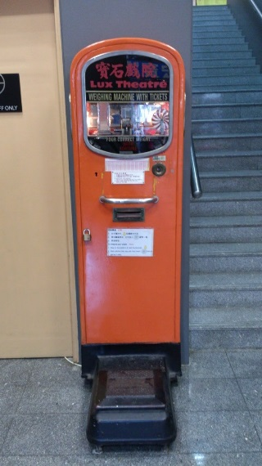
In Focus
Hong Kong Theatres – Lux Theatre
History:
Lux Theatre was first established in 1970 , reconstruct in 2012.
House Size:
House 1 – 363 seat
Address:
2J Bulkeley Street, Hung Hom, Kowloon

Slide 13
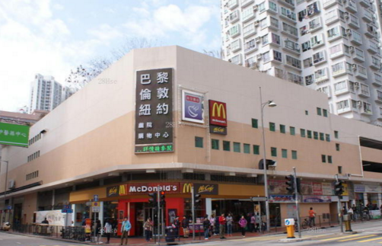
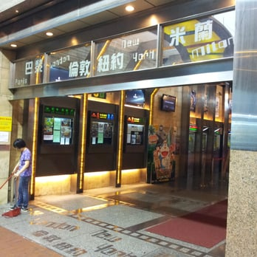
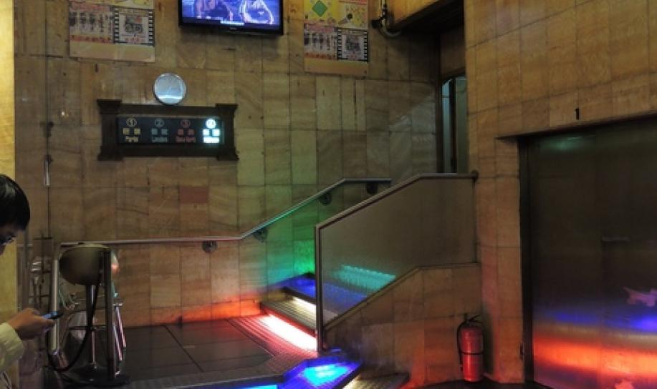
In Focus
Hong Kong Theatres – Paris London New York Milano Cinema
History:
Paris London New York Milano Cinema was first established in late 80’s.
House Size:
House 1 – 258 seat , House 2 – 258 seat , House 3 – 265 seat , House 4 – 265 seat
Address:
Hong Lai Garden, Ho Pong Street, TMTL 280, Tuen Mun, N.T.

Slide 14
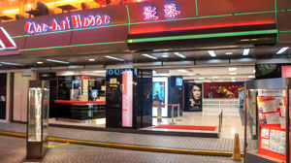
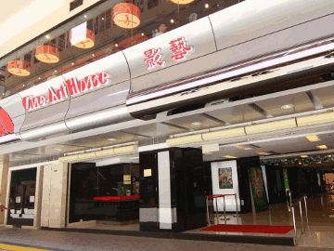
In Focus
Hong Kong Theatres – Cine-Art House
History:
Amoy Theatre was first established in 1987 , Cine-Art House took over it from 2009 till now.
House Size:
House 1 – 199 seat , House 2 – 243 seat , House 3 – 254 seat
Address:
G278-280 & 283, G/F, Amoy Plaza, Amoy Gardens, 77 Ngau Tau Kok Road, Ngau Tau Kok, Kowloon

Slide 15
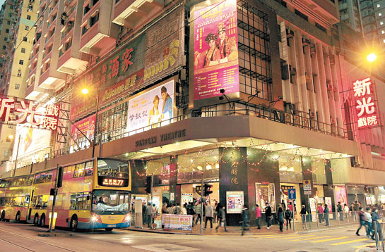
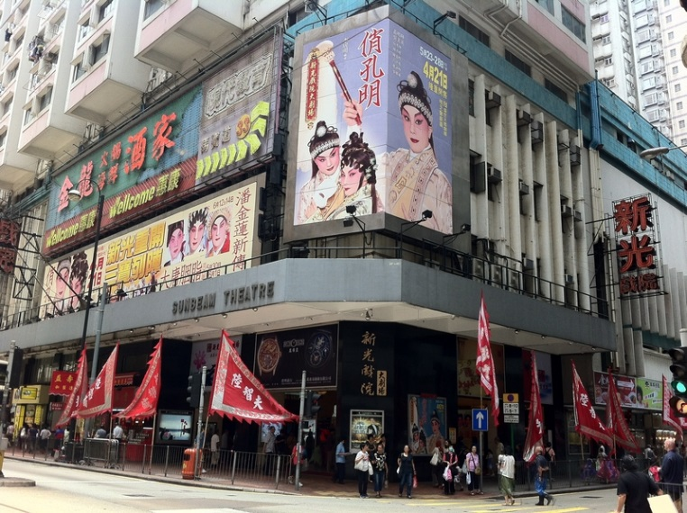
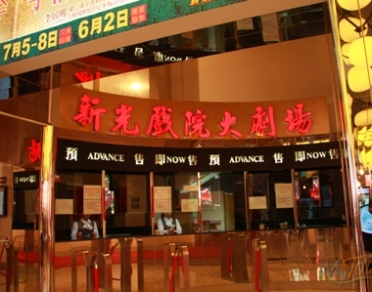
In Focus
Hong Kong Theatres – Sunbeam Theatre
History:
Sunbeam Theatre was first established in 1972 , reconstruct in 2012.
House Size:
House 1 – 1033 seat , House 2 – 340 seat
Address:
423 King's Road, North Point

Slide 16
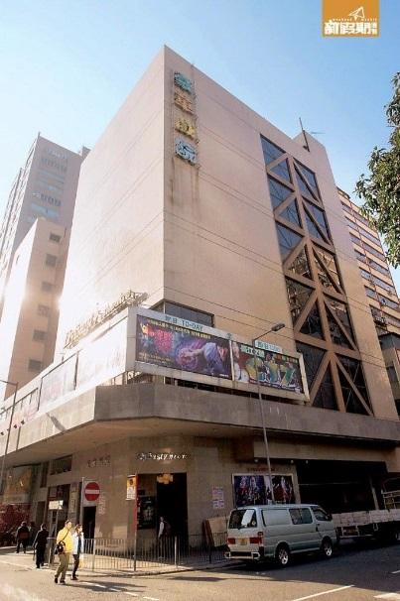
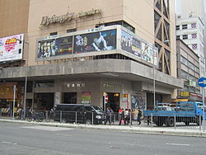
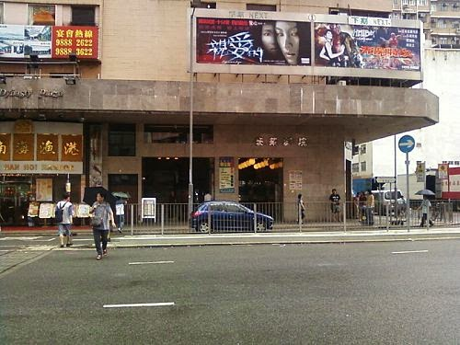
In Focus
Hong Kong Theatres – Dynasty Theatre
History:
Sunbeam Theatre was first established in 1991
House Size:
House 1 – 382 seat , House 2 – 186 seat , House 3 – 144 seat
Address:
4-4A Mongkok Road, Kowloon

