Slide 1
Salon Live Production Flypack
V3 1.10.18

Slide 2
INTRODUCTION
SALON 4K Live Production system

Slide 3
Salon 4K Live production
INTRODUCTION
Salon Films has always boast itself for owning the best and broadest range of
equipment, facilities and professionals involving in all stages of production.
Salon Films has spent a considerable effort in advancing the development of filming
system in the Pan-Asian content industry and introducing state-of-the-art technologies into the filmmaking process. On top, Salon has ventured in new 4K Live production
OB system.
The SALON 4K Live FLYPACK offers sophisticated, scalable video production environment,
using broadcast quality standards, at an affordable Price.

Slide 4
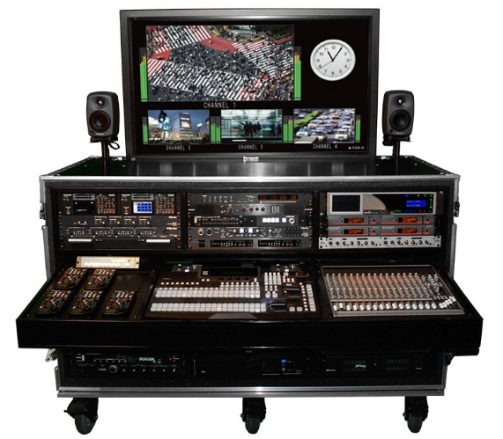
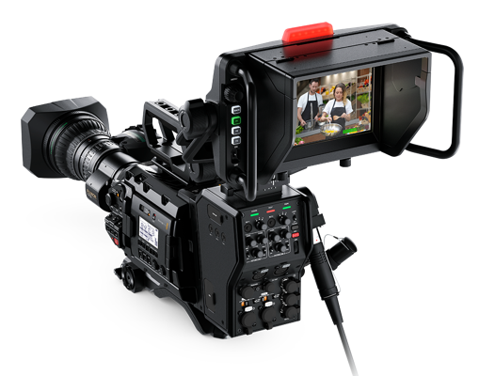
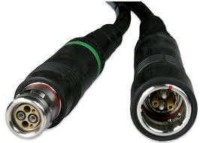
Salon 4K Live production
Specialities
Black magic URSA Broadcast cameras with single cable
Fiber converter and Studio
Viewfinder
Integrated
Flypack Sytem
SMPTE Fiber optic
cable up to 2KM

Slide 5
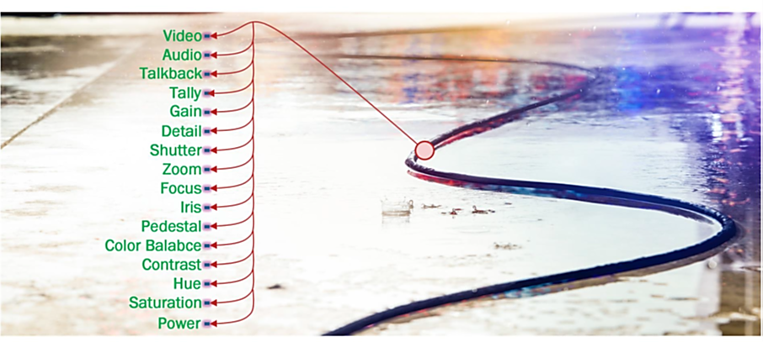
Salon 4K Live production
Specialities
Single Fiber Optic cable
Cameras + camera controls and Communication device are connected with single SMPTE Fiber optic cables.

Slide 6
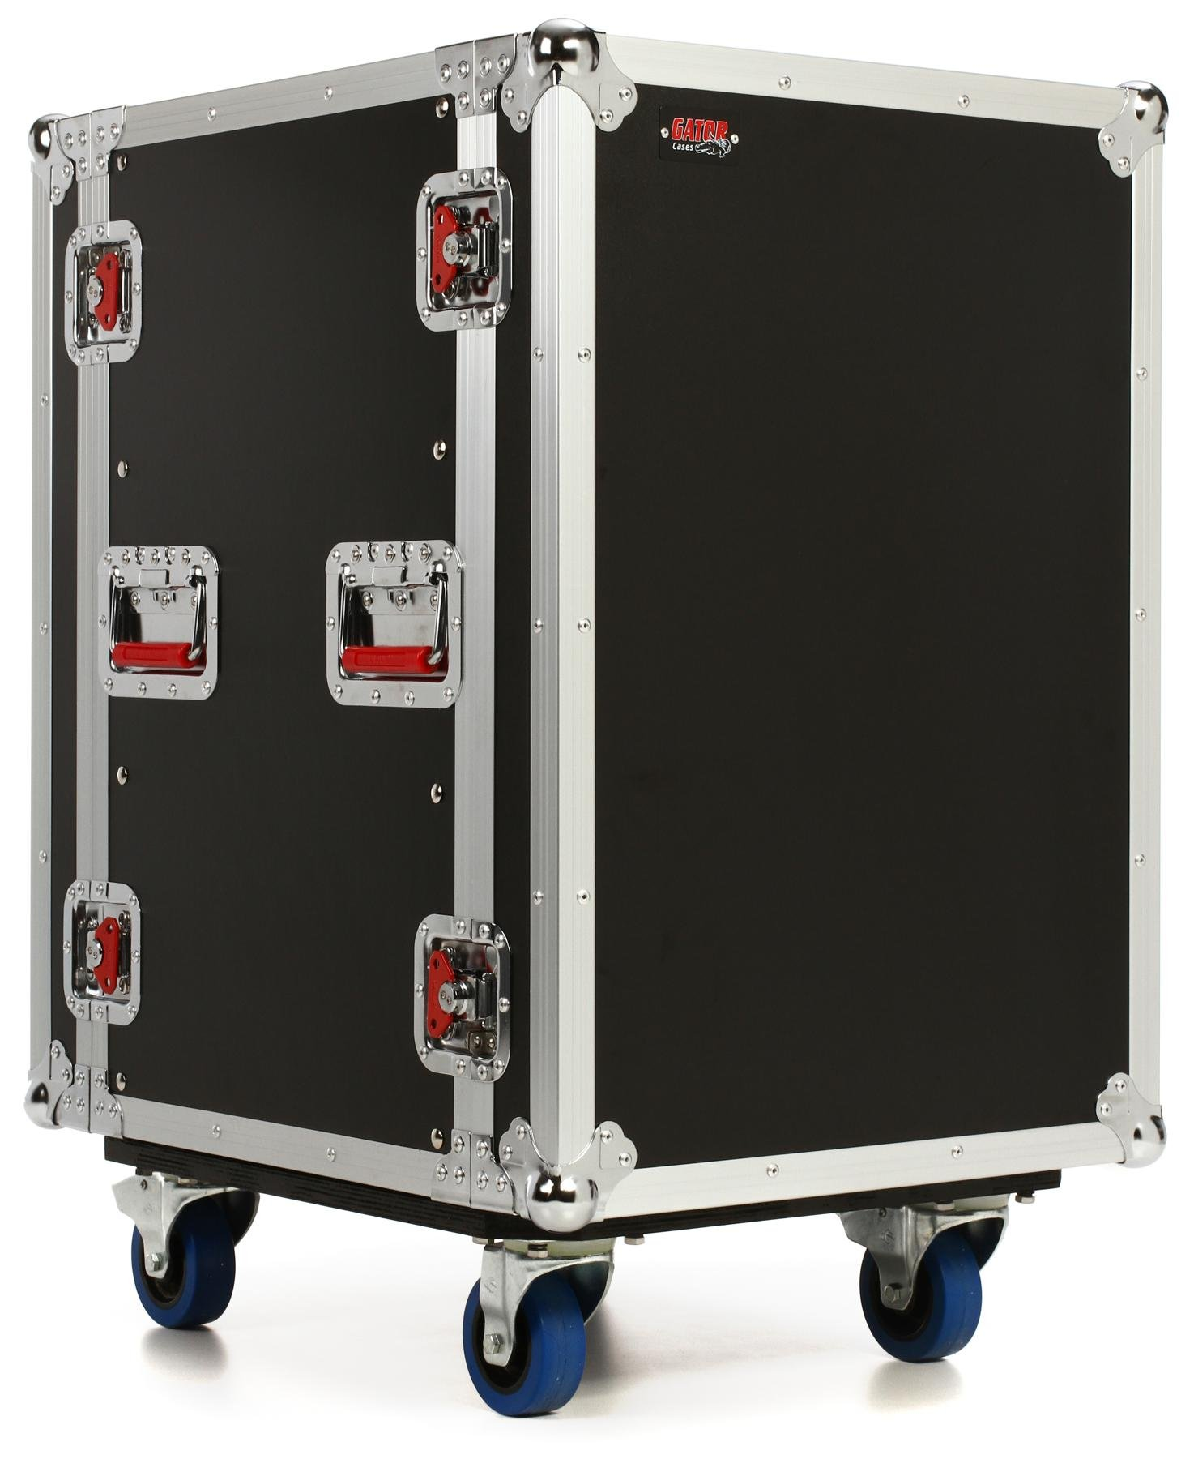
Salon 4K Live production
Specialities
PORTABILITY
Easily movable to any locations which cannot reached by huge live broadcast system.
The whole system together with camera fits in only cases.

Slide 7
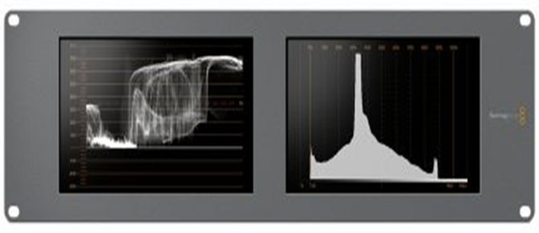
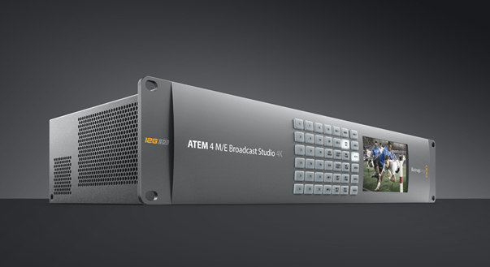
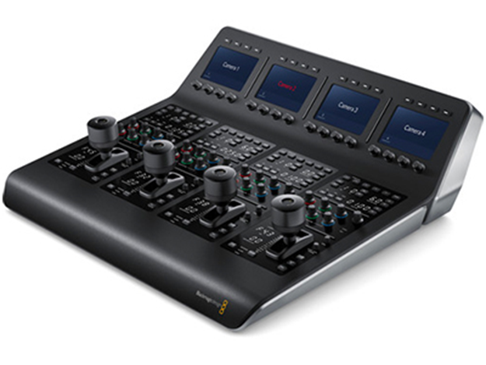
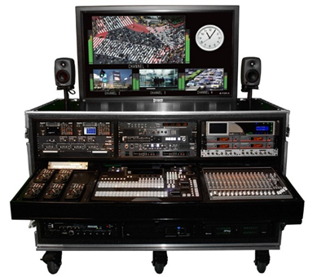
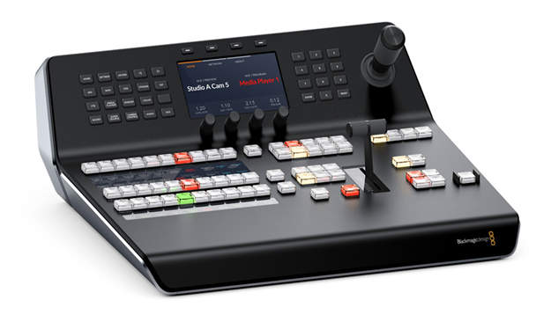
Salon 4K Live production
Specialities
INTERGRATED HARDWARE
Integrated with advanced live production switchers system and other essential hardware.
.

Slide 8
INTERGRATED HARDWARES
In FLYPACK

Slide 9
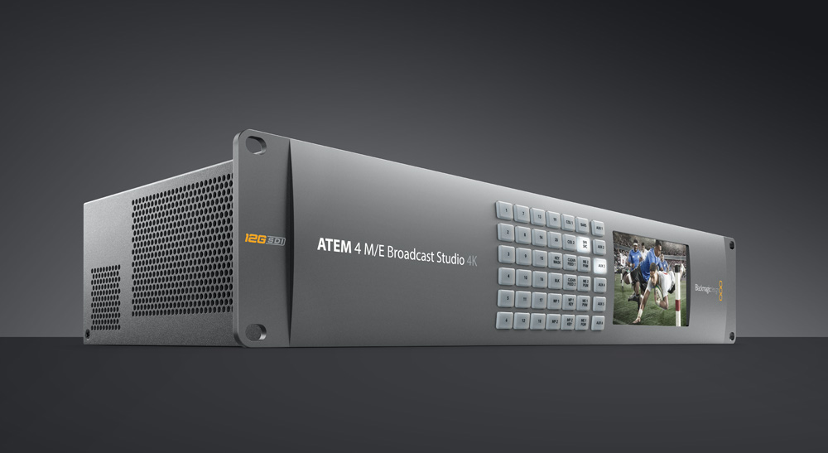
Black magic 4M/E Broadcast Studio Mixer
20-Input 12G 4K Switcher with 4 mix/effects
Incredibly high performance live production switcher
latest formats and high frame rates,
all the way up to Ultra HD 2160p59.94
ATEM Advanced Chroma Keyer
2 Ultra HD multi viewers, full 2D DVE, built in Super Source compositing engine with 4 picture in picture DVEs

Slide 10
Black magic 4M/E Broadcast Studio Mixer
20-Input 12G 4K Switcher with 4 mix/effects
Inputs
ATEM Broadcast Studio 4K model features 20 12G-SDI inputs for working in HD and Ultra HD up to 2160p60.
Every input supports embedded audio mixing and features a
frame resynchronizer
2 balanced XLR audio inputs for connecting professional mixers
Outputs
Record video master and to broadcast the program to the
audience at the event
ATEM includes program and down converted program outputs plus auxiliary outputs allowing clean feeds, perfect for
connecting to giant outdoor LED screens, projectors, disk
recorders, monitors and broadcast decks
Balanced XLR output of your audio mix, which is also
embedded into all video outputs.

Slide 11
Black magic 1M/E Advance Panel
Advanced Control Panel for ATEM Switchers
High quality curved buttons that help reduce
incorrect key presses
Professional joystick for DVE and camera
adjustments
Smooth weighted T‑bar fader
Shift buttons allow you to double up the number of
inputs by selecting a second set of shifted source
buttons so you can control up to 20 inputs

Slide 12
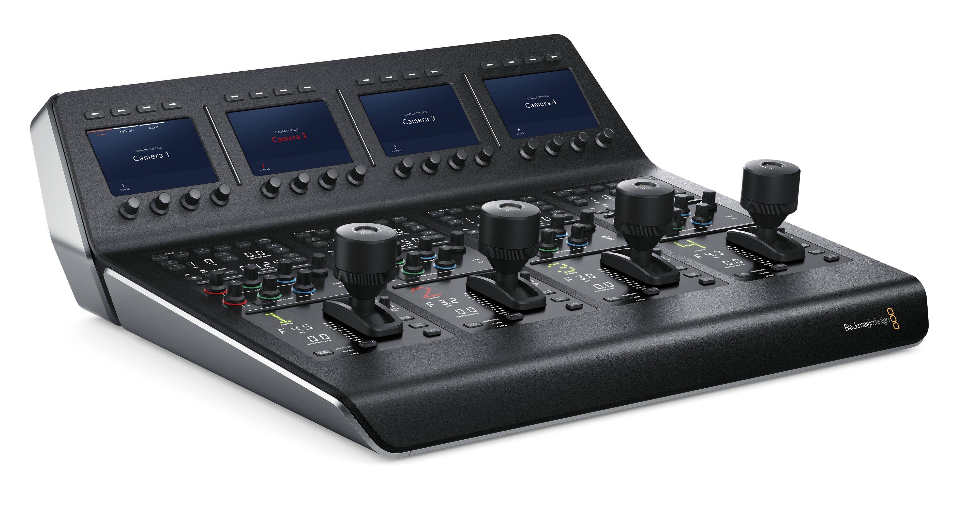
ATEM Camera Control Panel
Remotely control four cameras, all from a single control panel
Control up to 4 cameras at one time including
iris, shutter speed, white balance, master gain
pedestal, RGB and more.

Slide 13
Hyper Deck Studio 12G
Rack Mounted HD-SDI SSD Disc Recorder 12G 4K
HyperDeck Studio disk recorders let you record the highest quality uncompressed or compressed
ProRes and DNxHD video formats using fast 2.5“
SSDs
Designed with familiar VTR controls, HyperDeck
Studio includes innovative features that extend
beyond the capabilities of traditional decks.
Dual SSD slots let you record continuously,
so when one disk is full recording automatically
continues on the next SSD. You can mount an SSD
recorded from HyperDeck Studio on any computer
to access your files and now can work with media
directly without copying the files

Slide 14
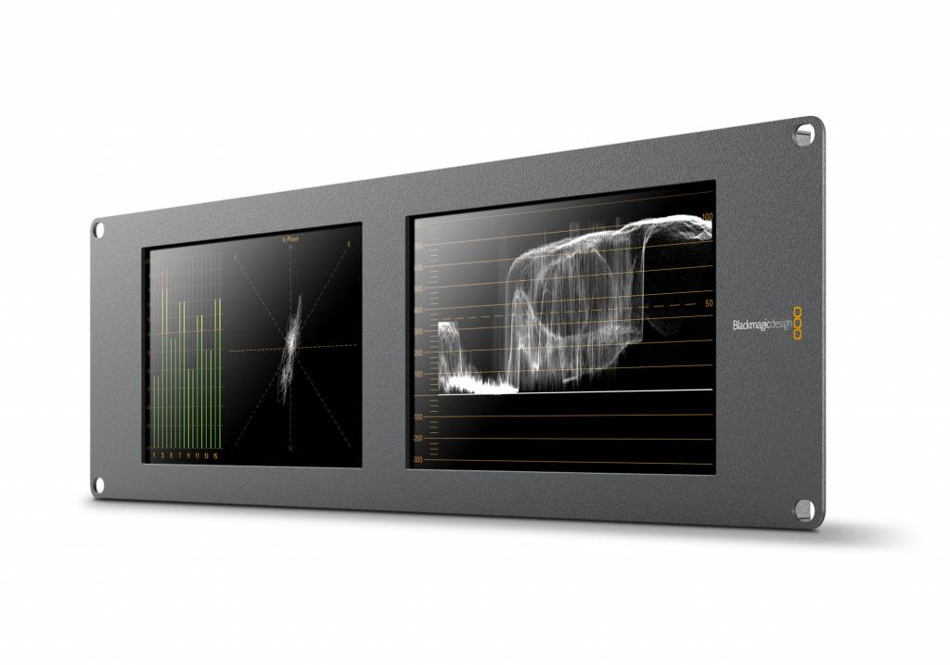
BLACKMAGIC SMART SCOPE DUO
Persistence picture monitoring
Black Magic Smart Scope Duo 4K is to check the persistence of the camera brightness, Black level, and colour.

Slide 15
MULTI CHANNEL INTERCOM
COMUNICATION
A multi channel intercom lets the director and
cameraman be on one channel while the stage
lighting and sound crew uses another channels without interruptions

Slide 16
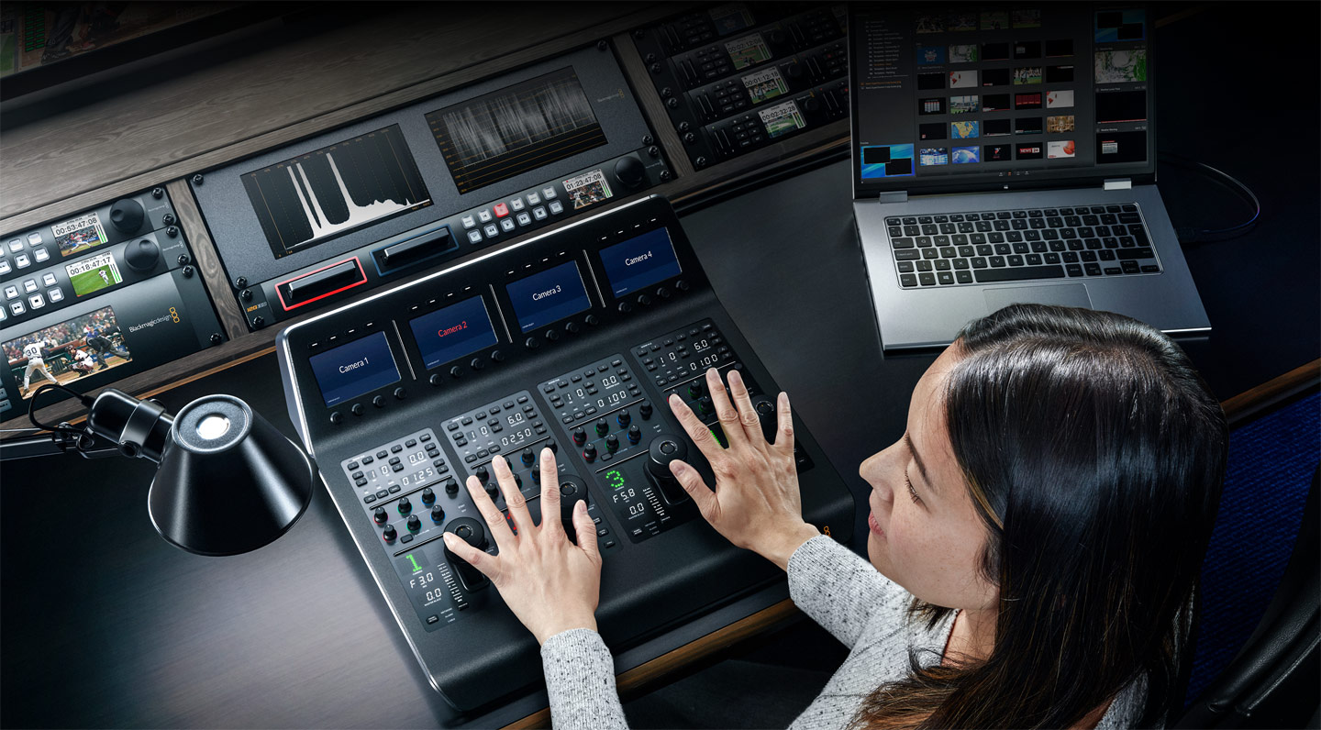
Salon 4K Live production
Specialities
FAST SET UP
Whole set up only takes less than 30 minutes.
All Cables in the flypack are pre wired, only need to connect the fiber cable and power up.

Slide 17
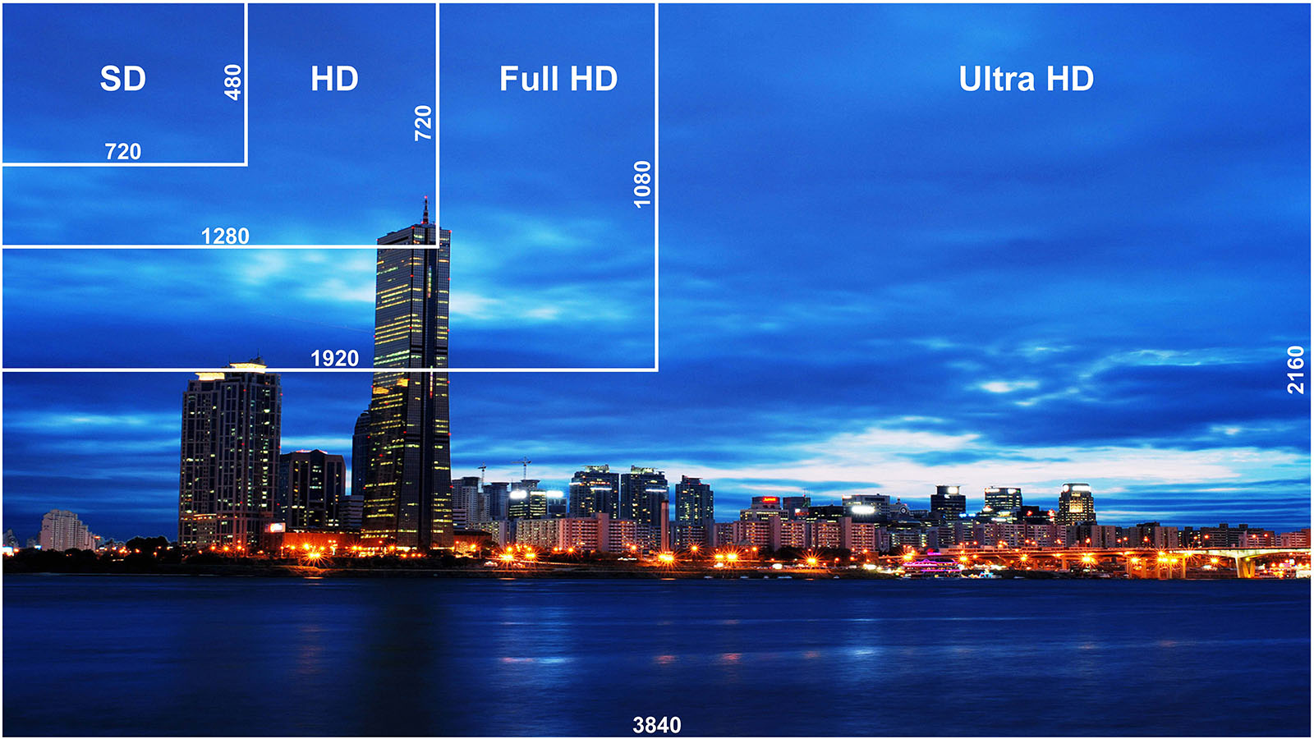
Salon 4K Live production
Specialities
LIVE HD - 4K
HD up to 4K UHD

Slide 18
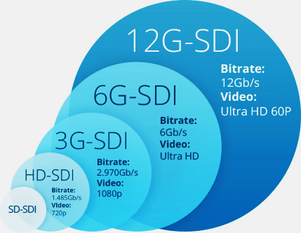
Salon 4K Live production
Specialities
12G – SDI capabilities
12G SDI input and outputs for
High Quality 4K UHD Images

Slide 19
APPLICATIONS

Slide 20
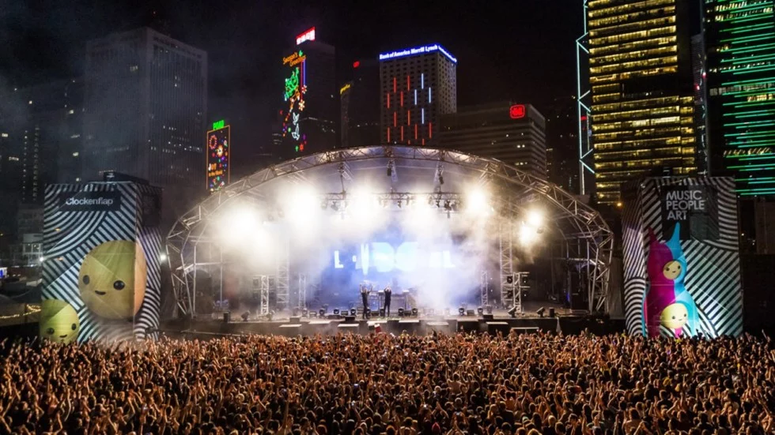
Salon 4K Live production
Applications
CONCERTS / CARNIVALS
Live coverage of concerts or carnivals.
Projection on huge Screens

Slide 21
Salon 4K Live production
Applications
Applications
GAMES / SPORTS
Football, Badminton etc

Slide 22
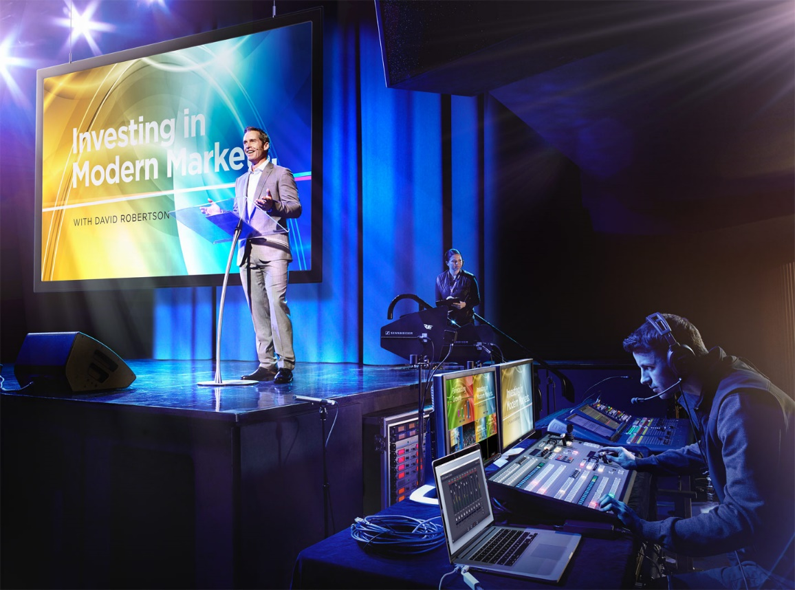
Salon 4K Live production
Applications
Applications
WEBINAR
Live Web seminar

Slide 23
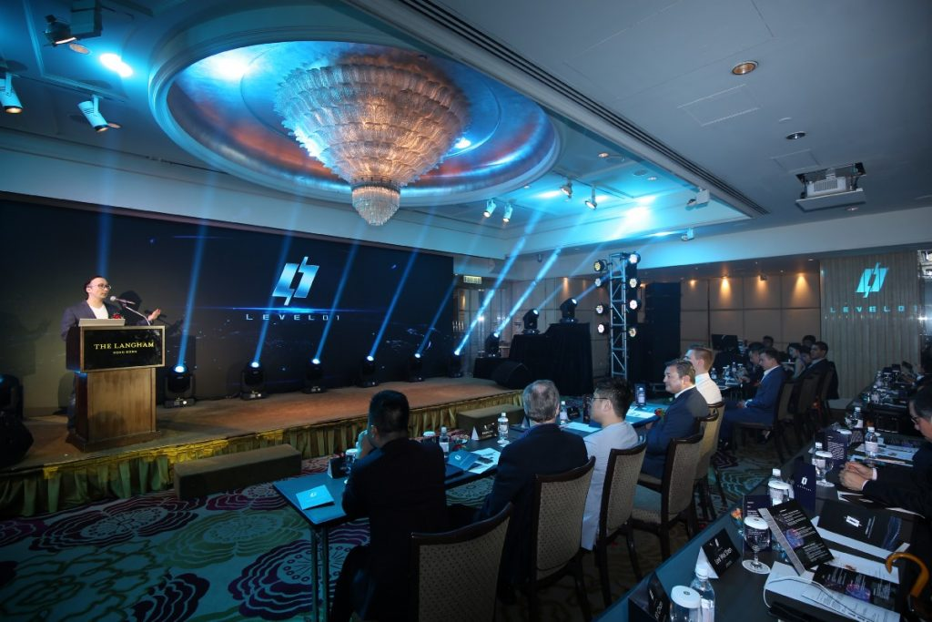
Salon 4K Live production
Applications
LIVE EVENTS
Launching, Movie Premier etc

Slide 24
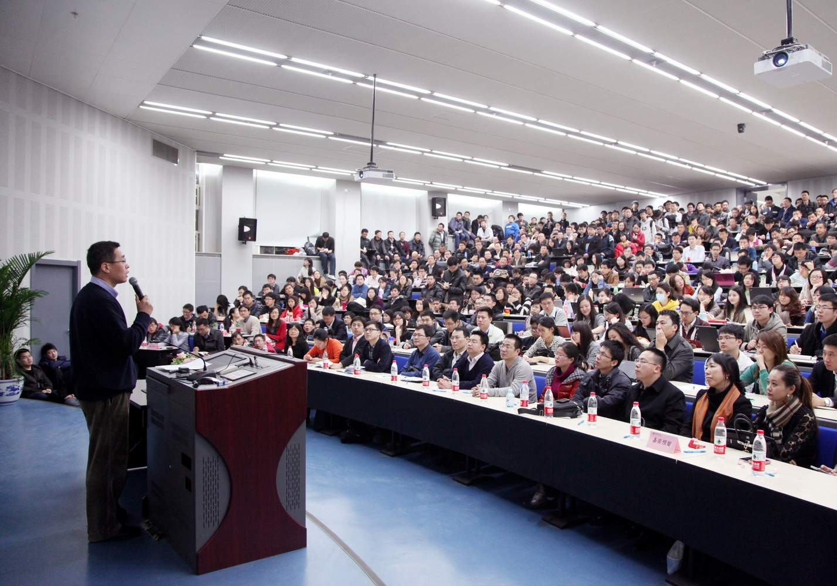
Salon 4K Live production
Applications
Applications
University Seminars / lectures live stream
to other Universities
.

Slide 25
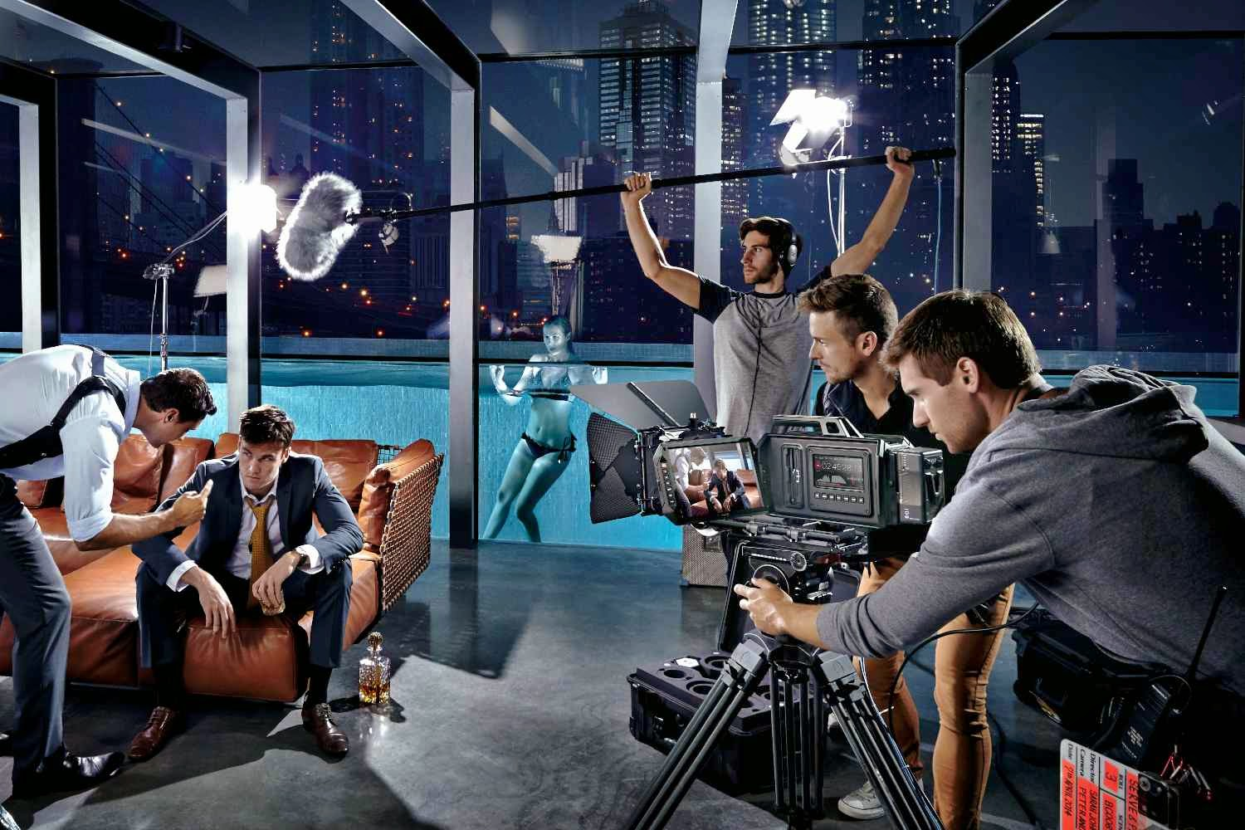
Salon 4K Live production
Applications
Applications
SITCOMS
Episodic Television shows

Slide 26
Salon 4K Live production
Applications
Applications
LIVE REALITY SHOWS
Travel log, Show how ordinary people behave in everyday life or in situations, represent
everyday life.

Slide 27
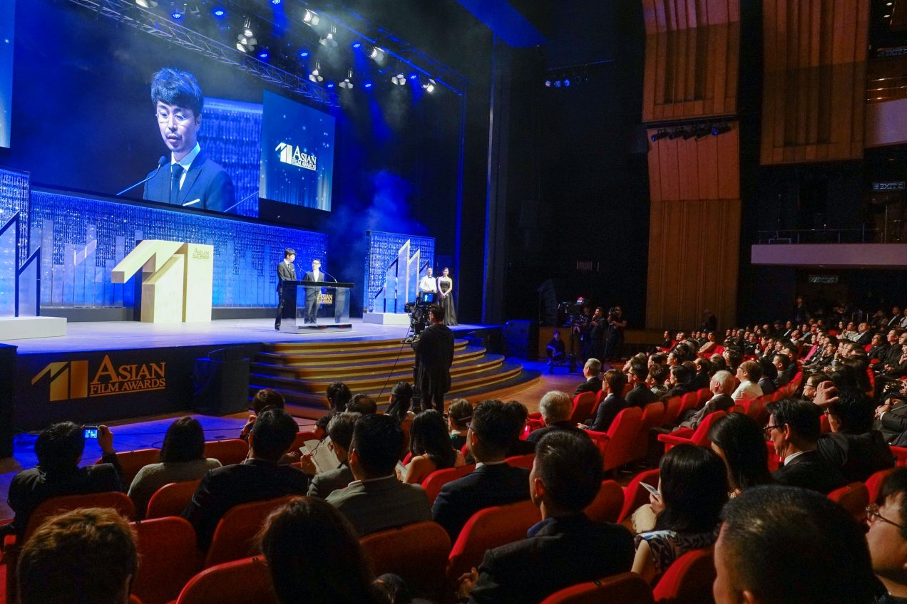
Salon 4K Live production
Applications
Applications
Festivals / Award show
coverage
.

Slide 28
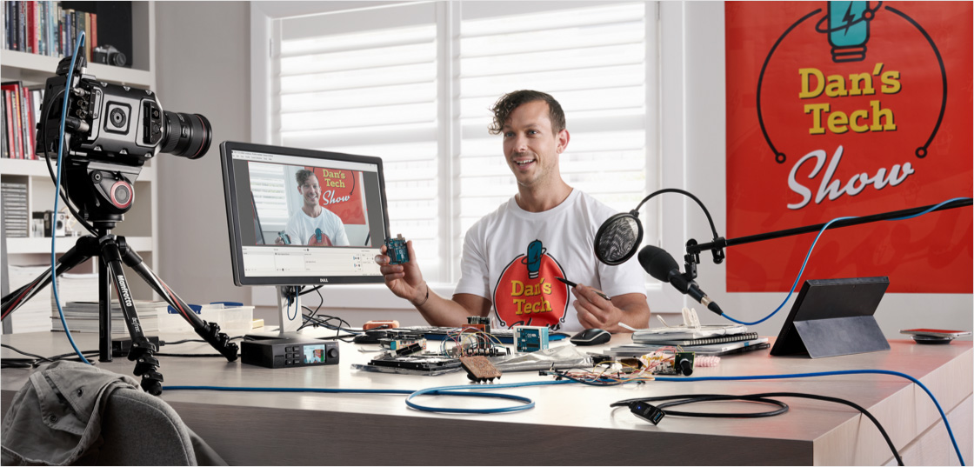
Salon 4K Live production
Applications
Applications
Live Magazine /
News
Programs on
Social media
.

Slide 29
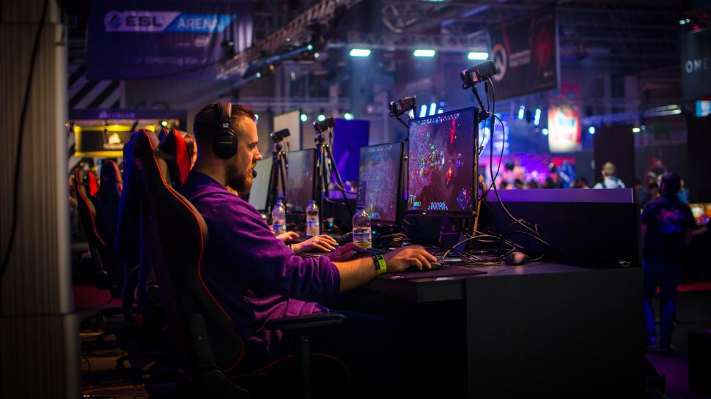
Salon 4K Live production
Applications
Applications
.
Video Game Live
streaming

Slide 30
ABILITIES

Slide 31
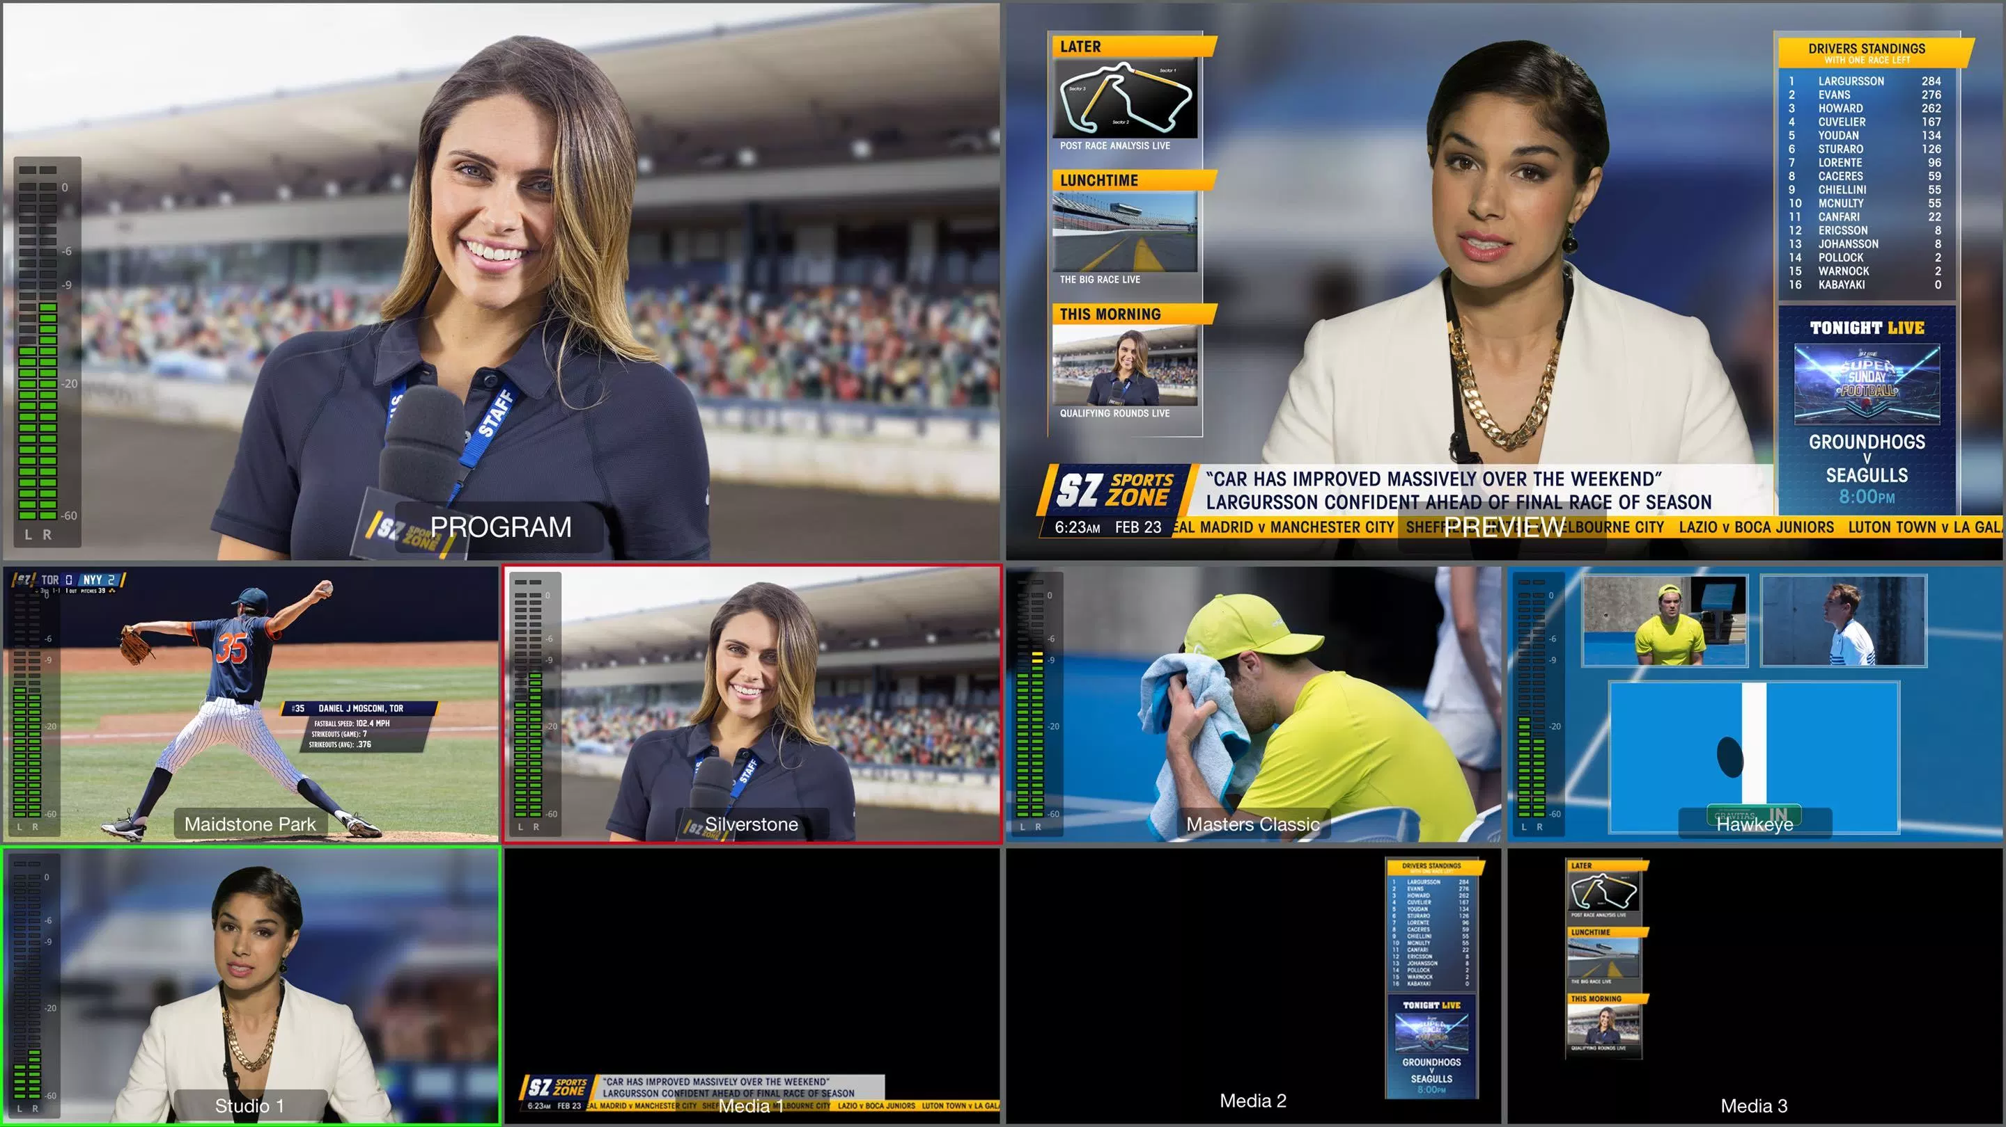
Multi viewer
Use a single screen for all your monitoring
The Multi viewer allows the director to
change the layout of the screen to his
preferences
ATEM's built in multi view lets you monitor
the switcher’s video inputs on a single
SDI monitor or regular HDMI TV
Multi view outputs in regular 1080i HD
Multi view makes it easy to watch your
program, preview, and live sources all
simultaneously on a single monitor and
you can even choose from 4 different
screen layouts

Slide 32
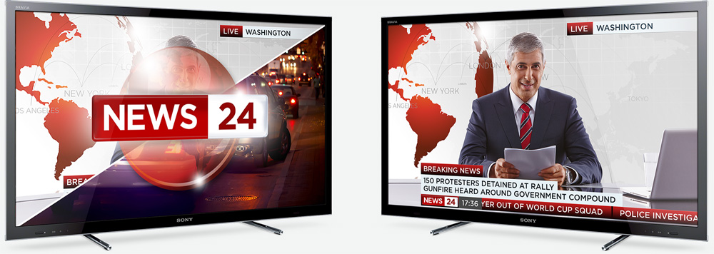
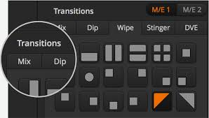
Creative Transitions
Get dozens of exciting effects and transitions
Huge range of real time high quality transitions that are available in all SD, HD or Ultra HD Resolutions.
Use mixes, dips, wipes and more for amazing
broadcast quality live switching.
Every transition is instantly available and you get full control of the transition type, pattern, length and
other attributes.
Create a customized ‘on air’ looks using the large
choice of wipe patterns.
The ATEM 1 M/E and 2 M/E Production Studio 4K
models also include animated stingers and DVE
transitions.

Slide 33
Digital Video Effects
Position, resize, rotate and scale in real time
Amazing high quality DVE to position,
resize, rotate and scale live video all in real time.
Create professional picture-in-picture effects with
customizable 3D borders, shadows and lighting.
Add dynamic DVE transitions to your production
with squeeze, push, swoosh and spin effects that
displace your live video revealing the next source.
you can even use the DVE for graphic wipe
transitions

Slide 34
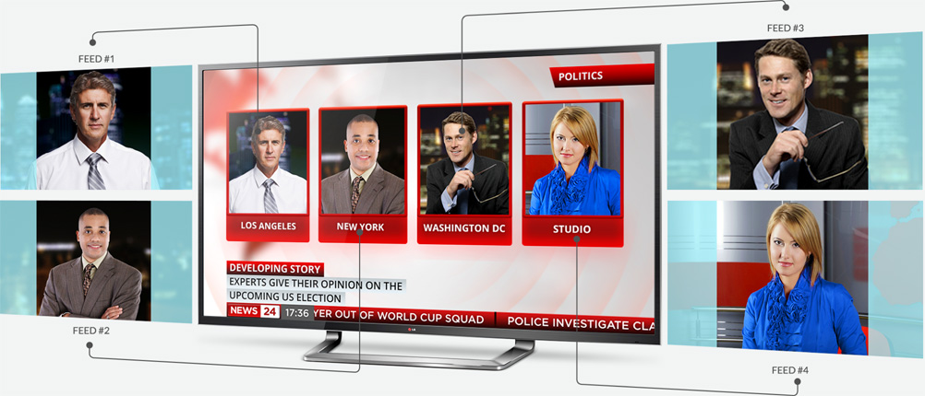
Super Source
Multi super source
Add multi box compositions quickly and easily with ATEM Super Source
Get a completely separate 5 layer switcher
with the power of 4 picture in picture DVEs
and 4 keyers that you can assign to any
ATEM video input
Using Super Source for multi camera
interviews or picture in picture production while
leaving all your M/Es, keyers and DVE
completely free for other tasks.
Super Source compositions can also be
quickly saved and recalled.

Slide 35
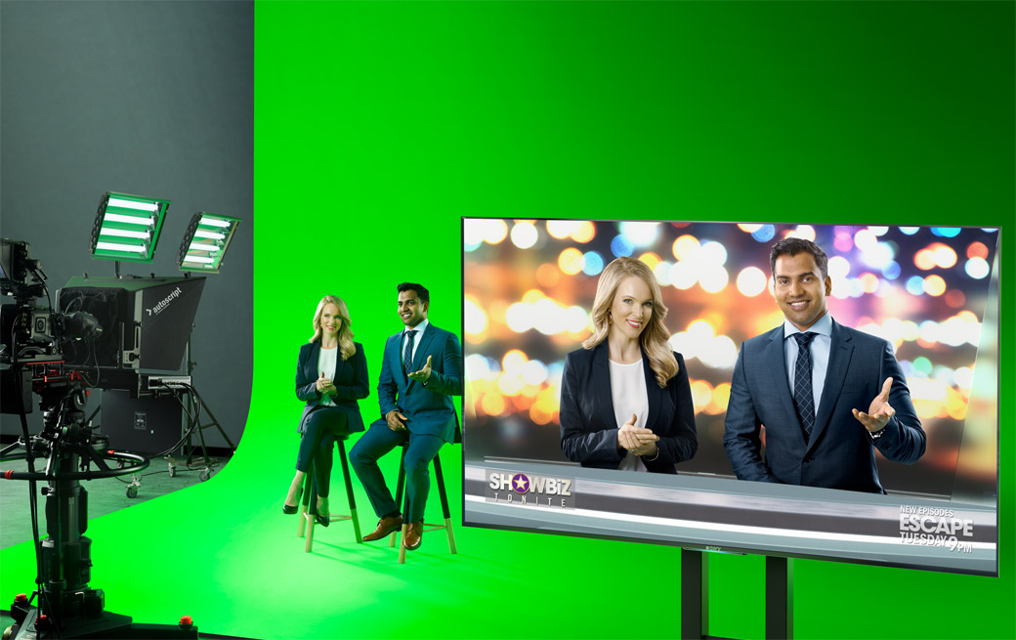
Advanced Chroma Keyer
Built in chroma, luminance, linear and pattern keyers
Features a new next generation advanced chroma keyer
that lets you pull incredibly clean keys for truly professional,
broadcast quality live compositing.
The advanced keyer features adjustable on-screen controls for selecting and sampling a region of colour from
the image.
This new keyer also features foreground, background and
edge adjustment controls, and chroma correction tools for
spill and flare suppression so you can fine tune the key.
ATEM 4 M/E Broadcast Studio 4K model you now get 4
advanced chroma keyers on each of the 4 mix effects rows
so can create massive multi layer effects

Slide 36
SUMMARY

Slide 37
SUMMARY - SHOOT TO DELIVERY
5
FINAL DELIVERY
FINAL 4K DELIVERY TO AUDIENCE
STREAMING
4
STREAMING BY IP / SATELITE
DISTRIBUTION
3
DISTRIBUTION TO CLOUD / SOCIAL MEDIA / TV / INTERNET CHANNELS UP TO 4K
2
SHOOTING
USING BLACKMAGIC URSA BROADCAST CAMERAS
LIVE SWITCHING
1
LIVE SWITCHING USING SALON FLY PACK SYSTEM

Slide 38
Thank
You

